Slide 1
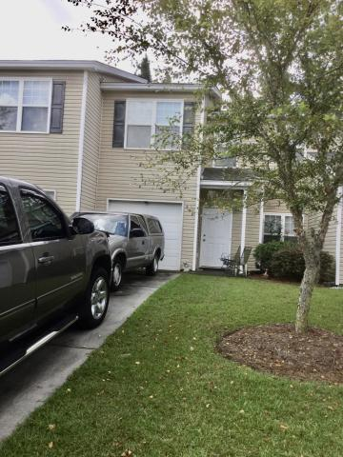
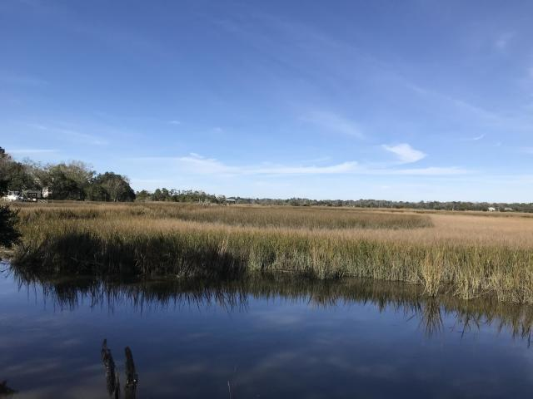
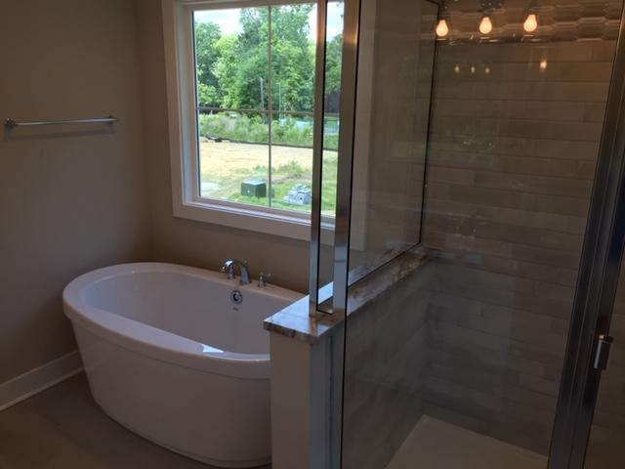
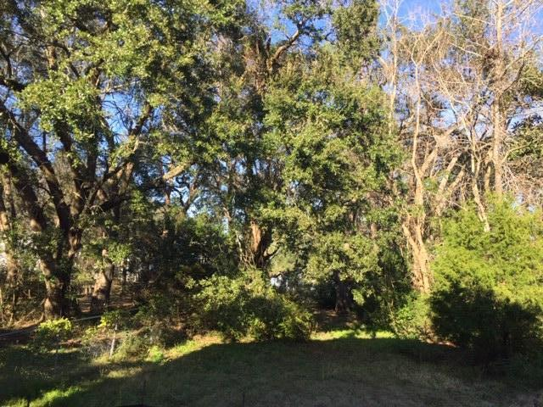
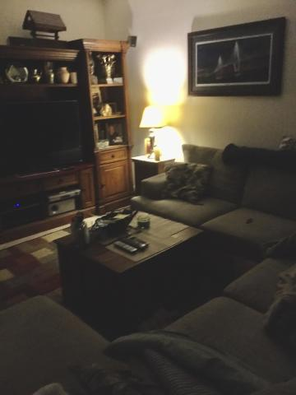
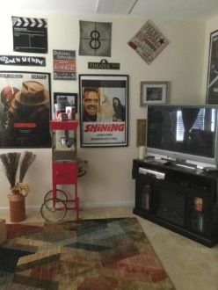
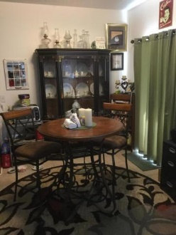
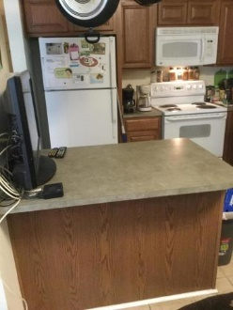
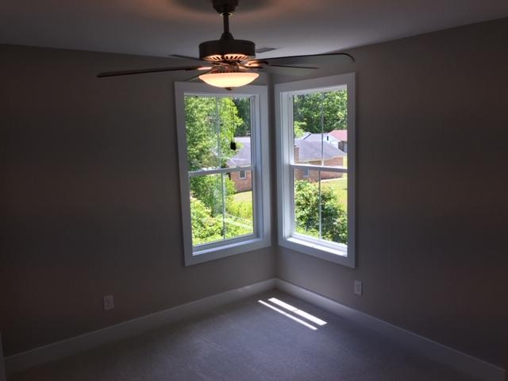
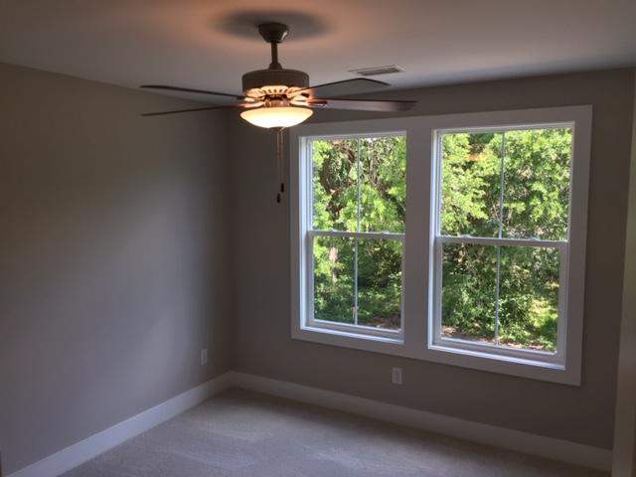
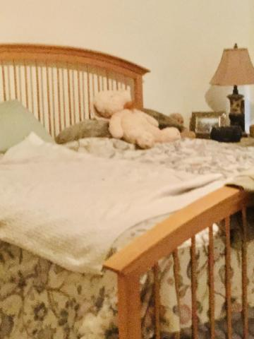
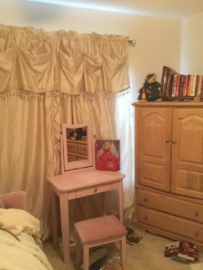
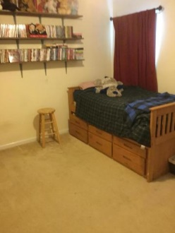
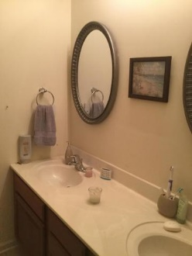


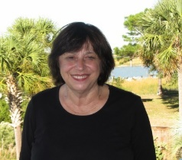
Just Listed!
249 Grand Oaks Drive
Grand Oaks Preserve
Ladson, SC 29456
MLS# 20023317
$159,900
3 Bedrooms :: 2½ Baths :: 1,685 sf
SPACIOUS CONDO -TOWNHOME LIVING. GREAT FLOOR PLAN WITH 2 SPACIOUS LIVING AREAS, EAT IN KITCHEN LARGE MASTER WITH 2 WALK IN CLOSETS WITH SEPARATE GARDEN TUB AND SHOWER. LARGER PATIO WITH TILE FLOORING IN ENTRANCE AND KITCHEN HAS A GREAT EAT IN WITH A BREAKFAST BAR. CONVENIENT TO SHOPPING, RESTAURANTS, AND INTERSTATE. NEIGHBORHOOD AMENITIES INCLUDE A COMMUNITY POOL, PLAYGROUND, PLUS....
Eric Draper
(843) 442-7118
eric.draper@gmail.com
Judith Hartin
843-834-1972 | jnhartin@comcast.net
www.coastalpropertiescharleston.com
Metro Realty Group LLC | 1231 Columbia Ave | Irmo, SC 29063

