Slide 1
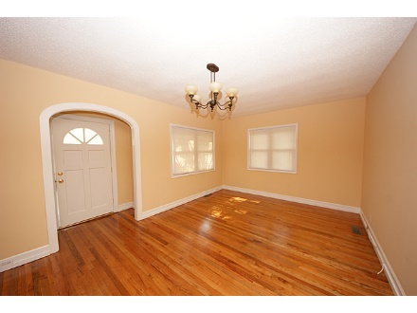
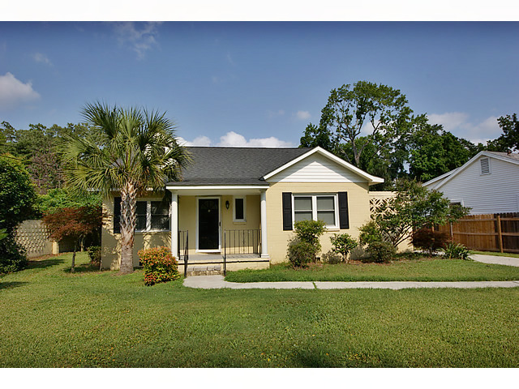
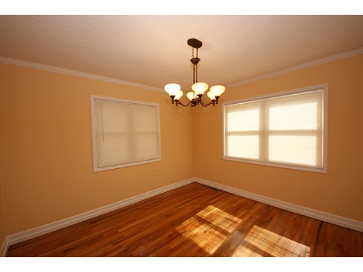
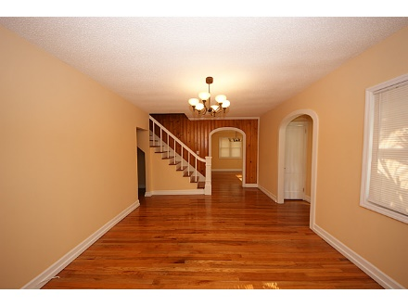
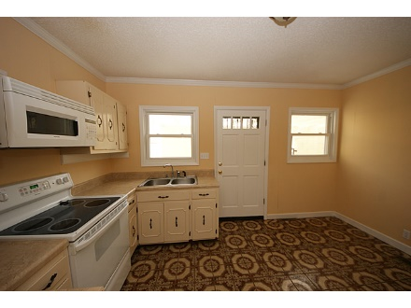
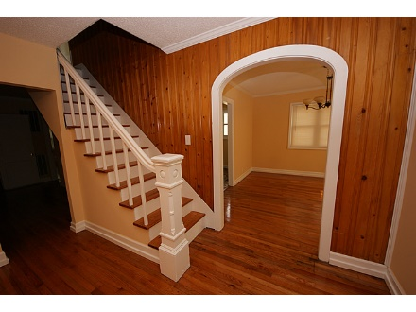
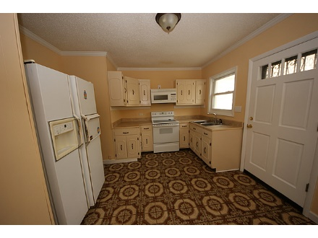
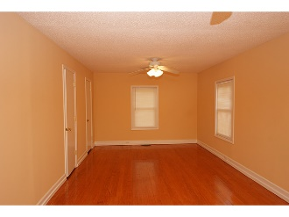
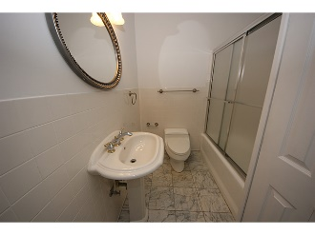
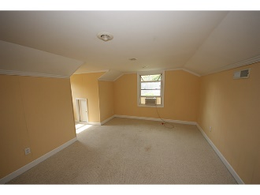
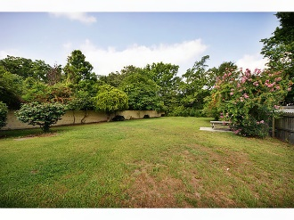
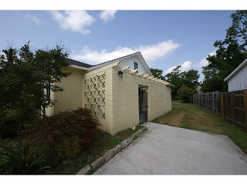

Price Reduced on James Island
249 Howle Avenue
Pecan Grove
James Island, SC 29412
MLS# 15012464
$269,999
Beautiful home on large lot! Convenient location just minutes to downtown, shopping, county park, boat landing and beaches. Arched doorways to living and dining room. Hardwood floors throughout, tile in bathrooms. Former attic converted to two additional small rooms containing berber carpet. Upstairs included in heated sqftg although ceiling height is 6'7''. Architectural shingled roof, refinished floors, berber carpet, oven, microwave and windows just few years old. Irrigation system to convey as-is. If exact square footage and specific schools are important, please verify.
Kim Adinolfi
843-452-9923
kim.adinolfi@yahoo.com
Lisa Cable
843-224-4712
lcable69@gmail.com
SunCoast Realty Partners, LLC | 3 Cannon Street | Charleston, SC 29403

