Slide 1
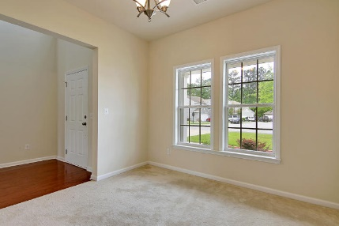
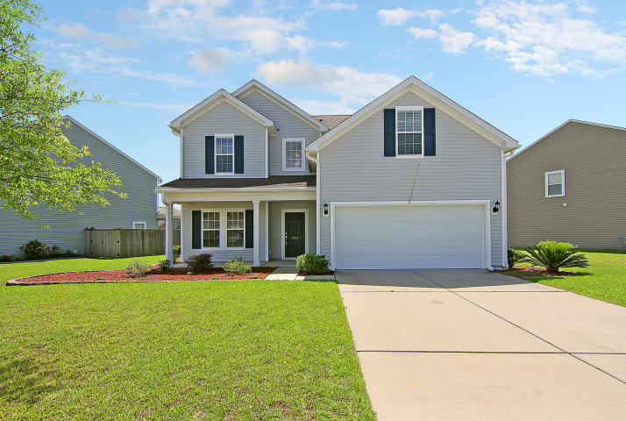
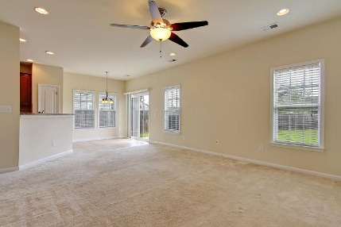
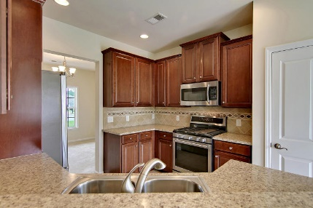
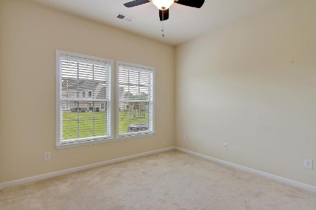
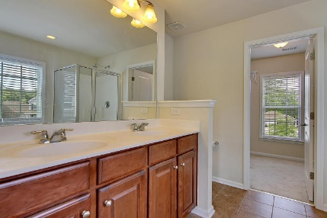
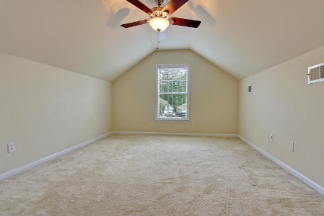
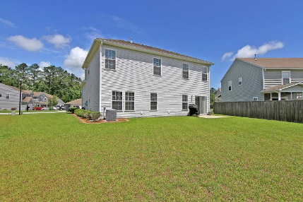


249 Mayfield Drive Brickhope Plantation ~ Goose Creek MLS# 17012567 ~ $230,000
Just Reduced!
Beautiful, Wonderfully Maintained 4 Bedroom Home in Brickhope Plantation! Upgraded Eat-In Kitchen with Stainless Steel Appliances! Step inside this home and immediately notice the grand 2-story foyer.
Downstairs, you will find a formal dining, large living room, office/study, and powder room. Upstairs are 4 bedrooms, including a great master suite with double vanity and separate garden tub and shower in the ensuite bath, along with a large master closet. The laundry room is upstairs as well.
The community boasts a clubhouse with fitness center, swimming pool, playground, and recreation fields! Minutes to everything Charleston has to offer!
Stan Huff
(843) 670-2835
stan.huff@agentowned.com
www.stanhuff.com
Devon Jones
(843) 452-6063
devon@agentowned.com
www.agentowned.com
AgentOwned Preferred Group | 824 Johnnie Dodds Blvd | Mt. Pleasant, SC 29464

