Slide 1
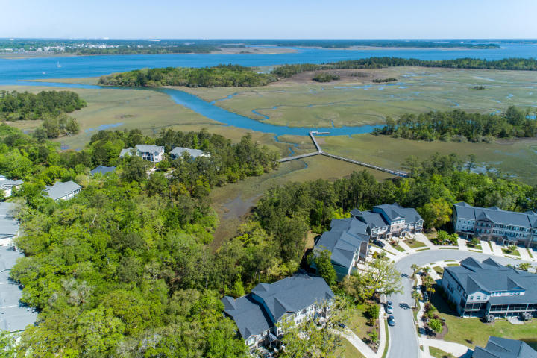
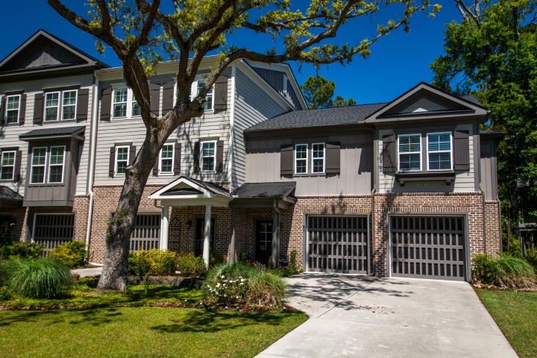
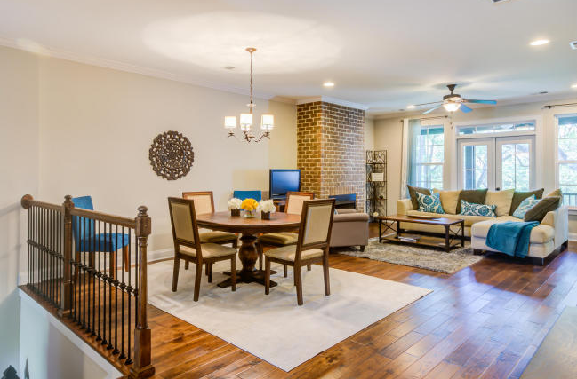
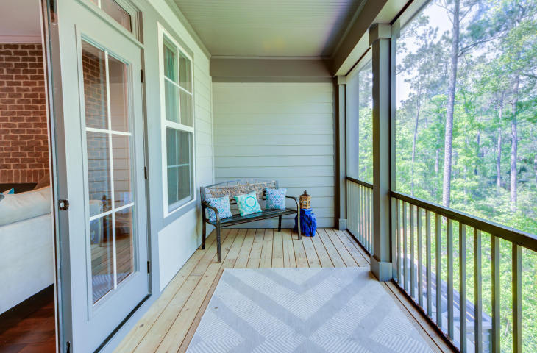


Etiwan Pointe Open House ~ Saturday 1:30-3:30
249 Slipper Shell Ct
Mount Pleasant
MLS# 18011042
$419,900
In Mount Pleasant, 249 Slipper Shell is the only one-story fee-simple townhouse in MLS for sale! Plus 1,700 SF garage! Plus view of a wooded wetland marsh! Plus built 2014 with upgrades! The open floor plan for the kitchen-dining area-family room-porch captures natural light and views of the wooded marsh. The Master Suite overlooks the marsh and is split from the two guest bedrooms. The 1,700SF ground floor garage is concrete offering storage for 3 cars, golf carts, boats, fishing gear or jet skis. The community amenities include a pool, clubhouse, workout facility and dock with a floater for crabbing, fishing and sunning. Location is superb: within 5-15 minutes to beaches, I-26, I-526, Historic Charleston, local public schools, shopping, restaurants, bars and athletic activities.
Kay Kennerty
MBA, ABR, CRS, GRI
843-345-5011
KKennerty@aol.com
www.KayKennertyHomes.com
The AgentOwned Realty Company
824 Johnnie Dodds Blvd, Mt. Pleasant, SC 29464

