Slide 1
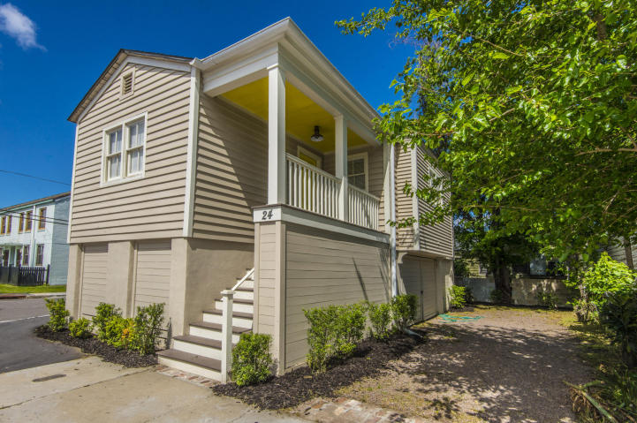
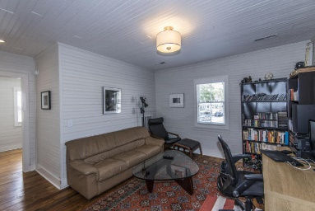
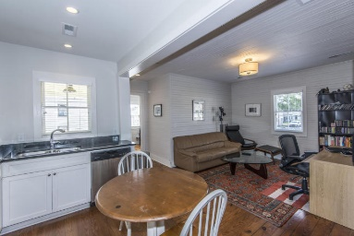
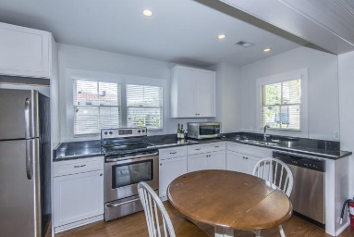
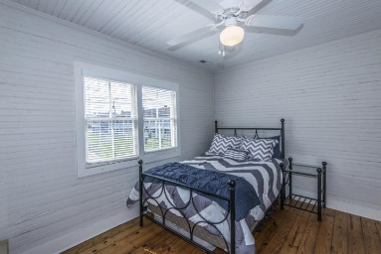
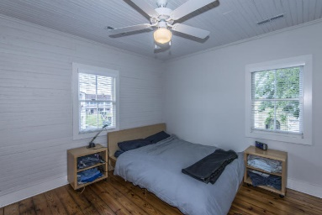
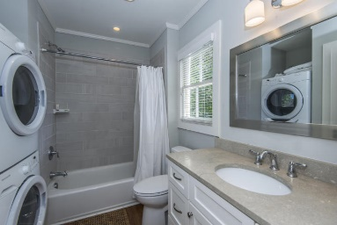
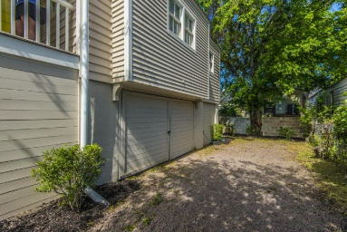


Huge Price Reduction!
Investor Opportunity
24 Norman Street
West Side
Charleston, SC 29403
MLS# 17010295
$285,000
This 2 bedroom Charleston bungalow home was completely restored and kitchen expanded in 2015. Restoration / renovation included new roof, electrical, plumbing, HVAC, paint, kitchen and bath. The original Heart pine flooring was refinished and the original bead board wall has been restored. Tall ceilings make the place feel very open. Private drive for parking! Home was also raised to meet FEMA standards. Current owner pays $688 yr for flood insurance. Tons of storage space under home! Convenient to MUSC, Citadel, Hampton Park or all that King Street has to offer!
Jennifer Frampton Pait
843-568-9509
jenniferfp@carolinaone.com

