Slide 1
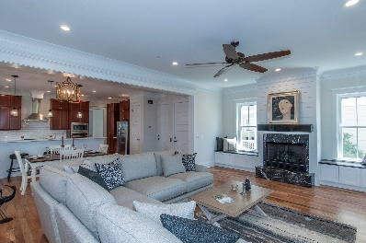
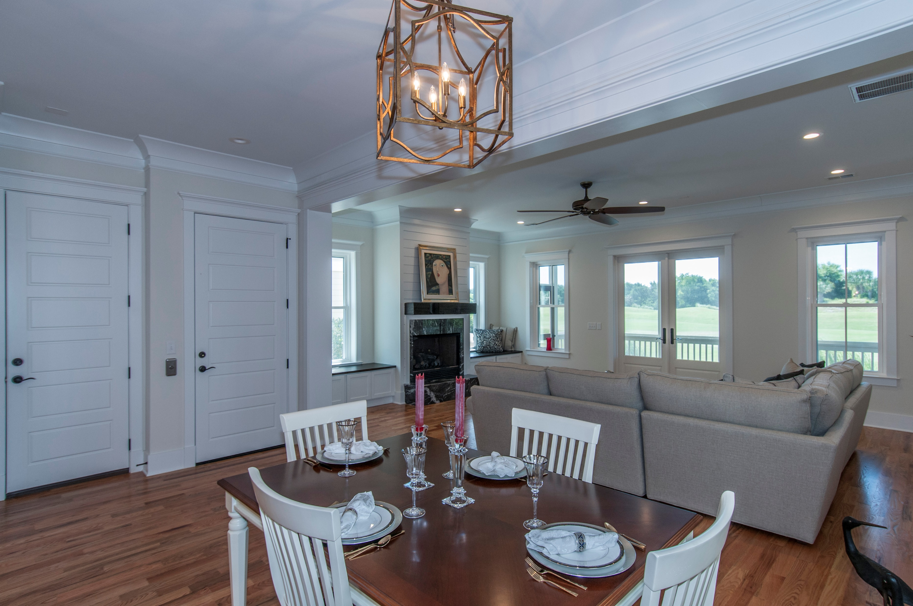
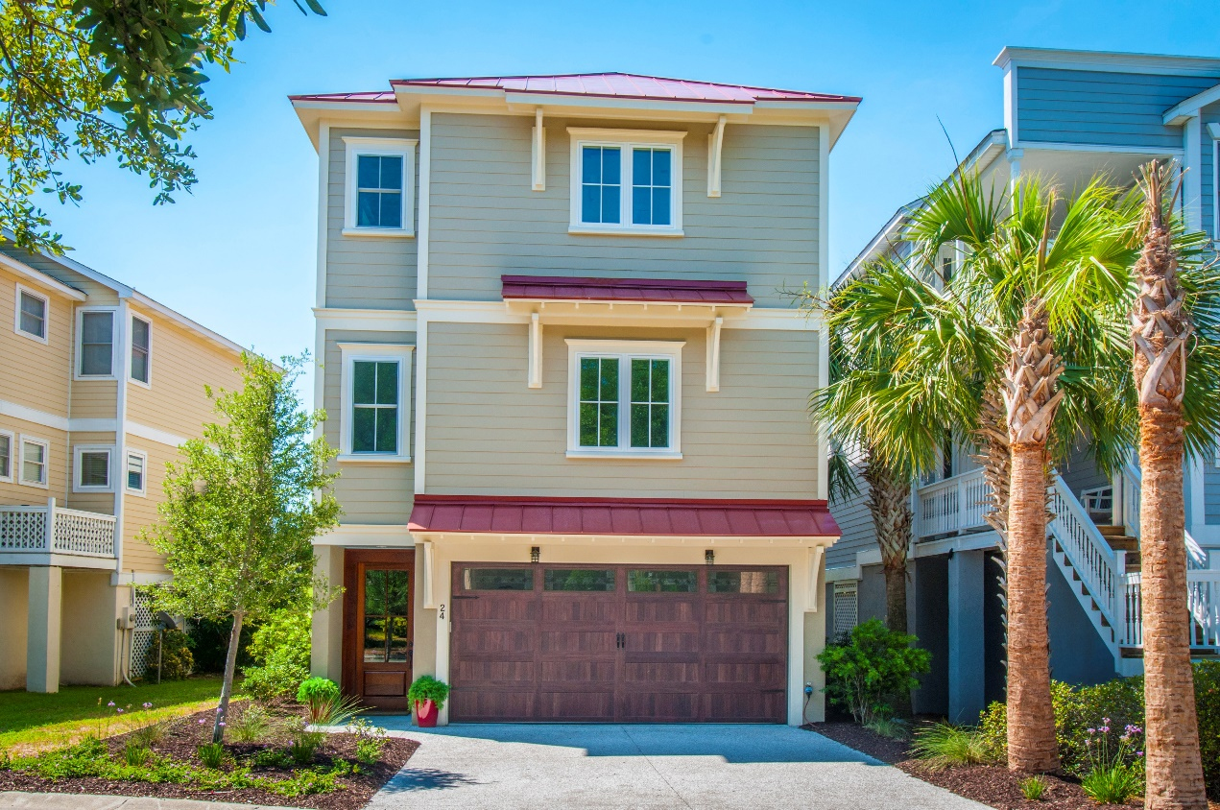
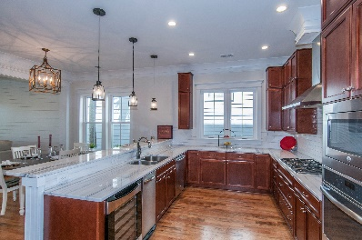
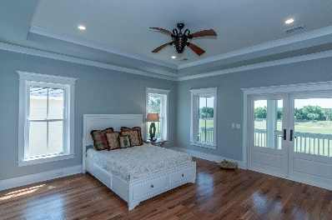
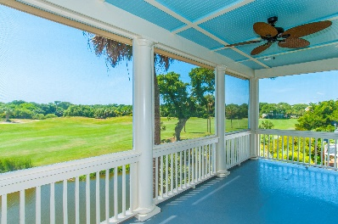
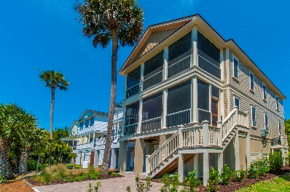


24 Yacht Harbor Court MLS# 15030718 ~ $1,149,000
Bonuses offered through 8/31/16:
Buyer - Free Wild Dunes Swim Social membership
Broker - $10,000 Selling Bonus at closing
Yacht Harbor prime lot on long lagoon & 14th hole Harbor Course offers picturesque views from living, Master, dual screened porches! Open floor plan, hardwood, marble and porcelain tile flooring, custom crown, all bedrooms have custom built-ins and en suite baths, ship lap wall accent, reclaimed beam mantel, kitchen w/gas cooktop, 28 bottle wine cooler, trash compactor, metal roof, 2 x 6 ext walls, cement siding, hurricane windows, irrigation, 1250 SF garage w/alternate space, outdoor shower, & paver patio. Walk, cart, bike or ride to Morgan's Creek Marina for fun & dining, boating. Also, enjoy Wild Dunes amenities, a la carte club options (Fazio golf course) and Atlantic ocean beaches!
Elevator to all levels
Lot Elevation is AE 13
Viwinco Hurricane rated windows
Raised seam metal roof
Water faucets on front, rear, and screened porches!
(No reason for dead flowers!)
Paver Patio
Garage is up fitted with additional electrical for golf cart charge or workshop
Custom heavy duty garage door, Custom Mahogany finished
Exterior door from inside garage to rear living area and paver patio
Hot/Cold Outdoor Shower
Spray foam insulation in attic ceiling
Multi zoned HVAC
10'Ceilings
Custom Rosewood Cabinetry in kitchen with 2 Corner lazy Suzanne's to maximize use of space, soft close drawers, pull outs
GE Profile Kitchen Appliances that include:
-Microwave/Convection Oven
-Wall oven
-Refrigerator
-Trash Compactor
-Dishwasher
Deep Sinks
Garbage Disposal
Custom Built closets throughout all bedrooms, linen and laundry
Granite in kitchen and all baths
Custom tile in all bathrooms and entry and oak wood floors throughout
Master bath elegant oval soaking tub with wand for body rinse
Oversized shower with wide glassed door entrance
Dual vanity with cosmetic seating area
Additional cabinetry
Separate commode area
Main level Bedroom/Office with window seat with storage
and attached bath.
Pocket doors maximize wall space.
Front entry door is custom Mahogany
Boat slips are available for lease and purchase Morgan's Creek Marina
$10,000 Bonus!
Listed by
Bill Donovan 843-991-0146 donovans@carolinaone.com
Renee Meyer Mobile - (843) 991-0007
renee@carolinaoneplus.com
www.CharlestonHomesHotline.com
Carolina One Real Estate
1503 Palm Blvd
Isle of Palms, SC 29451

