Slide 1
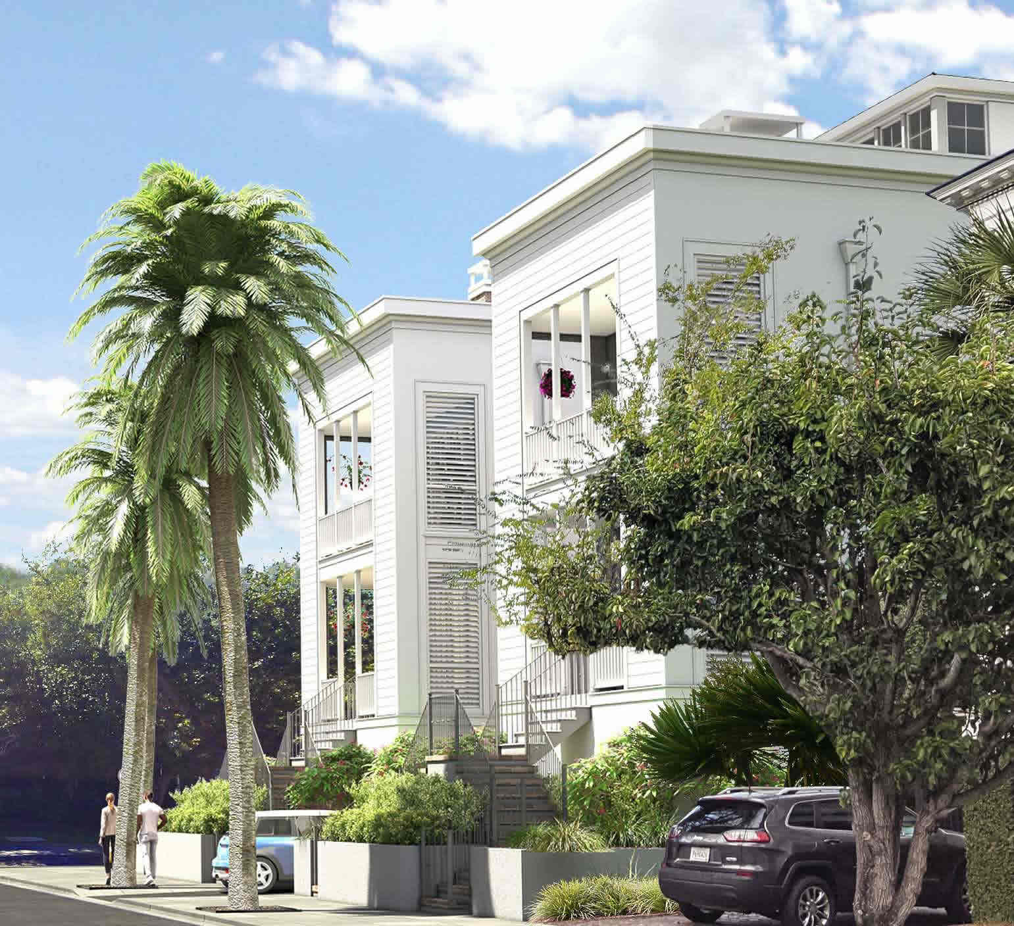
New Construction Downtown
Estimated Completion of 24 Bennett October 15, 2022
Estimated Completion of 28 Bennett Spring 2023 *Rendered image
3,173 H/C sf
4 Bed
4 ½ Bath
Office, Loft, & Rooftop Deck
2 Car Drive under parking
24 Bennett
Street
28 Bennett
Street
DRAFT
Nate Depino
843-200-2721
nathan@hbrtwn.com
Delpino Custom Homes www.DelpinoCustomHomes.com
Delpino Custom Homes
New Construction on the Charleston Peninsula with a perfect combination of Modern Lowcountry in one of the most historic neighborhoods on the Peninsula. Both homes feature modern floor plans with luxury finishes and rooftop decks to enjoy the Charleston Cityscape. Located on the Corner of Gadsden and Bennett St, you are just blocks away from MUSC and Colonial Lake. Call for additional details and pricing

