Slide 1
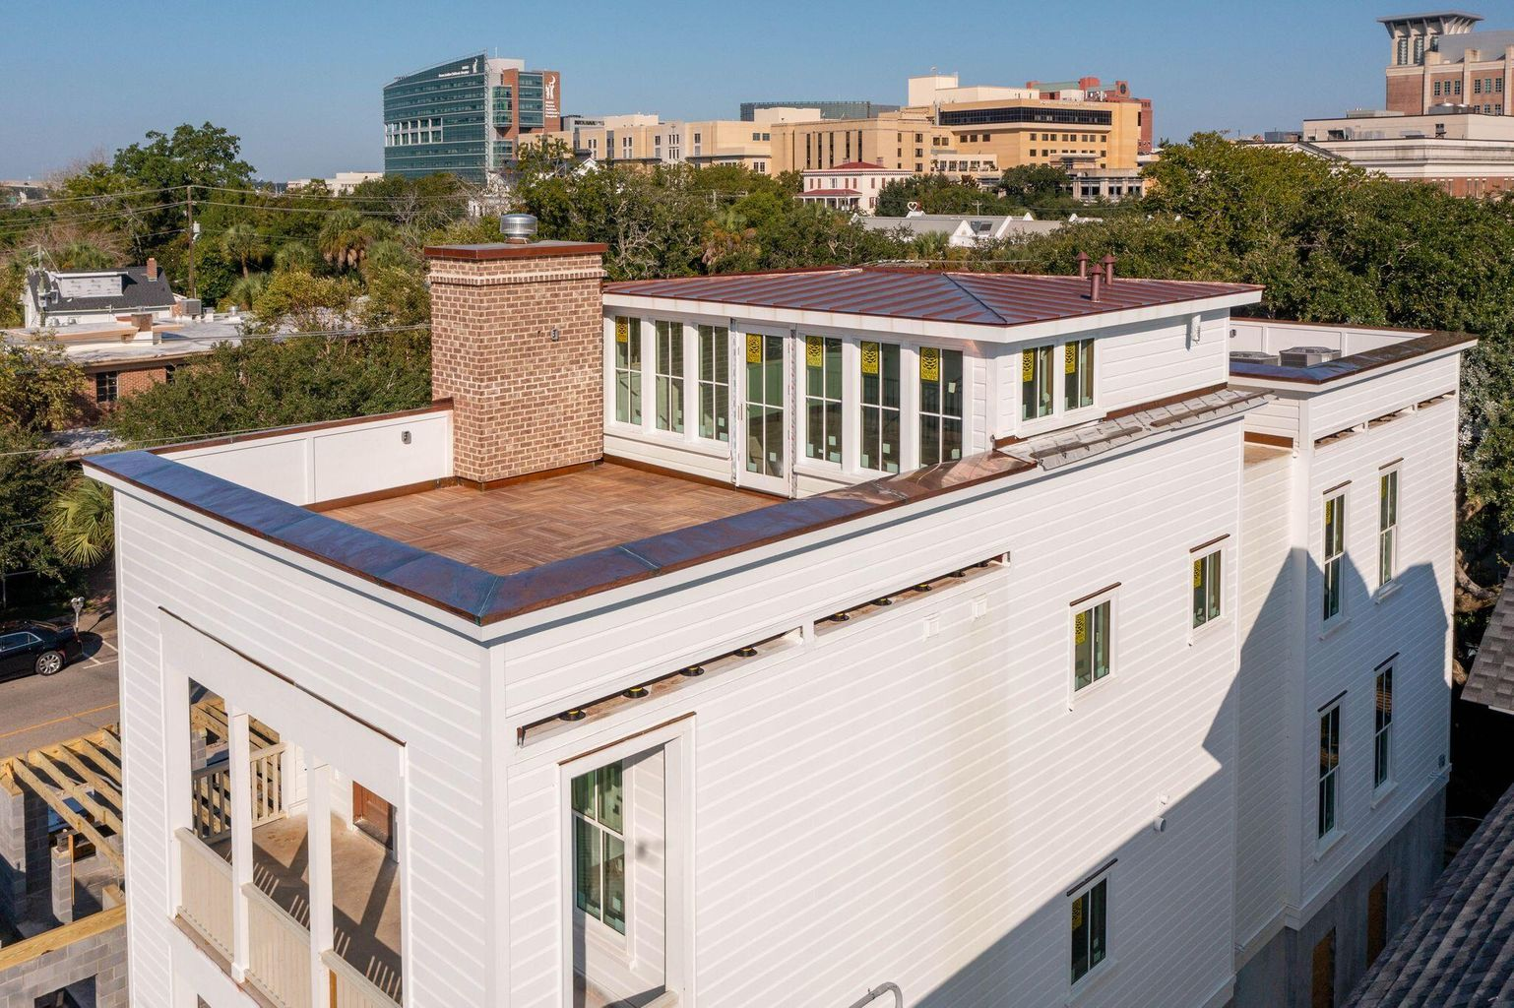
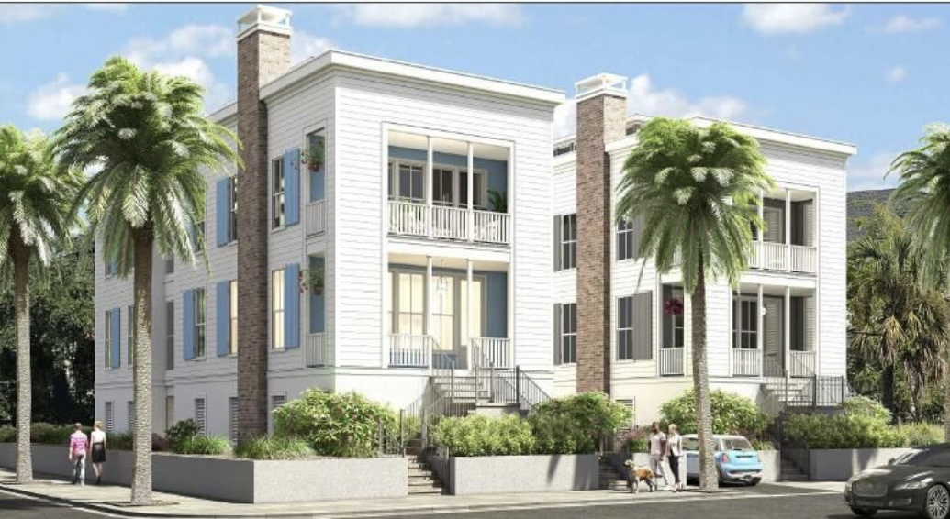
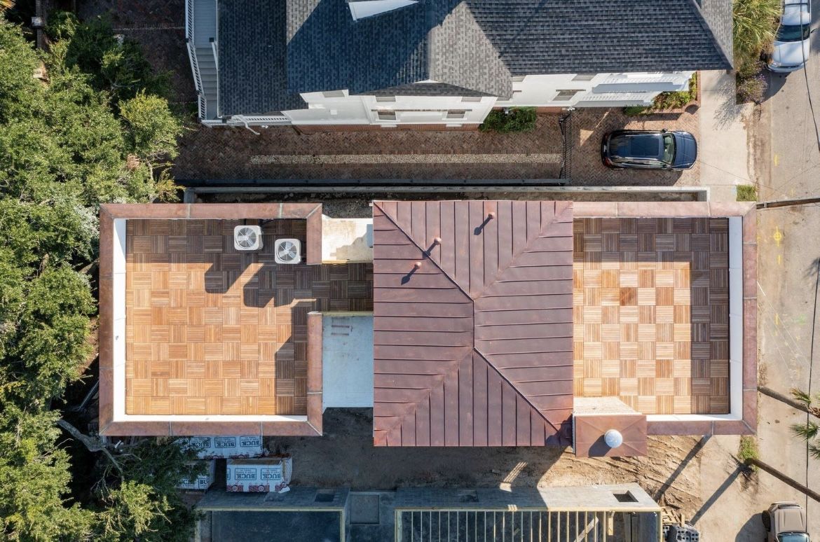
Brand New Construction Downtown
*Rendered image
24 Bennett Street
MLS# 22013637
$2,950,000
Estimated Completion of 24 Bennett October 15, 2022
Estimated Completion of 28 Bennett Spring 2023
3,173 H/C sf
4 Bed
4 ½ Bath
Office, Loft, & Rooftop Deck
2 Car Drive under parking
28 Bennett
Street
DRAFT
Nate Delpino
843-200-2721
nathan@hbrtwn.com
Delpino Custom Homes www.DelpinoCustomHomes.com
Move into this ***New Construction*** home on the Charleston Peninsula this October! This new 4Br/4Ba Home features the perfect combination of Modern Lowcountry aesthetic in the Traditional and Historic neighborhood setting of Harleston Village. You'll be just blocks away from MUSC, Roper, Colonial Lake, City Marina & CofC and you'll enjoy rooftop view of the Ashley River and Ravenel Bridge. Additional feature include- Wet Bar & Wine tower, Kitchen Island with Waterfall, 2 Roof top decks with IPE decking, Elevator, Drive under 2 car garage, Custom Built-ins, Custom Plaster finishes, Luxury Lighting plus a study and rooftop Atrium, Modern Floor plan, suited bedrooms plus many more luxury finishes.
Delpino Custom Homes

