Slide 1
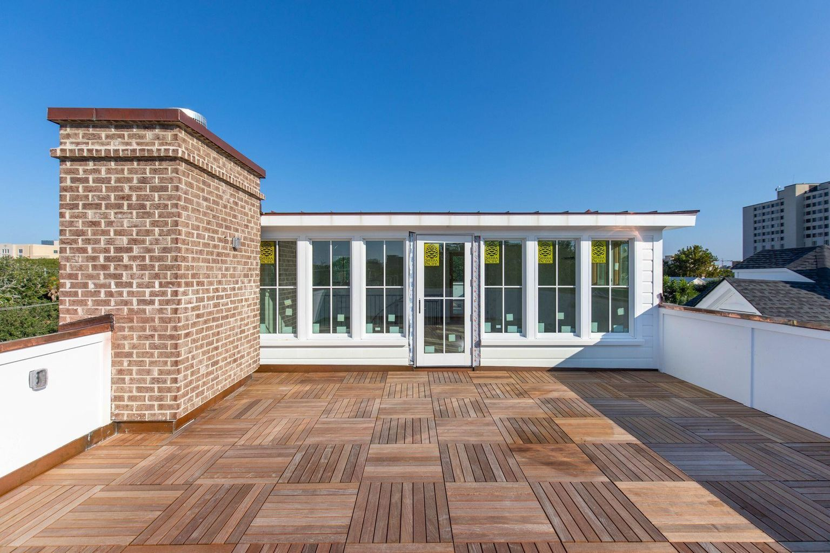
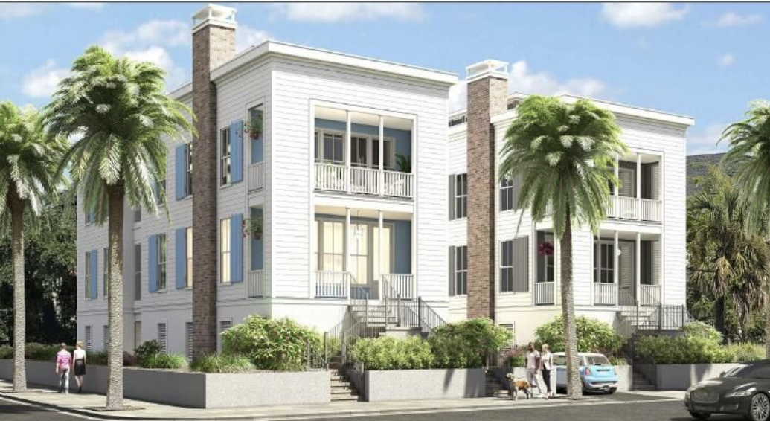
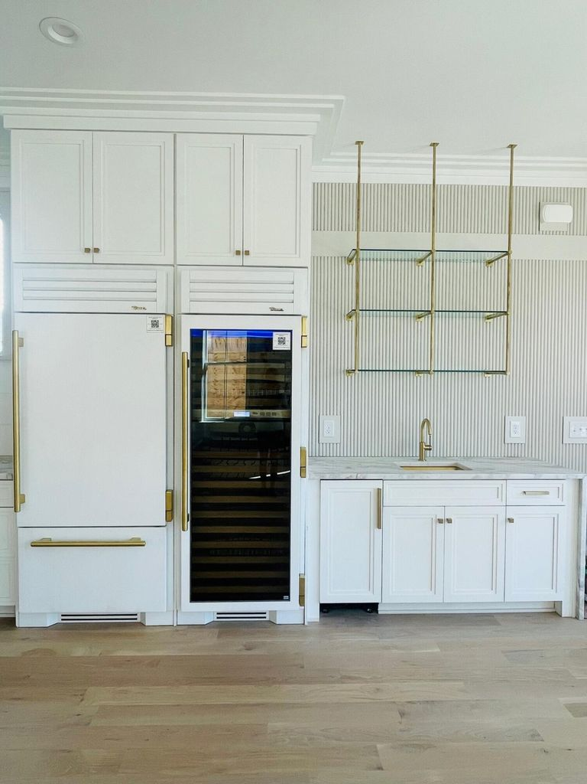
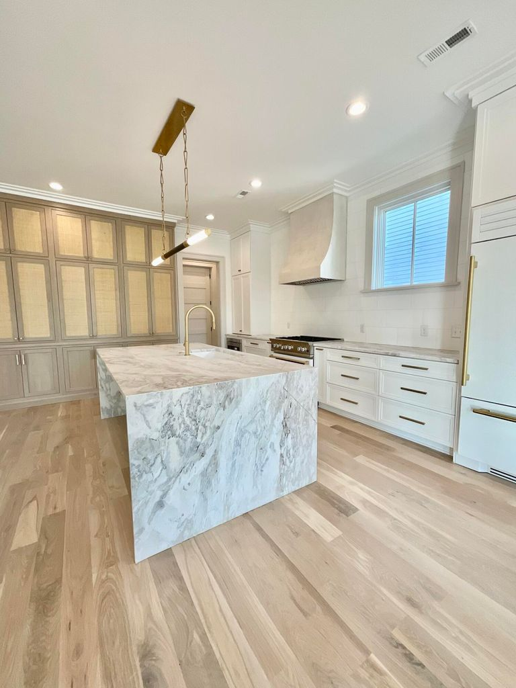
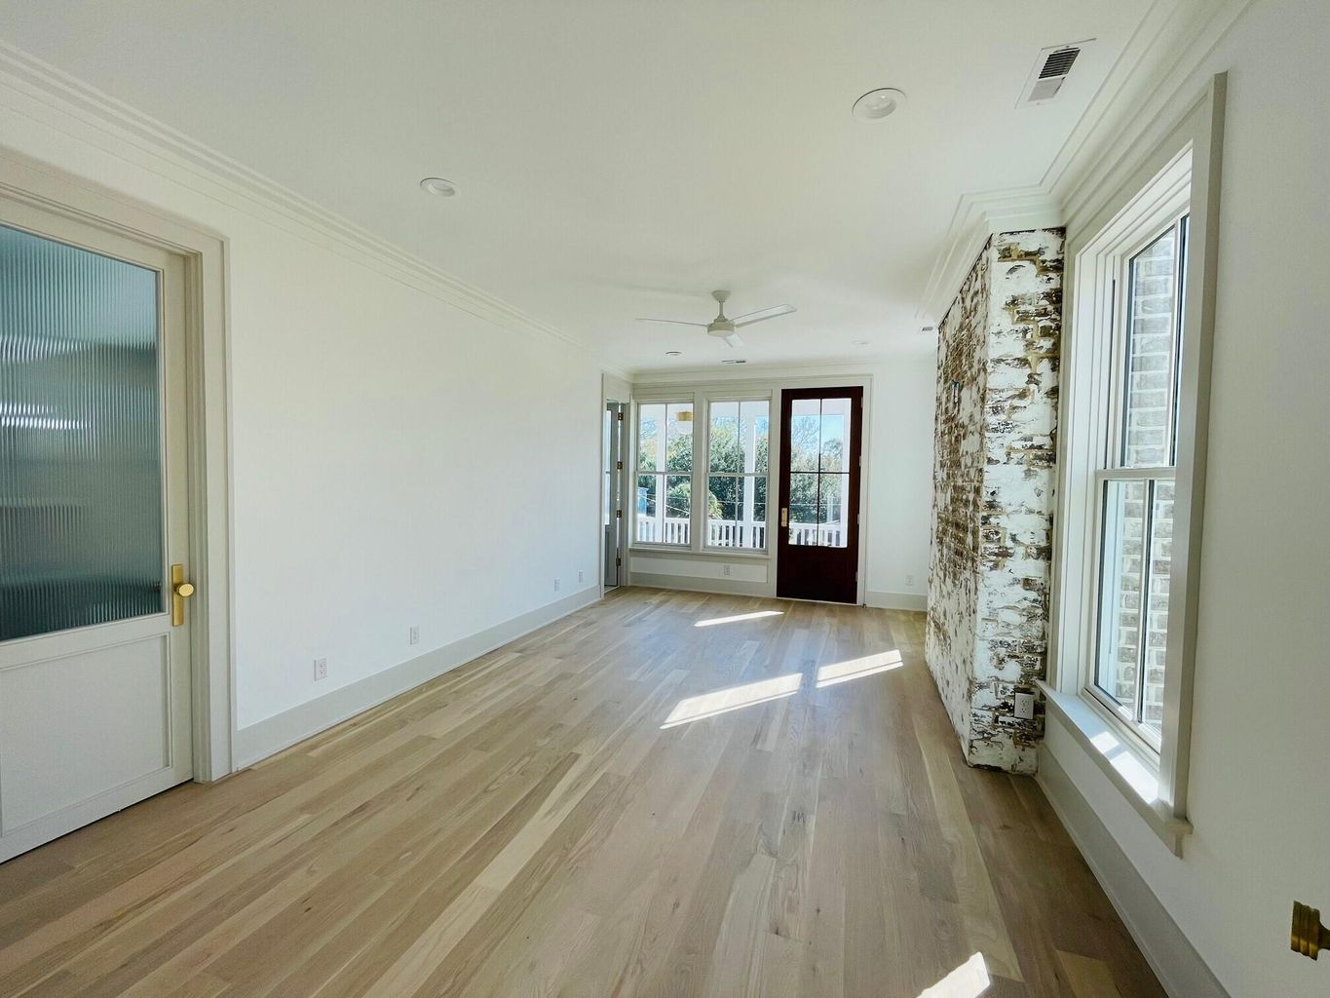
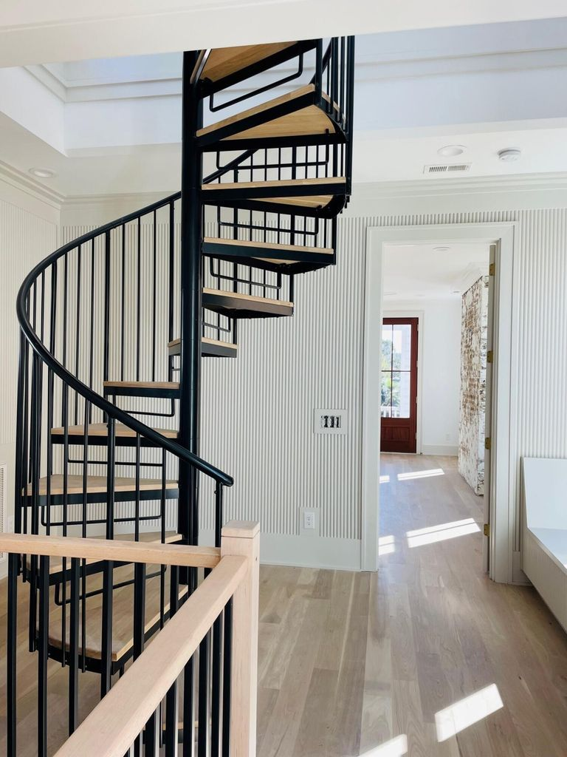
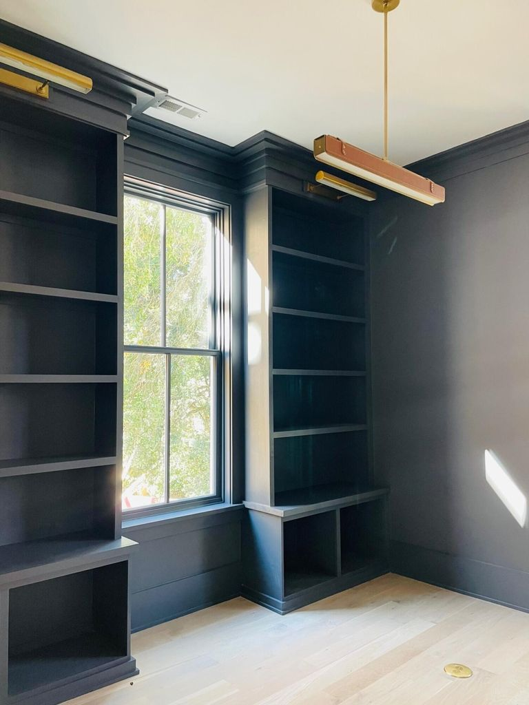
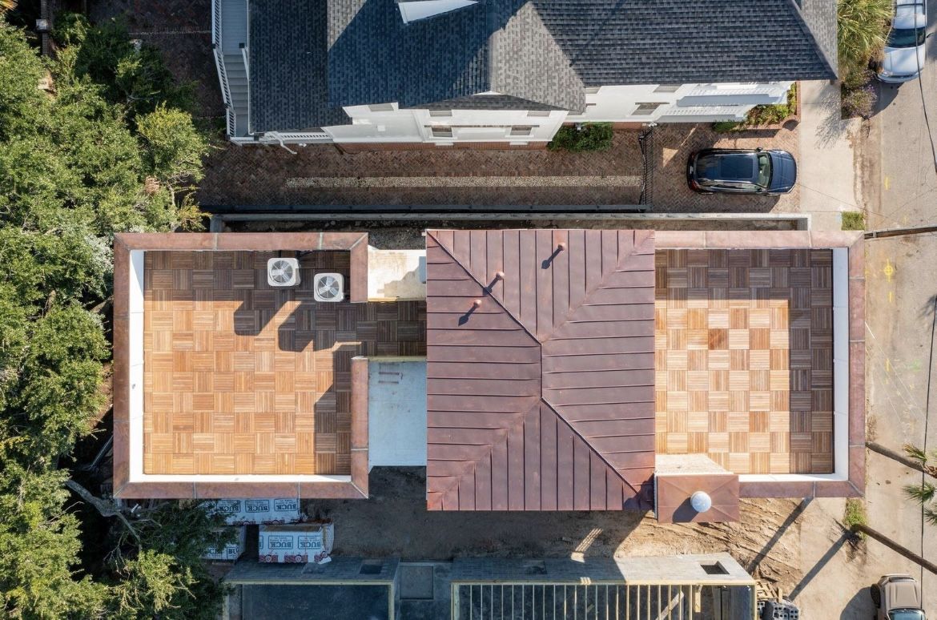
Nate Delpino
843-200-2721
nathan@hbrtwn.com
Delpino Custom Homes www.DelpinoCustomHomes.com
Open House Thursday 12-2!
24 Bennett Street | Harleston Village
MLS# 22013637 | $2,950,000
3,173 H/C sf
4 Bed
4 ½ Bath
Office, Loft, & Rooftop Deck
2 Car Drive under parking
28 Bennett
Street
DRAFT
*Rendered image
Move into this ***New Construction*** home on the Charleston Peninsula this November! This new 4Br/4Ba Home features the perfect combination of Modern Lowcountry aesthetic in the Traditional and Historic neighborhood setting of Harleston Village. You'll be just blocks away from MUSC, Roper, Colonial Lake, City Marina & CofC and you'll enjoy rooftop view of the Ashley River and Ravenel Bridge. Additional feature include- Wet Bar & Wine tower, Kitchen Island with Waterfall, 2 Roof top decks with IPE decking, Elevator, Drive under 2 car garage, Custom Built-ins, Custom Plaster finishes, Luxury Lighting plus a study and rooftop Atrium, Modern Floor plan, suited bedrooms plus many more luxury finishes. * 3 bedrooms on second floor with a spacious master * all leading to a rooftop deck with Ipe wood tile flooring * Charleston in the evening will be stunning
Delpino Custom Homes

