Slide 1
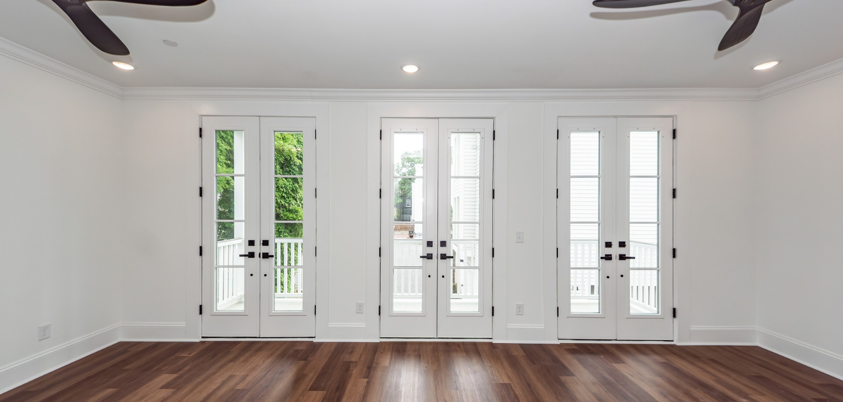

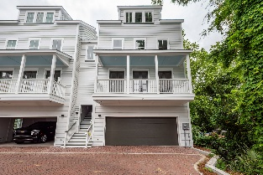
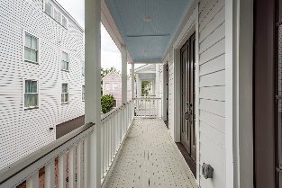
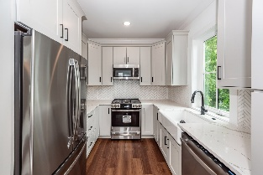
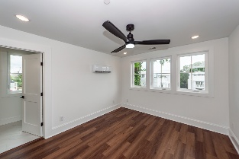
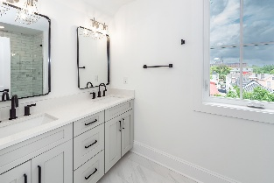


24 Iron Forge Alley Charleston, SC 29403 | MLS# 24026736 | Now Offering at $899,900
Live And Work Here
VIRTUAL TOUR
What once was an actual iron forge in the 1700's, is now this stunning new development of 12 well appointed luxury homes! This development offers 12 unique 2-3 bedroom floor plans all with upgraded appliances, 42'' cabinets, granite/quarts countertops, recess LED lighting throughout, accent light fixtures, solid core doors, residential sprinkler systems, balcony off of the family room, luxury vinyl flooring, and tile throughout! This particular unit has 3 bedrooms and 3.5 bathrooms. Take advantage of the opportunity to own a piece of history on Iron Forge Alley in the heart of charming Downtown Charleston!
John Vance
843-814-0039
john@charlestonrealtypros.com
Charleston Realty Pros, LLC | PO Box 2953 | Summerville, SC 29484

