Slide 1
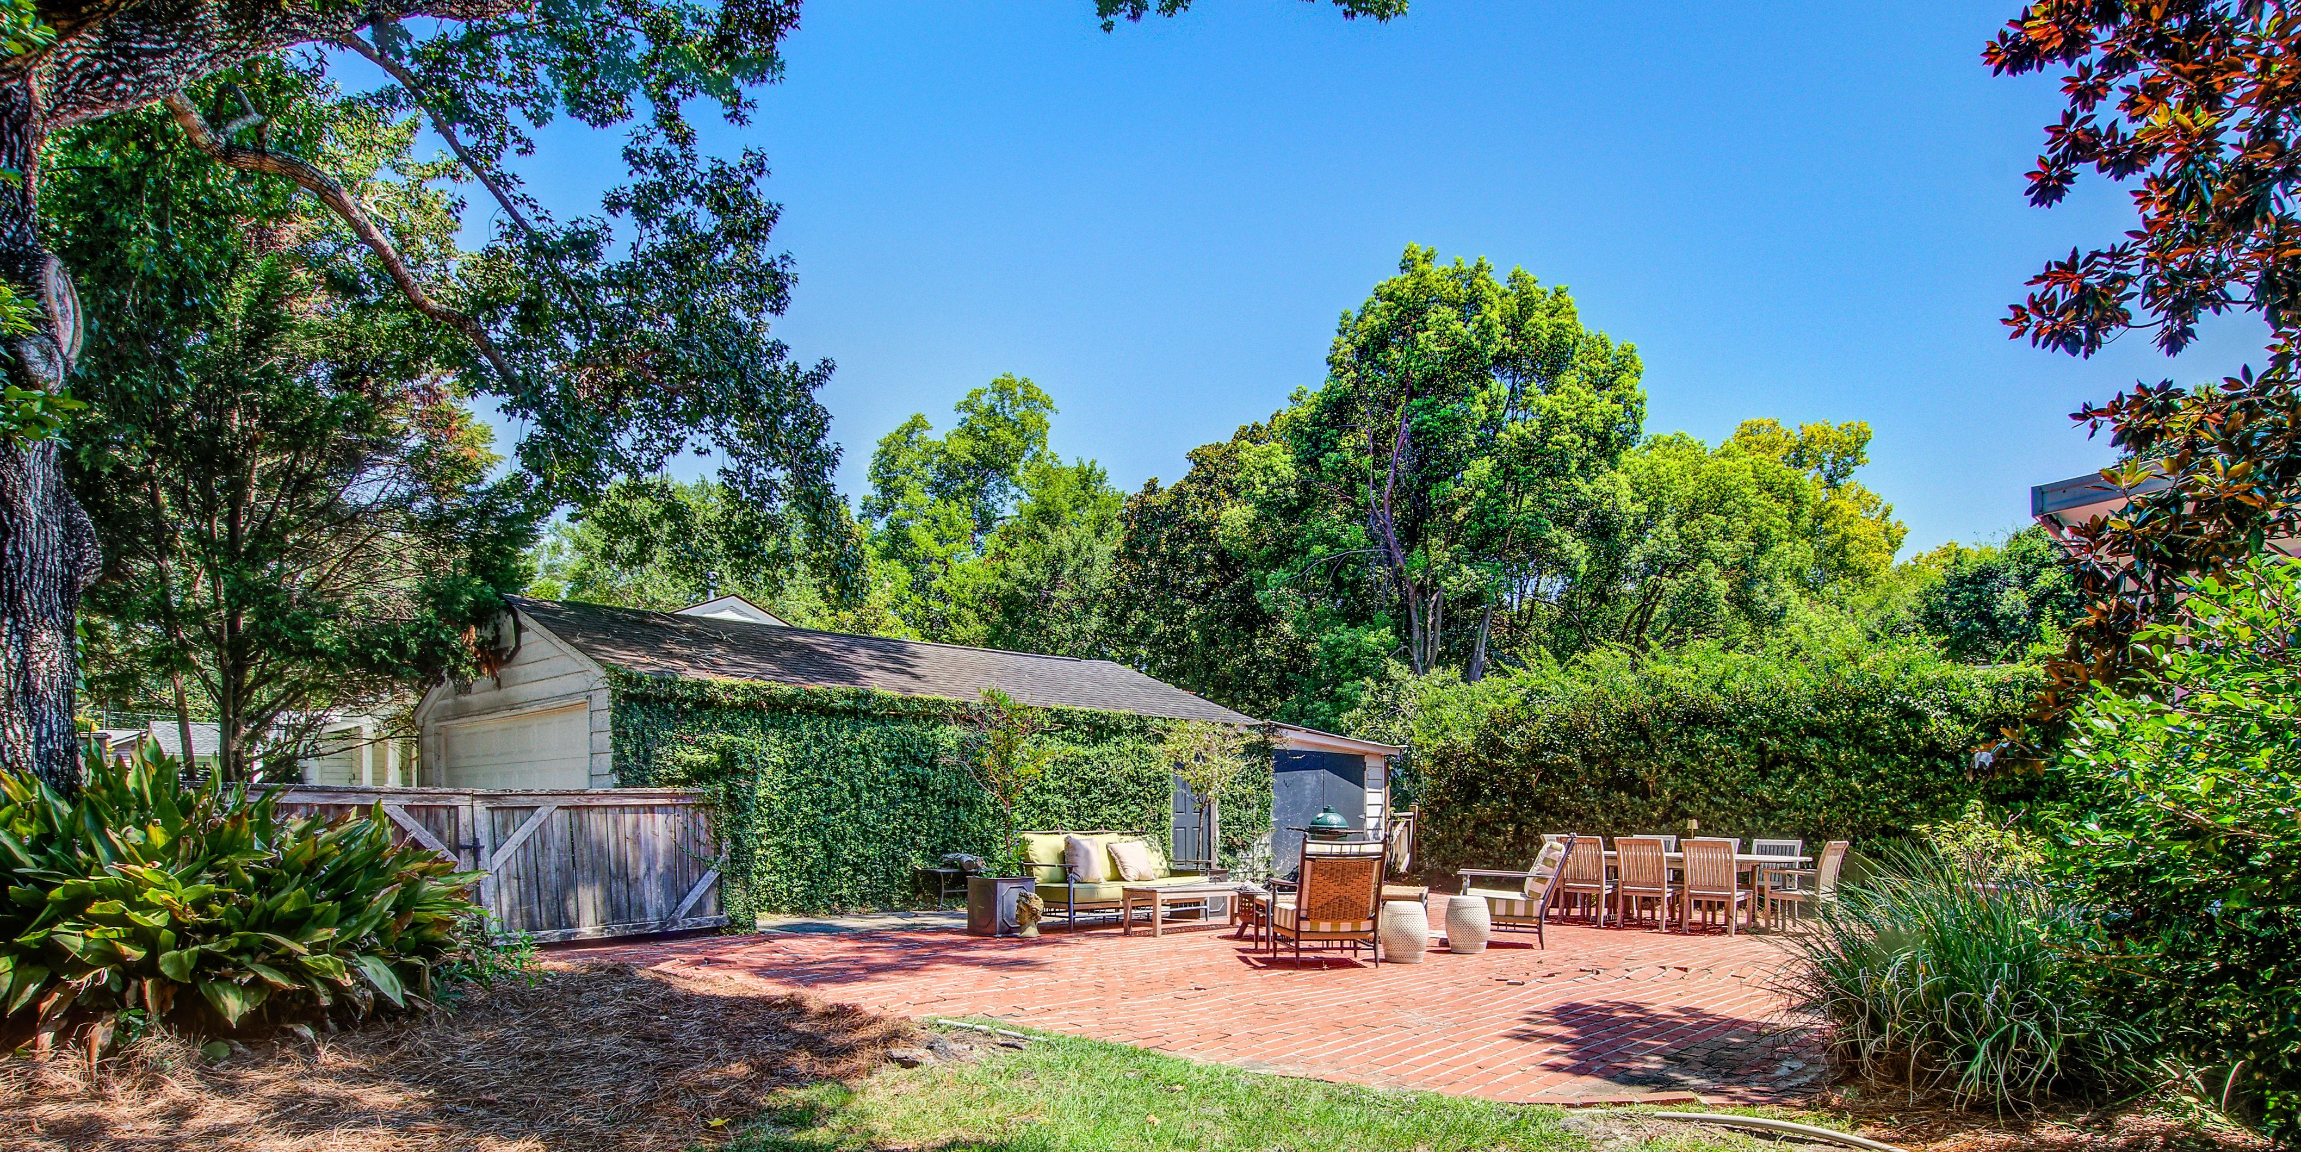
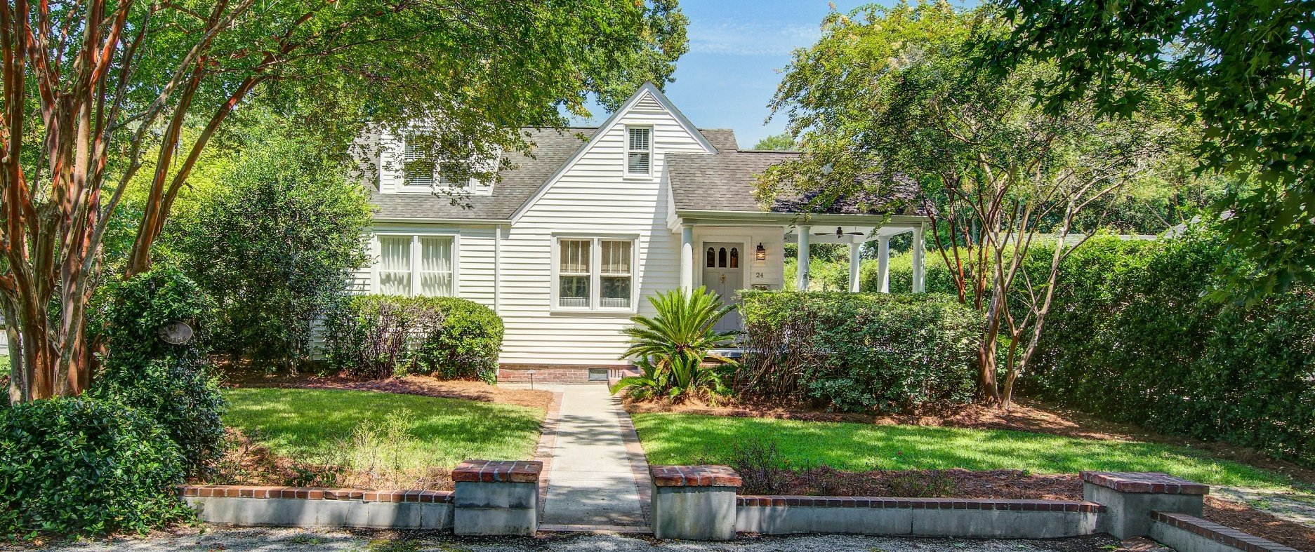
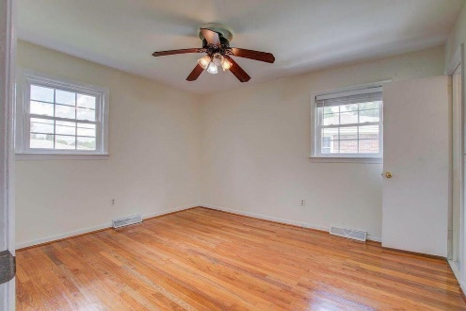
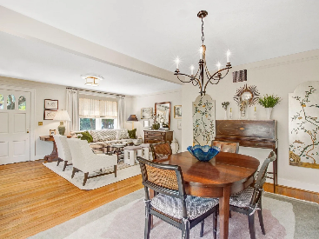
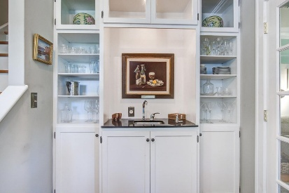
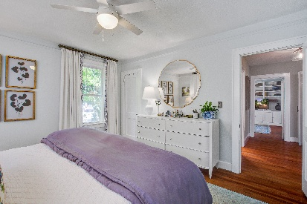
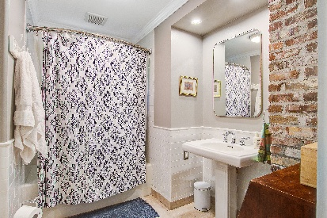
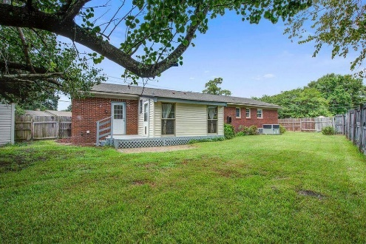


Charming 1947 Home in Avondale Just 3 Miles from Downtown Charleston
24 Oakdale Place
Avondale | Charleston, SC 29407 | MLS# 25021505 | $1,100,000
If you’re searching for that perfect blend of historic charm and modern convenience, look no further than this Avondale gem.
Tucked away on a picturesque corner lot shaded by mature trees, this three-bedroom, two-bath home captures the essence of Lowcountry living—just minutes from all the dining, shopping, and culture of downtown Charleston.
Jan Miller Cell (843) 345-9719 | Jan.Miller@nvrealtygroup.com
NV Realty Group | 91 Broad St, Ste A | Charleston, SC 29401
janmiller.nvrealtygroup.com

