Slide 1
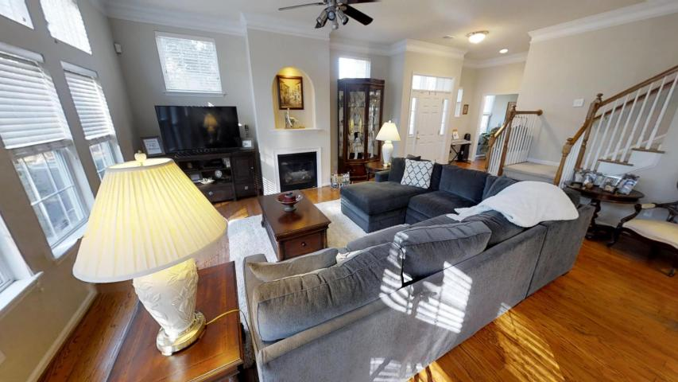
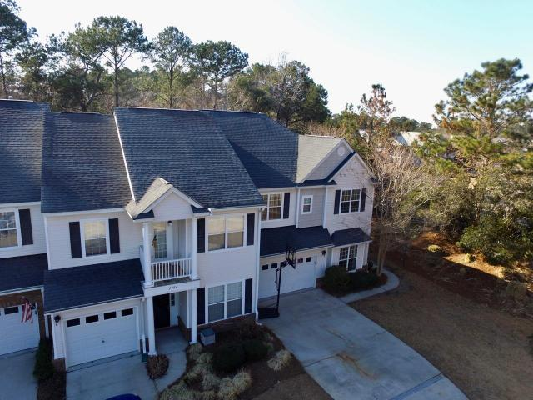
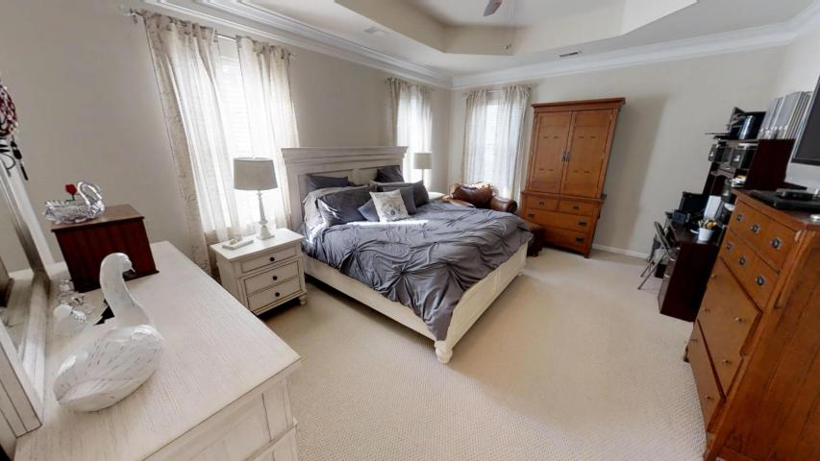
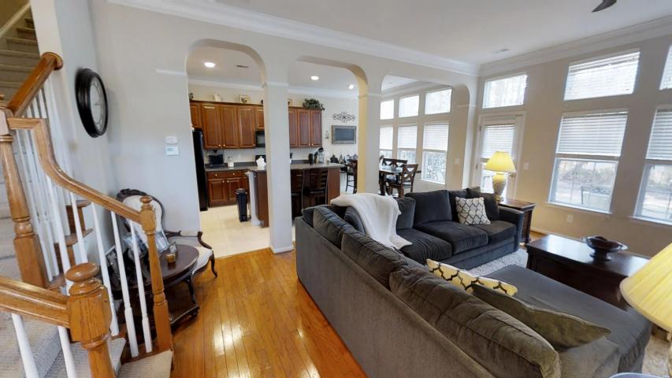
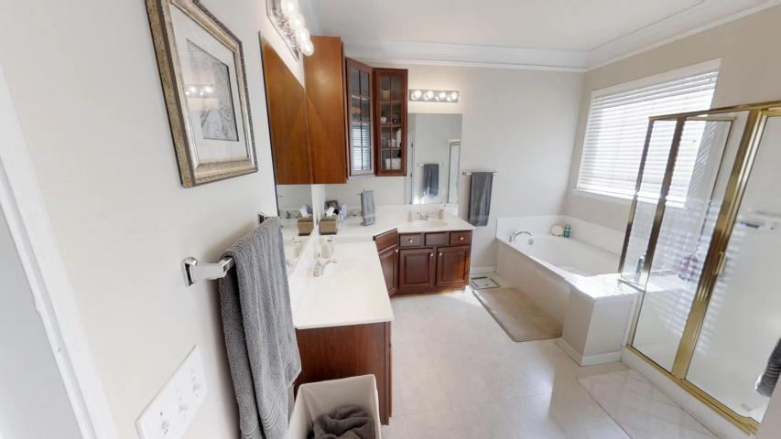
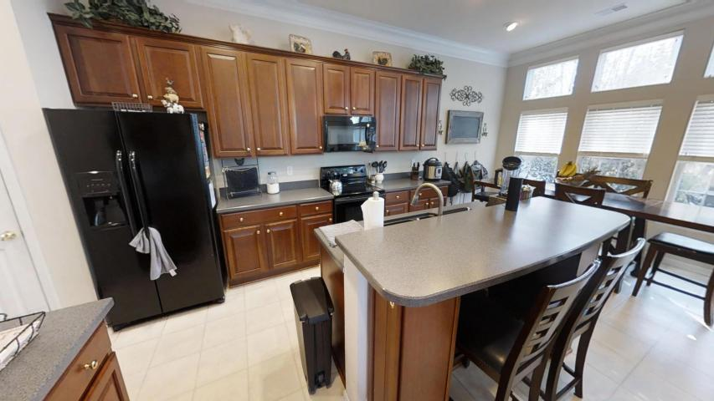
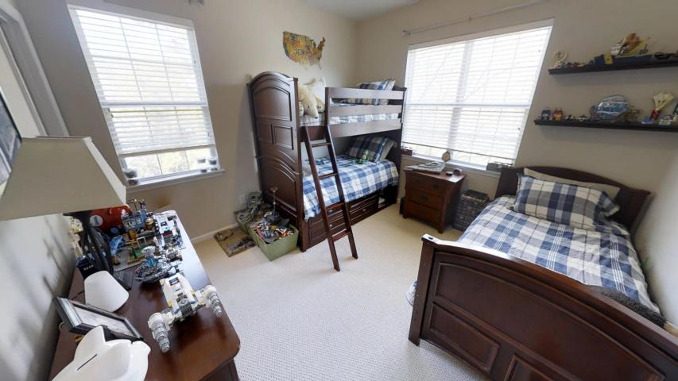
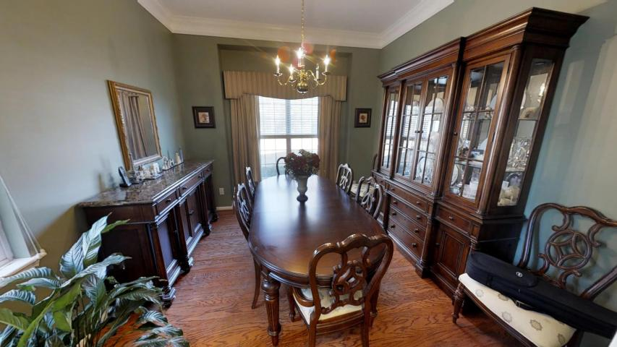
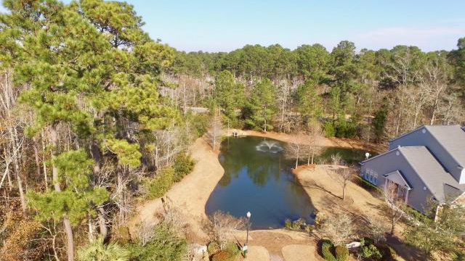

Quiet End Unit Featuring An Open Floorplan
2500 Draymohr Court
Park West ~ Mount Pleasant
MLS# 18001707 ~ $369,900
This is a rare four bedroom open concept townhome in Park West. In addition the location within the desirable Keswick community, with its Palmetto Tree lined street and sidewalks on both sides of the road, is unbeatable. You’ll find this 2432 square foot end unit at the very end of the cul-de sac. Woods behind AND beside the house provide fantastic privacy and the extra long driveway accommodates several cars in addition to the two car garage. Upon entry you will be impressed with the open layout, where the eat-in kitchen overlooks a large family room with a gas fireplace.
This is an excellent floor plan offering versatility to its owners. Park West is a sought after Mt. Pleasant community offering two pools, tennis courts, a playground and miles of walking and biking trails for residents to enjoy. The amenity center is within walking distance of this neighborhood. Living in a low maintenance townhome affords you the opportunity to enjoy all of the amenities. Children in grades Pre-K through Eight attend schools located in Park West and Wando High is a short ride away. A dog park and Town of Mt. Pleasant Recreation Department are located in Park West. The convenience of shopping, restaurants, doctors offices and other professional services located inside this all inclusive community make this a smart place to call home. The beaches and historic downtown Charleston are just a short ride away!
3D Walk thru tour on mls or go to
https://my.matterport.com/show/?m=TfYH4LtiFdw
Ellen O'Neil
Broker/Owner
Ellen O'Neil Realty
ABR, e-PRO, CNE
Charleston Realtor of Distinction
(843)300-8530
http://EllenONeilRealty.com

