Slide 1
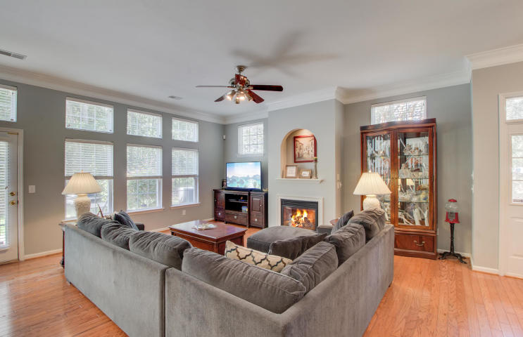
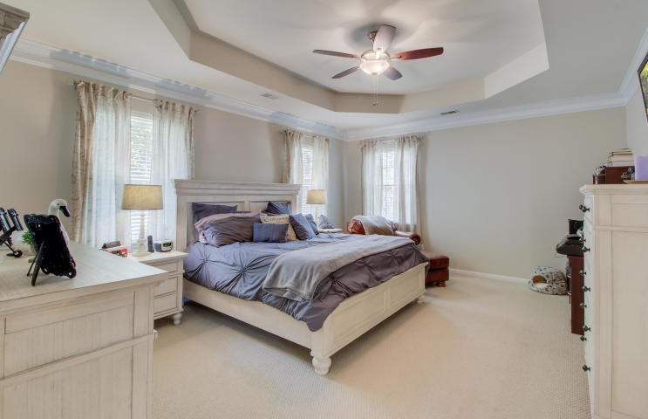
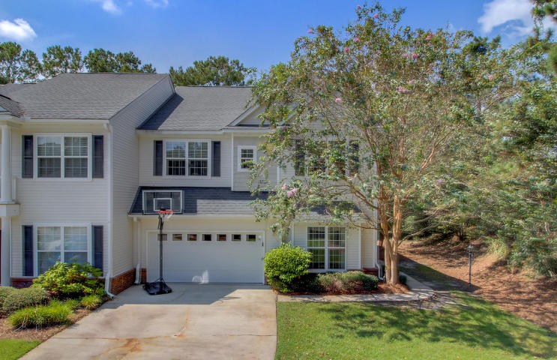
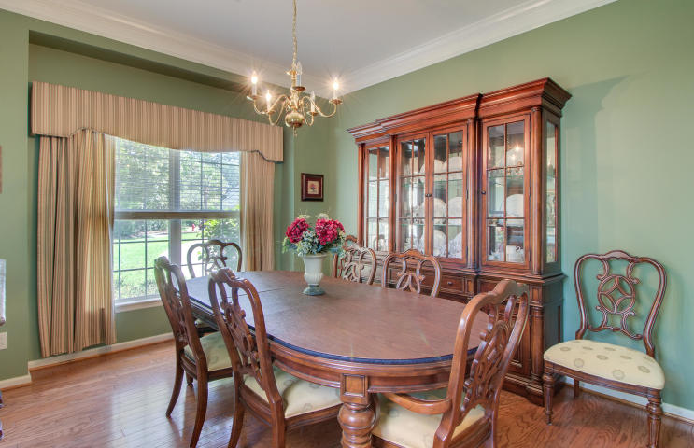
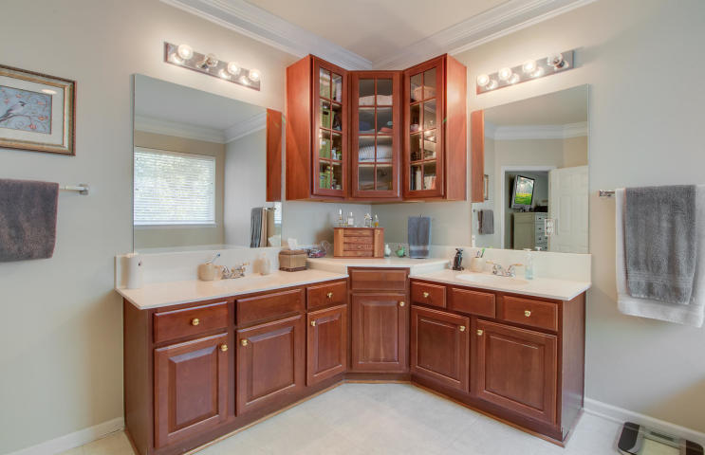
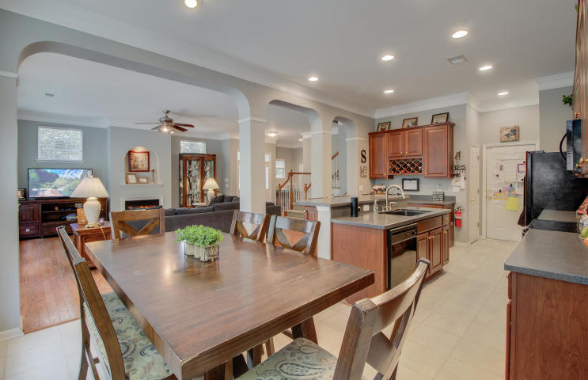
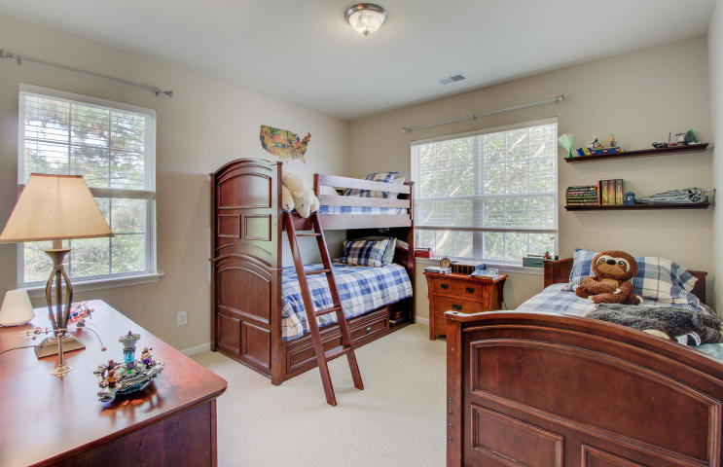
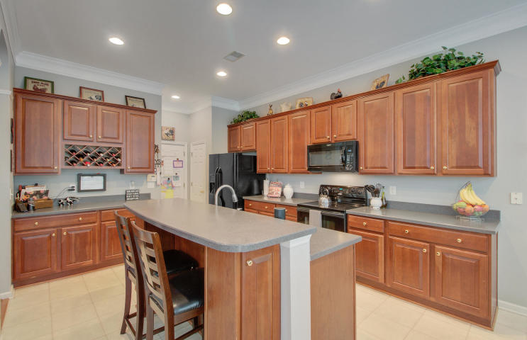
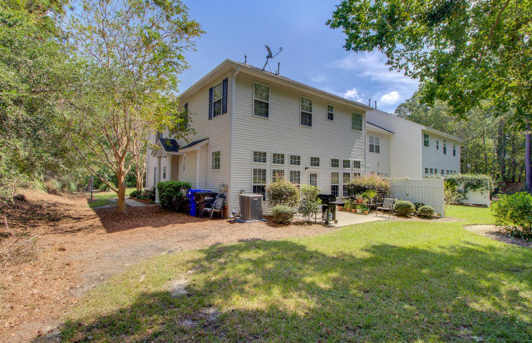


Just Reduced! Short Drive to Beach!
2500 Draymohr Court
Park West
Mount Pleasant, SC 29466
MLS# 19025454 ~ $379,000
This is a rare four bedroom open concept townhome in Park West. In addition the location is unbeatable - in the desirable Keswick community, with its Palmetto Tree lined street and sidewalks on both sides of the road. You'll find this 2432 square foot end unit at the very end of the cul-de-sac. Woods behind AND beside the house provide fantastic privacy and the extra long driveway accommodates several cars in addition to the two car garage. Upon entry you will be impressed with the open layout, where the eat-in kitchen overlooks a large family room with a gas fireplace. A separate dining room could easily be used as an office if desired. Ten foot ceilings on the first floor add to the spacious feeling, and the hardwood floors and crown molding add a touch of class. The majority of the interior of the home has been freshly painted and it is looking sharp! The kitchen boasts cherry cabinets, solid surface countertops and a breakfast bar. The home is flooded with light due to the numerous windows overlooking the rear patio and private, wooded back yard. Upstairs you will find four generous sized bedrooms. The master suite is very large and has a huge closet. In the master bath are dual sinks for added convenience. Three additional bedrooms and full bath are located opposite the master suite, This is an excellent floor plan offering versatility to its owners. Park West is a sought after Mt. Pleasant community offering two pools, tennis courts, a playground and miles of walking and biking trails for residents to enjoy. The amenity center is within walking distance of this neighborhood. Living in a low maintenance townhome affords you the opportunity to enjoy all of the amenities. Children in grades Pre-K through Eight attend schools located in Park West and Wando High and Oceanside Academy are a short ride away. A dog park and Town of Mt. Pleasant Recreation Department are located in Park West. The convenience of shopping, restaurants, doctors offices and other professional services located inside this all master planned community make this a smart place to call home. The beaches and historic downtown Charleston are just a short ride away! This spacious townhome is a wonderful alternative to a single family home- give up the exterior maintenance and yard work so you can get out and enjoy all that Charleston and the beaches have to offer!!
View Virtual Tour here: https://my.matterport.com/show/?m=G8P5KrGKhAp
Ellen O'Neil
Broker/Owner, ABR, e-PRO, CNE
Charleston Realtor of Distinction
(843) 300-8530
www.EllenONeilProperties.com

