Slide 1
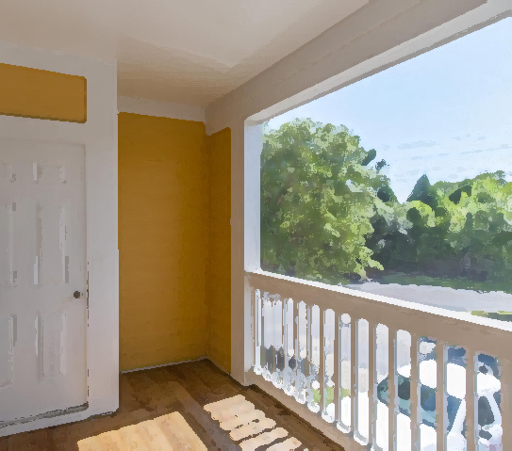
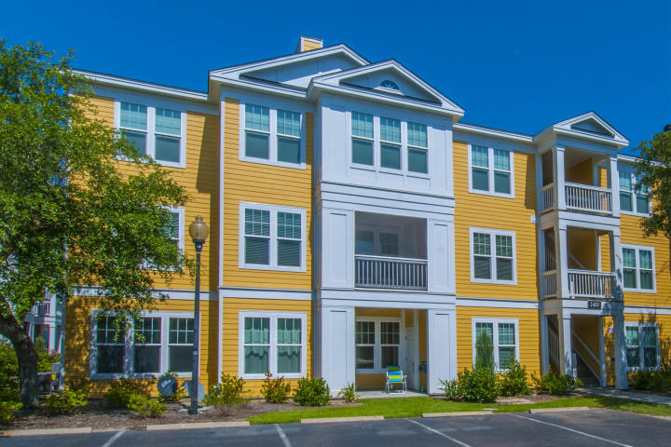
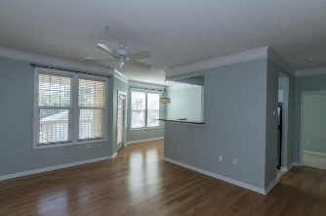
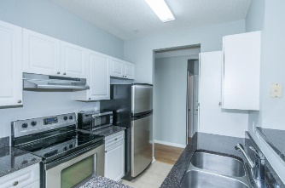
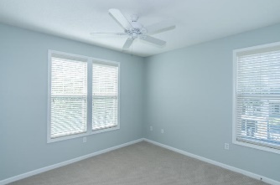
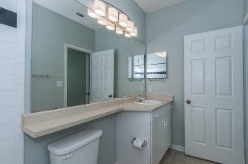
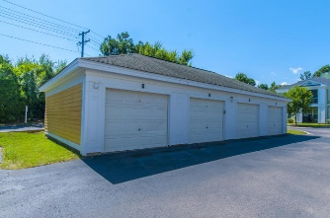


2500 Beaucastel Road #2421 Southampton Pointe ~ Mount Pleasant
Move-in Ready 2nd floor condo in the desirable Southampton Pointe. Open floor plan with beautiful hardwood floors. Kitchen features granite counter tops, stainless appliances, pantry and eat-in dining. Relax after a long day on the screened porch. Two nice size bedrooms with lots of extra storage. Also includes a garage. And did I mention freshly painted. Amenities include Club House, pool, tennis courts, and exercise center. Conveniently located to shopping, schools, beaches and downtown Charleston.
Asking $236,500
MLS# 16018935
1,057 SqFt
2 Bed/2 Baths
Great Location... This one won't last long!
Don Dawson 843-514-0452 ddawson@carolinaone.com Carolina One Real Estate • 2713 Highway 17 North • Mount Pleasant, SC 29466
www.TeamDawsonSC.com

