Slide 1
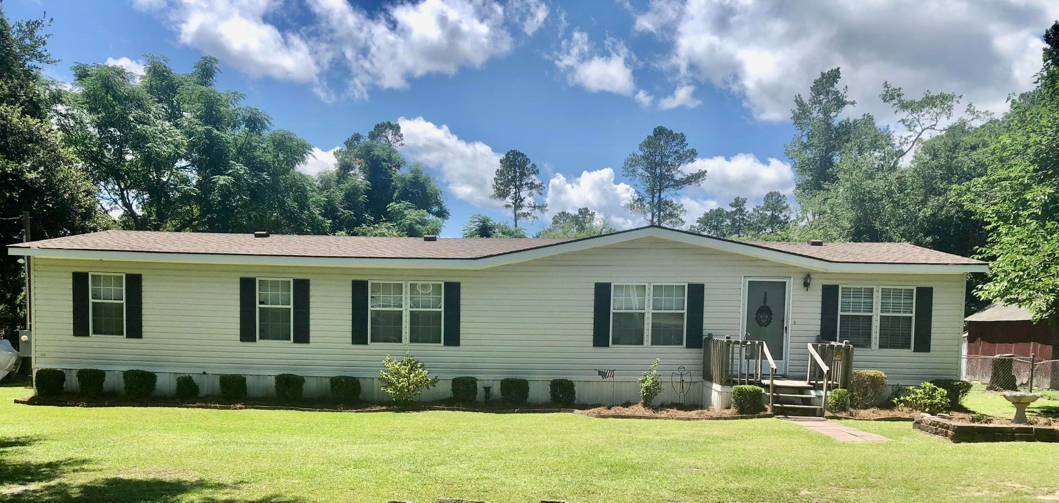
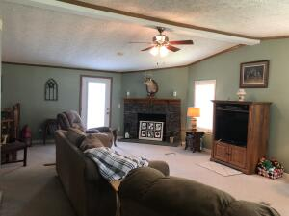
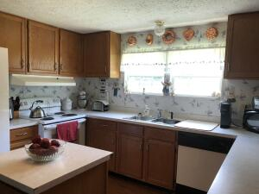
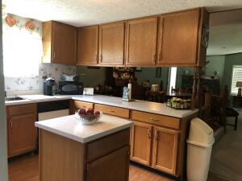
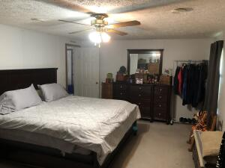
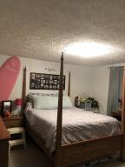
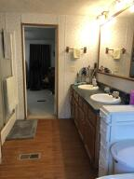
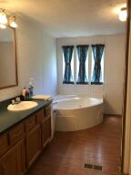
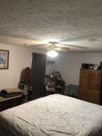
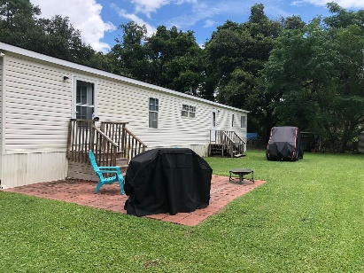
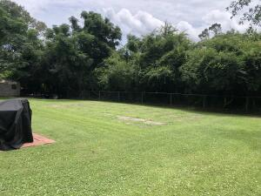


2501 S Hwy 17A Summerville, SC 29483 | MLS# 22019266 | $250,000
RESIDENTIAL OR INVESTMENT PROPERTY
Welcome to this well taken care of home where the Roof was replaced in 2018 and HVAC in 2015. The spacious open floor plan is very welcoming and perfect for entertaining. All of the bedrooms are nice size and the master bedroom can easily accommodate a king size bed. The master bath has a dual sink vanity, garden tub, separate shower and walk in closet! The home also sits on a very large lot which is almost half of an acre and there is No HOA! You can store all your toys and or work equipment right at home. Grow a garden and have some chickens! This property has the capability to be zoned commercial if you are looking to make this a work from home business there is plenty of room to build to suit. Flood zone is X so flood insurance is not required. Located in DD 2 school district. The adjacent property to the right is also for sale..... this could be an opportunity for friends or family to purchase and be your neighbor or for you to also purchase to have a great investment property. Both lots would almost make an acre. Lots of potential and possibilities here.
Kelly Rozier
(843) 209-3129
kellywrozier@gmail.com
Brand Name Real Estate
4 Carriage Lane Suite 106
Charleston, SC 29407

