Slide 1

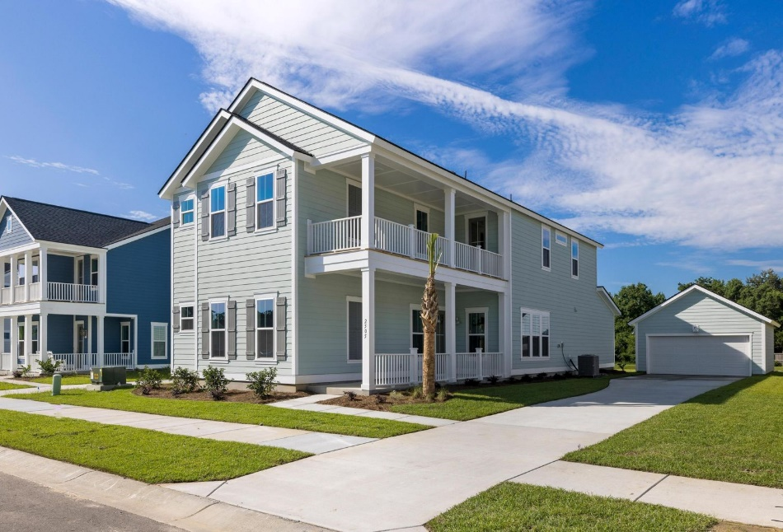





Stonoview - New Construction
2505 Hatch Drive
Truly Brand New!!
Price Improvement & Motivated Seller
Ready for Occupancy…Never Been Lived In!!
5 Bedrooms / 3,300 SF
Downstairs Master Bedroom
Open Floor Plan
Waterfront Community On Stono River
Deep Water Community Dock With Sundeck, Boat Storage, Floating Boat Slips, Resort Style Pool, Clubhouse, Tennis Courts, Walking Trails
Detached Studio!
MLS# 22022783
$875,000
Nancy Hoy
843-224-3588
nhoy@carolinaone.com
Equal Housing Opportunity
If you have a brokerage relationship with another agency, this is not intended as a solicitation. All information deemed reliable but not guaranteed.

