Slide 1
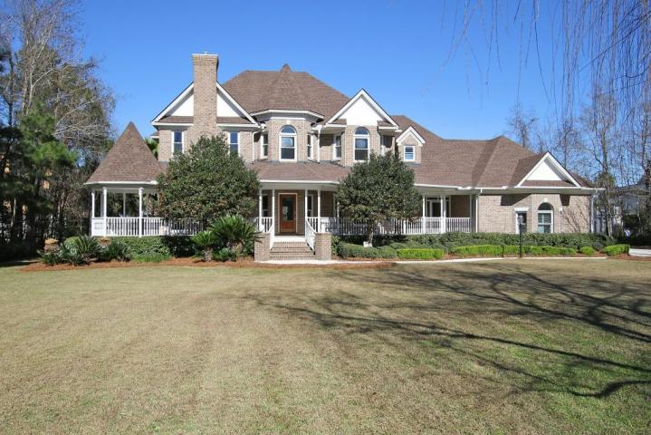
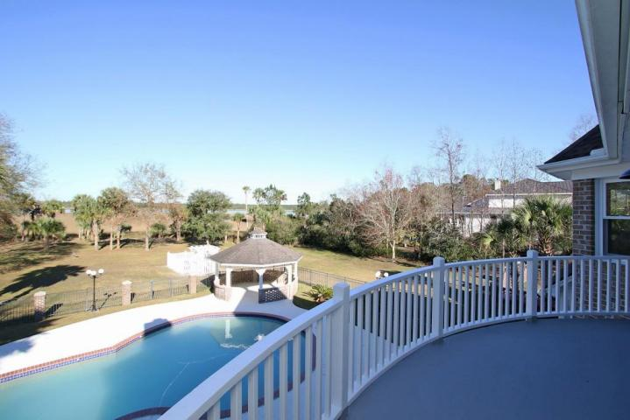
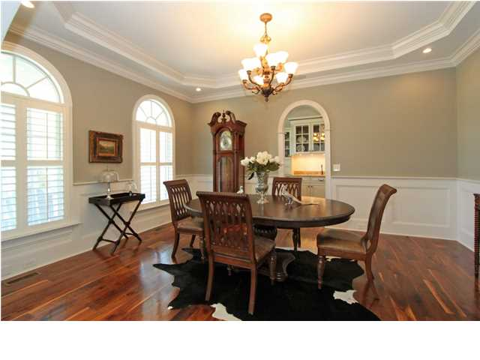
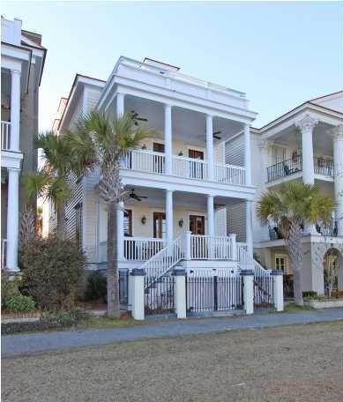
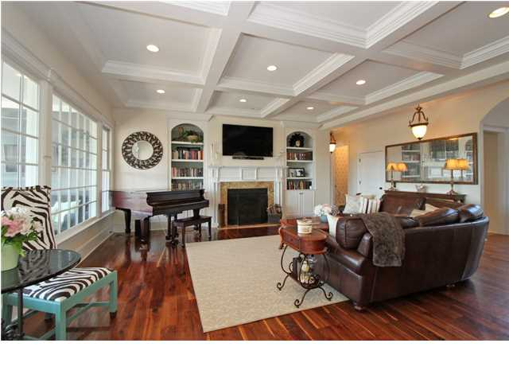
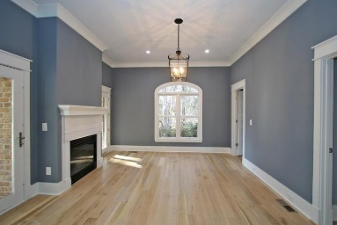
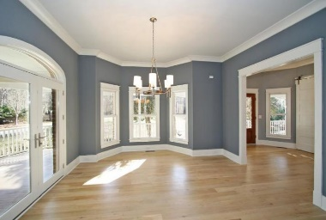
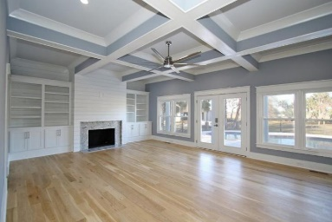
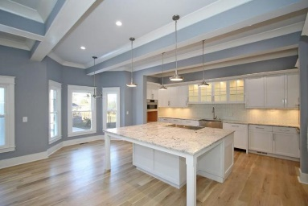
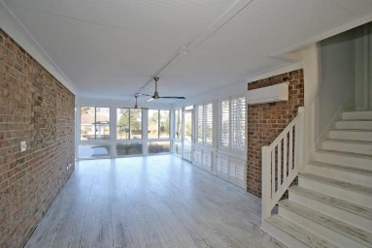
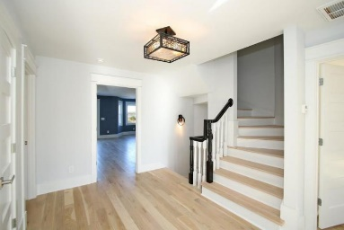
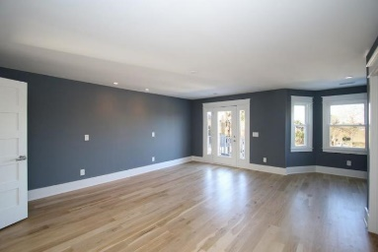
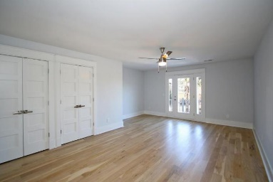
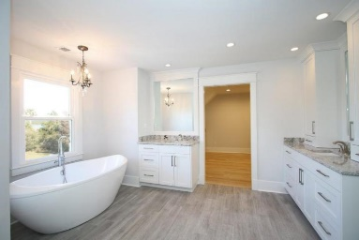
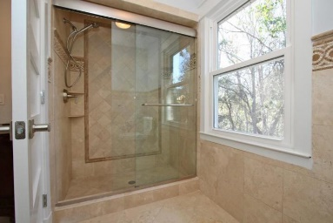
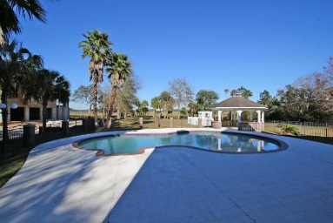
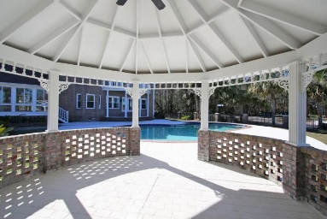
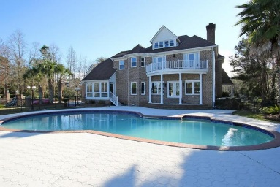
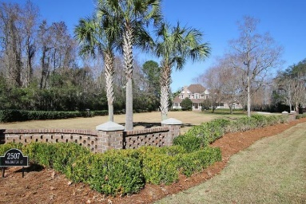


2507 Willington Ct
Mount Pleasant
MLS# 16000657
$1,400,000
Luxury Waterfront Estate in Dunes West
Enjoy your own tropical paradise in this beautiful estate on the Wando River with dock permit in hand. This stately brick home is newly reconstructed , down to the studs. Huge, open foyer with study/bedroom to the left and formal dining to the right. Dream kitchen with over-sized island, custom cabinetry, granite counters and top of the line appliances. Great room with fireplace, open for entertaining and views overlooking the river. Second floor master suite with incredible water views. Master bath with over-sized soaking tub ,shower with dual shower sprays and large walk in closet with built ins. Three additional bedrooms upstairs, one with its own private bath and two others with jack and jill bath. Laundry room with prep sink and workspace also on this level. Third floor media room with a half bath. Mother in law suite over garage with access from main house as well as a separate entrance from a sun room overlooking river, saltwater pool and gazebo. New roof, fully encapsulated crawlspace, 2 tankless water heaters, spray foam insulation. Whether you are looking for custom finishings, bones of a house or the one plus acre waterfront site...You have it all.
Must see to appreciate!
Clay Cunningham
O (843) 886-8110
M (843) 345-4647
clay@carolinaone.com
www.claysre.com
Carolina One Real Estate
1503 Palm Blvd Ste
Isle of Palms, SC 29451

