Slide 1
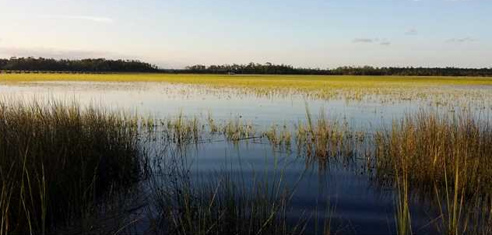
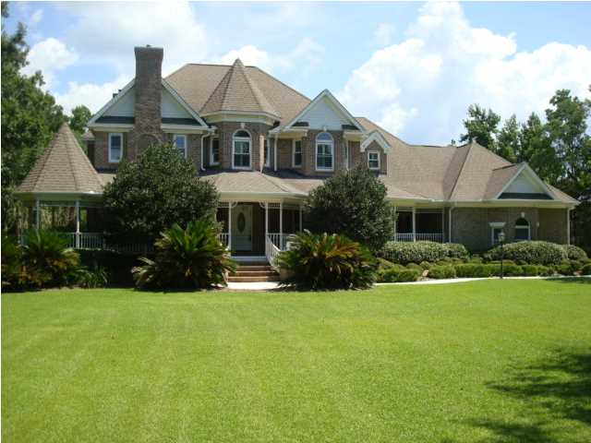
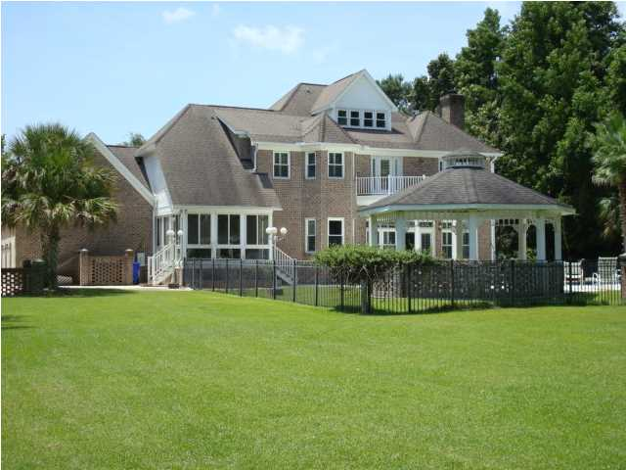
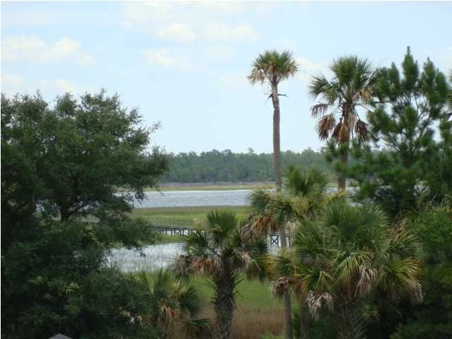
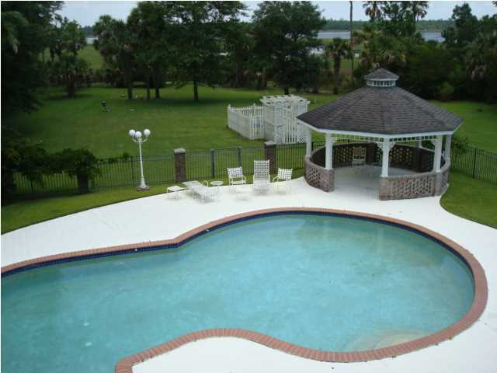
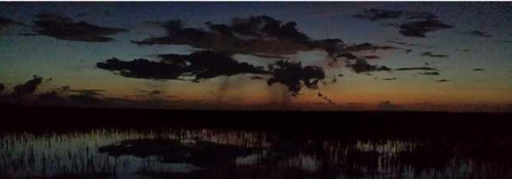
DIRECT WANDO RIVER FRONTAGE
6000 PLUS SQ FT :: REDUCED TO $795,000
OWNER FINANCING::NO BANK NEEDED
OWNER FINANCING AVAILABLE...NO BANK FINANCING NEEDED! This property is truly an oasis...The lot value alone without a house is $700,000 or more ...The property is over 1.5 Acres of high land with frontage on the Wando River and Marsh where when you are in the home or backyard you can't even see another home...Just woods!...Marsh and Water!...Privacy...Privacy...and more Privacy! This is absolutely the best deepwater lot in Mount Pleasant...PERIOD!. Sellers have a dock permit in hand to construct a dock that leads to the Wando River...With 9 feet of water at low tide...Truly deep water without the sandbars and oyster beds of some other deep water lots. This property sits on a cul-de-sac with only 3 other homes on the street...So there is virtually no traffic and again...Lots of Privacy... When I visited the property for the first time I saw 7 deer in the front yard and the owners tell me they see more in the rear of the property. This is truly a piece of heaven! The home was designed to take advantage of the great lot and location. This is a 60 foot long front porch...A balcony off the master bedroom on the rear of the property overlooking the marsh and river...Plus a rear yard in-ground pool with a gazebo that has cable and electricity. If you demolished the house and included the land value...Plus the sewer and water lines,.. Plus the driveway and entrance feature...And in-ground pool and gazebo and irrigation system you have a value that exceeds the asking price...REALLY!!!!! ...Said differently...you are getting the house for free! Once repairs and upgrades are made this is a $1,500,000 property that can be purchased for only $795,000. When you look at the photos of the home you will see that it has been upgraded and updated from the original home built in 1996...to include only 5 year old high-end kitchen appliances (Except for the Sub Zero refrigerator) Granite counters, 6 burner top of the line gas Thermadore range...Reverse osmosis water treatment system, etc...etc... The home boasts of 4 separate HVAC systems with 3 of them almost never used $40,000 value). The home has 95% of it's floor covering...Hardwood Oak or Ceramic Tile...AND you are still wanting to know why it's priced so low...So we will disclose to you that the property has had some "issues" that are fully disclosed in the documents section of this listing...Yes, there needs to be an investment made to "remediate" the issues that were caused by moisture damage from the HVAC System...But still with the asking price, plus your cost to upgrade and handle the "issues" you would have instant equity in your new home!
Rick Willis
843-327-3017
rwillisteam@gmail.com
The Group, LLC

