Slide 1

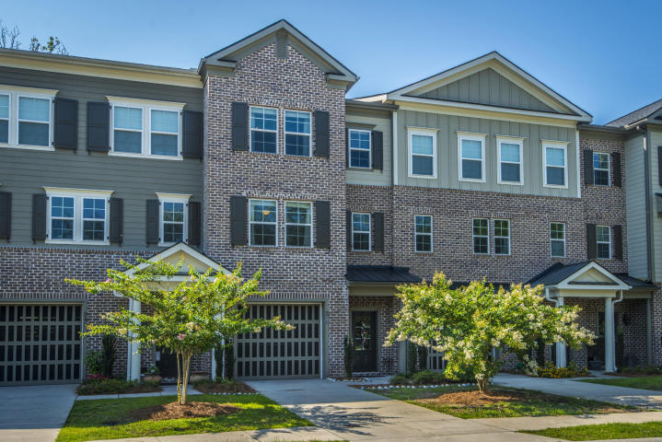
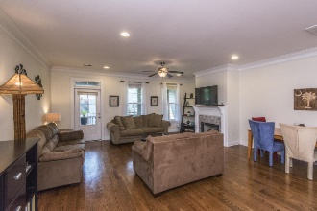
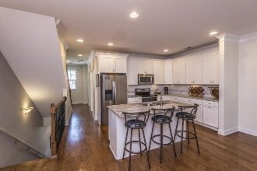
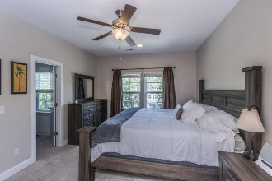
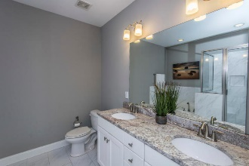
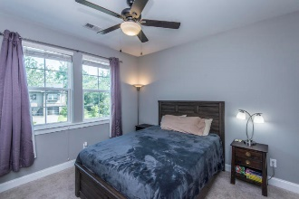
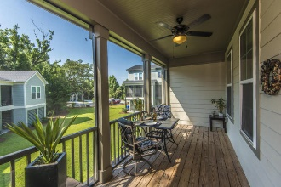
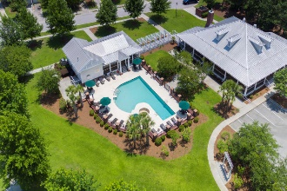
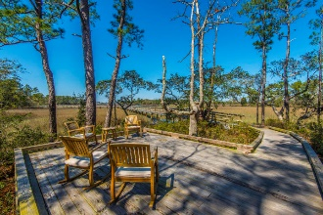
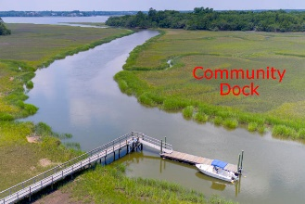


250 Slipper Shell Court
Etiwan Pointe ~ Mount Pleasant, SC 29464
MLS# 18017715 ~ $365,000
Great Location!
Luxury Lowcountry lifestyle marries the convenience of townhome living in this gorgeous property! Don't spend your free time on lawn care, spend it relaxing at the resort style swimming pool or crabbing off of the community dock! Do you like to travel? All exterior maintenance is included so simply lock the door and don't look back! Love to entertain? You can't beat the open floor plan and high end finishes that will welcome your guests! The main living floor is finished in rich medium toned hardwoods, high ceilings and capped off by two-piece crown moulding. The custom kitchen, adorned with white shaker cabinets complimented by stainless appliances, stunning light colored granite countertops and a custom tile backsplash, will be a joy for any home chef!
Already abundant cabinet and counter space, a center island separates the kitchen from the rest of the living area. Prep the evening's dinner on the island while friends gather around with a glass of wine! The large living and dining space is open and offers access to the screened-in porch, as well as a gas fireplace trimmed with the same beautiful granite surround and mantle. Upstairs, you'll find dual master suites, both with walk-in closets and en-suite luxury baths. The bathrooms are casually elegant and have the look featured in today's design blogs which set the tone for a relaxing beginning and end to each day. Dual vanities, oversized soaking tubs and large glass and custom tile showers are found in both master baths. The third bedroom is located on the ground floor and has its own full bathroom, appointed with equally luxurious finishes. This room's separation from the remainder of the home makes it ideal for use as a home office, guest suite, media room, man cave or exercise room... The possibilities are endless! Enjoy the beautiful outdoor setting from your lower level patio area without the added headache of lawn care ~ it's included in the very low monthly HOA dues! With resort-like neighborhood amenities including swimming pool, community dock and workout center with new equipment, Etiwan Point is the ideal location for anyone looking to upgrade their enjoyment while downgrading the work! Conveniently located just a stoplight away from I-526 and down the street from Belle Hall Shopping Center, you'll be minutes to dining, shopping and historic downtown Charleston! $1,850 credit available toward buyer's closing costs and pre-paids with acceptable offer and use of preferred lender.
Asking $1,200,000
MLS# 17023051
3,692 SqFt
4 Bed/3½ Baths
Short Drive to Historic Downtown Charleston & Beaches
Don Dawson
843-514-0452
ddawson@carolinaone.com
Carolina One Real Estate • 2713 Highway 17 North • Mount Pleasant, SC 29466
www.TeamDawsonSC.com

