Slide 1
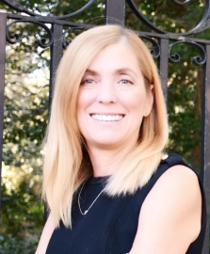
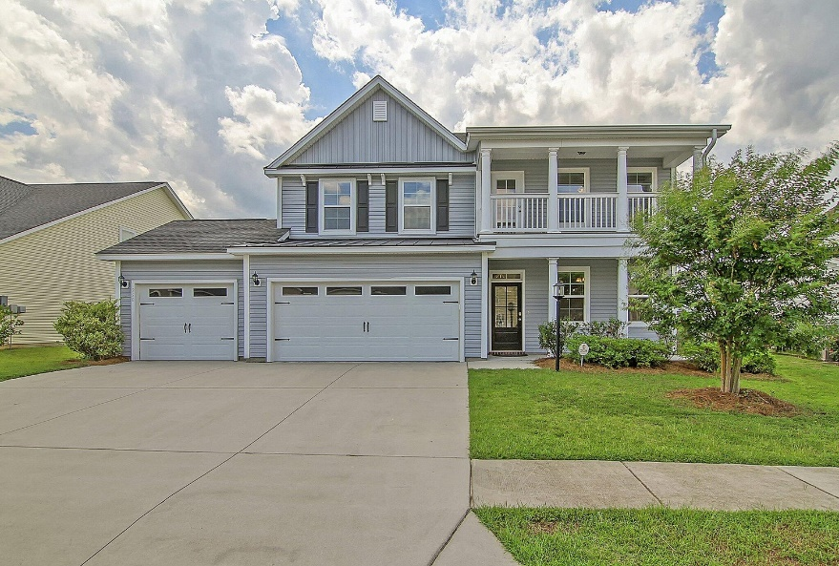
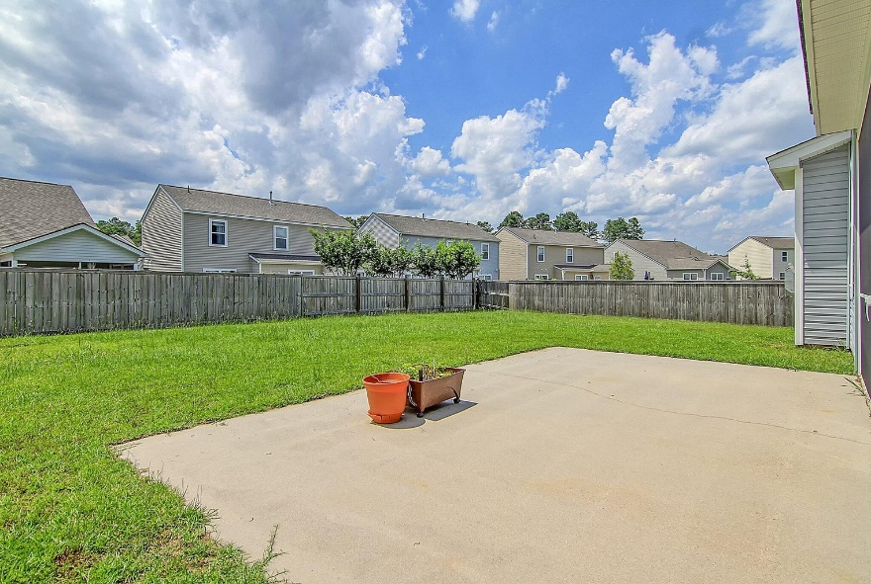
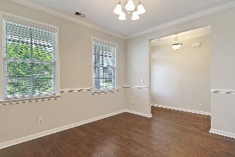
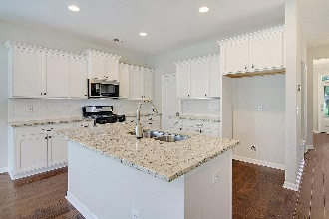
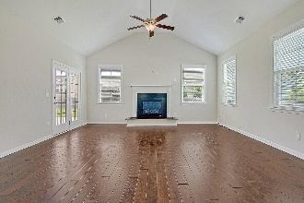
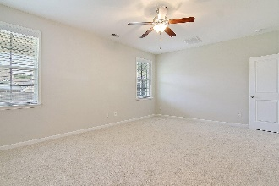
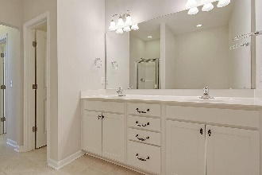

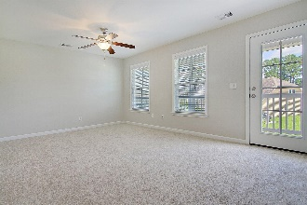
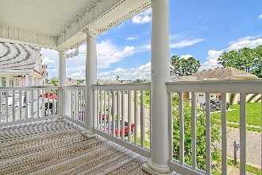
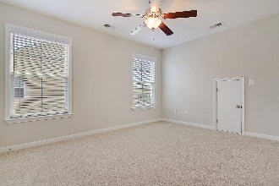
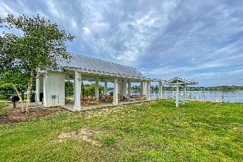
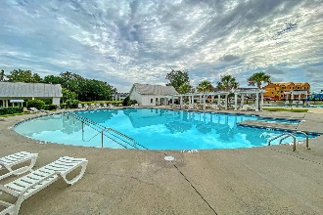
Move in Ready with 3 Car Garage in Foxbank Plantation
Debbie Cromer
ABR, RSPS, REALTOR, CRS
(843) 437-6342
debbie@debbiecromer.com
www.debbiecromer.com/
250 Topsaw Lane
Moncks Corner, SC 29461 | MLS# 23015895 | $500,000
Welcome to your dream home! This 5-bed, 3.5-bath property is sure to impress. As you step inside, you'll immediately be drawn to the hardwood flooring that flows throughout the main living area, creating a warm and inviting ambiance. The open floor plan connects the kitchen to the family room, where vaulted ceilings & a cozy gas fireplace await. The formal dining room sets the stage for unforgettable gatherings. On the main level, the master suite offers a luxurious bath, providing the ultimate retreat. Upstairs, discover four additional bedrooms, a large loft, & two full baths. For relaxation & outdoor enjoyment, a screen porch & a spacious backyard await you. Plus, the three-car garage includes a conditioned space in the third bay, ensuring ample storage options.
Foxbank Plantation is a Master Planned community featuring retail shops/ church/ fitness center/ amazing pool/ playground & open air pavilion on a 67 acre lake!
Video Tour
Century 21 Properties Plus | 1090 Park West Blvd; Ste 103 | Mount Pleasant, SC 29466

