Slide 1
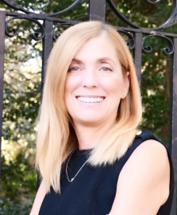
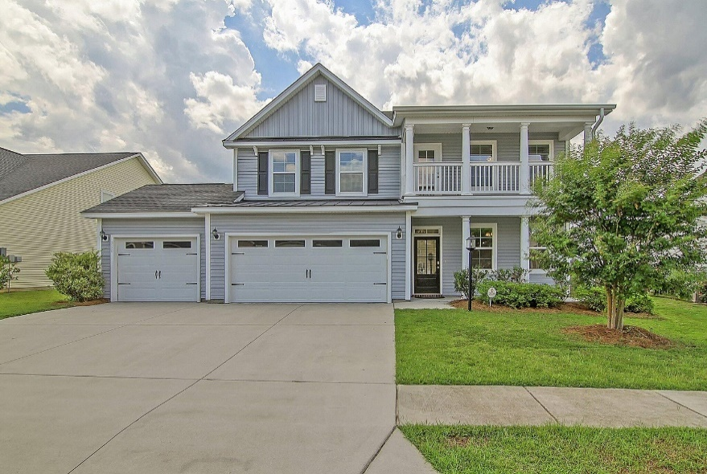
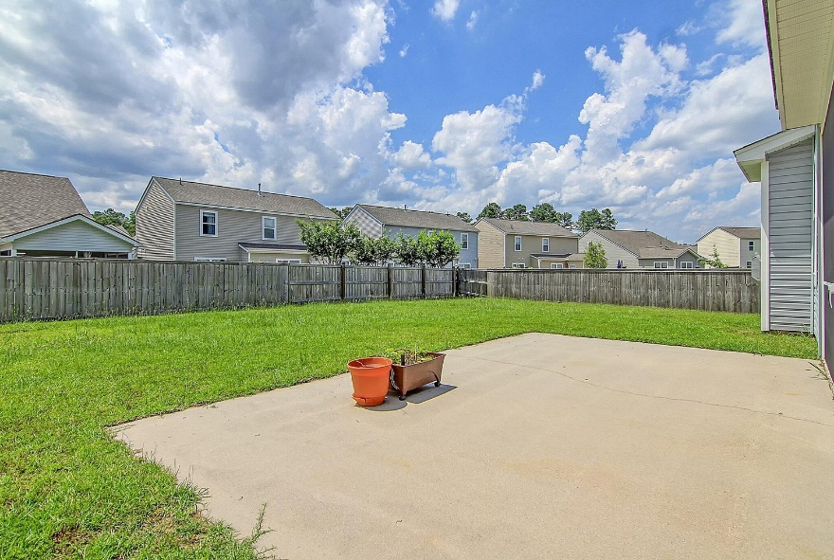
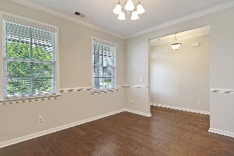
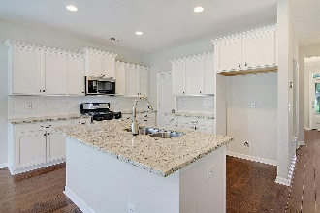
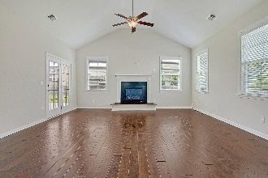
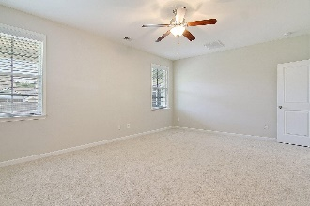
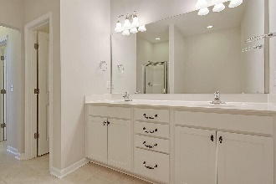

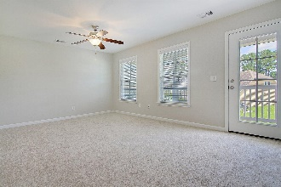
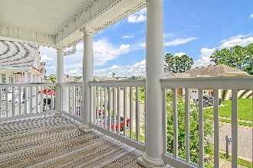
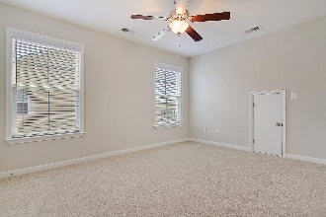
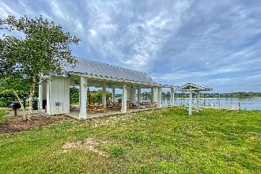
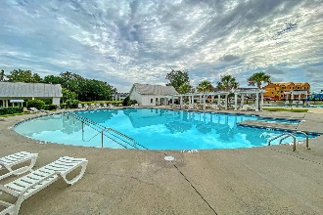
Move in Ready 5 Bed/ 3 ½ Baths
with 3 Car Garage
Debbie Cromer
ABR, RSPS, REALTOR, CRS
(843) 437-6342
debbie@debbiecromer.com
www.debbiecromer.com/
250 Topsaw Lane
Foxbank Plantation | Moncks Corner, SC 29461 | MLS# 23015895 | $500,000
This remarkable 5-bedroom, 3.5-bathroom gem features an impressive 3-car garage that's sure to catch your eye. Upon entering, the beautiful wood flooring throughout the main living area sets a welcoming and cozy tone. The open floor plan seamlessly connects the kitchen to the family room, where vaulted ceilings & a charming gas fireplace provide a comfortable space. Hosting unforgettable gatherings is a breeze in the formal dining room. The master suite on the main level boasts a luxurious bath, offering the perfect retreat. Upstairs, you'll find 4 more bedrooms, a spacious loft, & 2 full baths. Step outside to relax on the screened porch or enjoy the ample backyard space. And don't forget the 3-car garage, complete with conditioned space in the third bay for all your storage needs.
Foxbank Plantation is a Master Planned community featuring retail shops/ church/ fitness center/ amazing pool/ playground & open air pavilion on a 67 acre lake!
Video Tour
Century 21 Properties Plus | 1090 Park West Blvd; Ste 103 | Mount Pleasant, SC 29466

