Slide 1
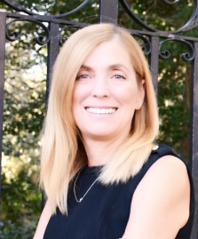
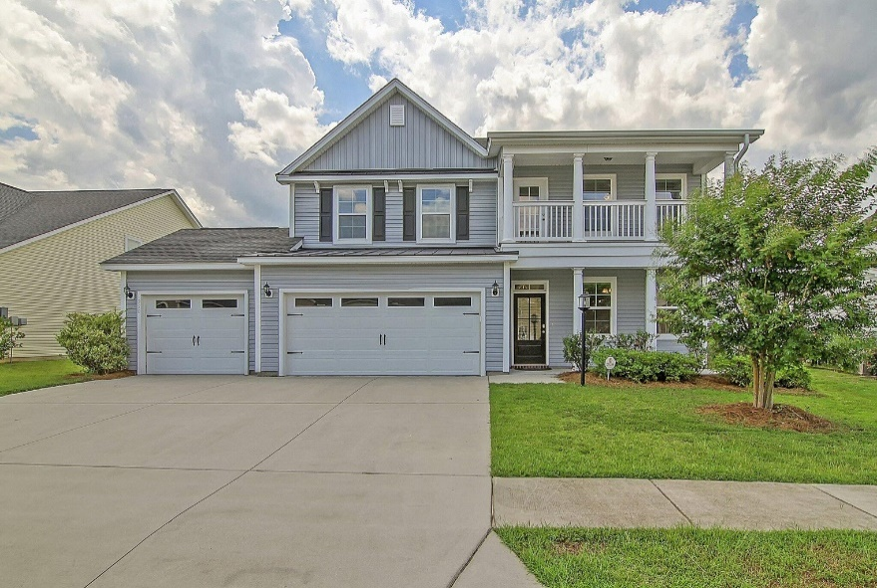
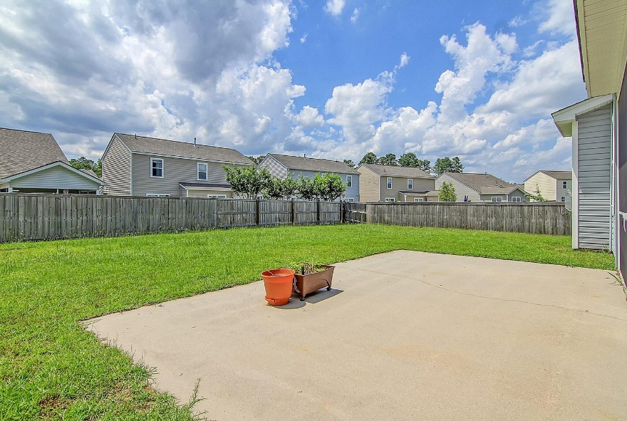
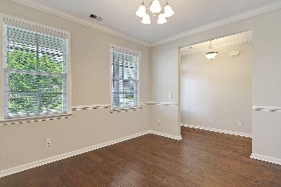
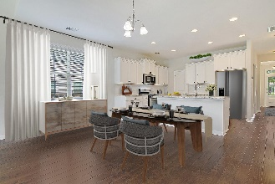
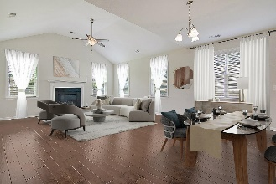
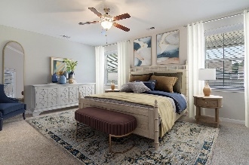
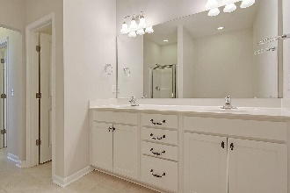

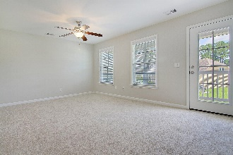
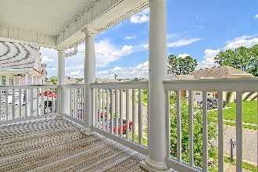
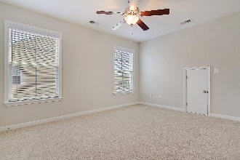
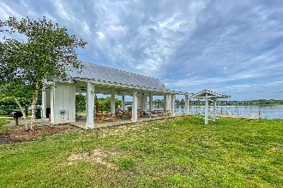
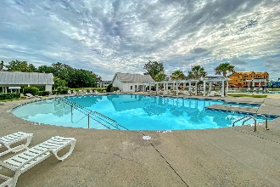
Move In Ready Home
With 3 Car Garage
Debbie Cromer
ABR, RSPS, REALTOR, CRS
(843) 437-6342
debbie@debbiecromer.com
www.debbiecromer.com/
250 Topsaw Lane
Foxbank Plantation | Moncks Corner, SC 29461 | MLS# 23024888 | $479,900
Welcome to this stunning 5-bedroom, 3.5-bath home, boasting a 3-car garage with a conditioned space in the third bay. The open floor plan seamlessly connects the kitchen to the living area, creating a warm and inviting atmosphere, accentuated by a cozy gas fireplace. The first floor features a luxurious master suite with a spa-like bath, offering a perfect retreat.
Upstairs, a spacious loft leads to three large secondary bedrooms and two full baths, ensuring ample space for family or guests. Enjoy the outdoors from the comfort of a screened porch overlooking a beautifully landscaped yard. This home is a perfect blend of elegance, comfort, and practicality.
Foxbank Plantation is a Master Planned community featuring retail shops/ church/ fitness center/ amazing pool/ playground & open air pavilion on a 67 acre lake!
Video Tour
Century 21 Properties Plus | 1090 Park West Blvd; Ste 103 | Mount Pleasant, SC 29466

