Slide 1
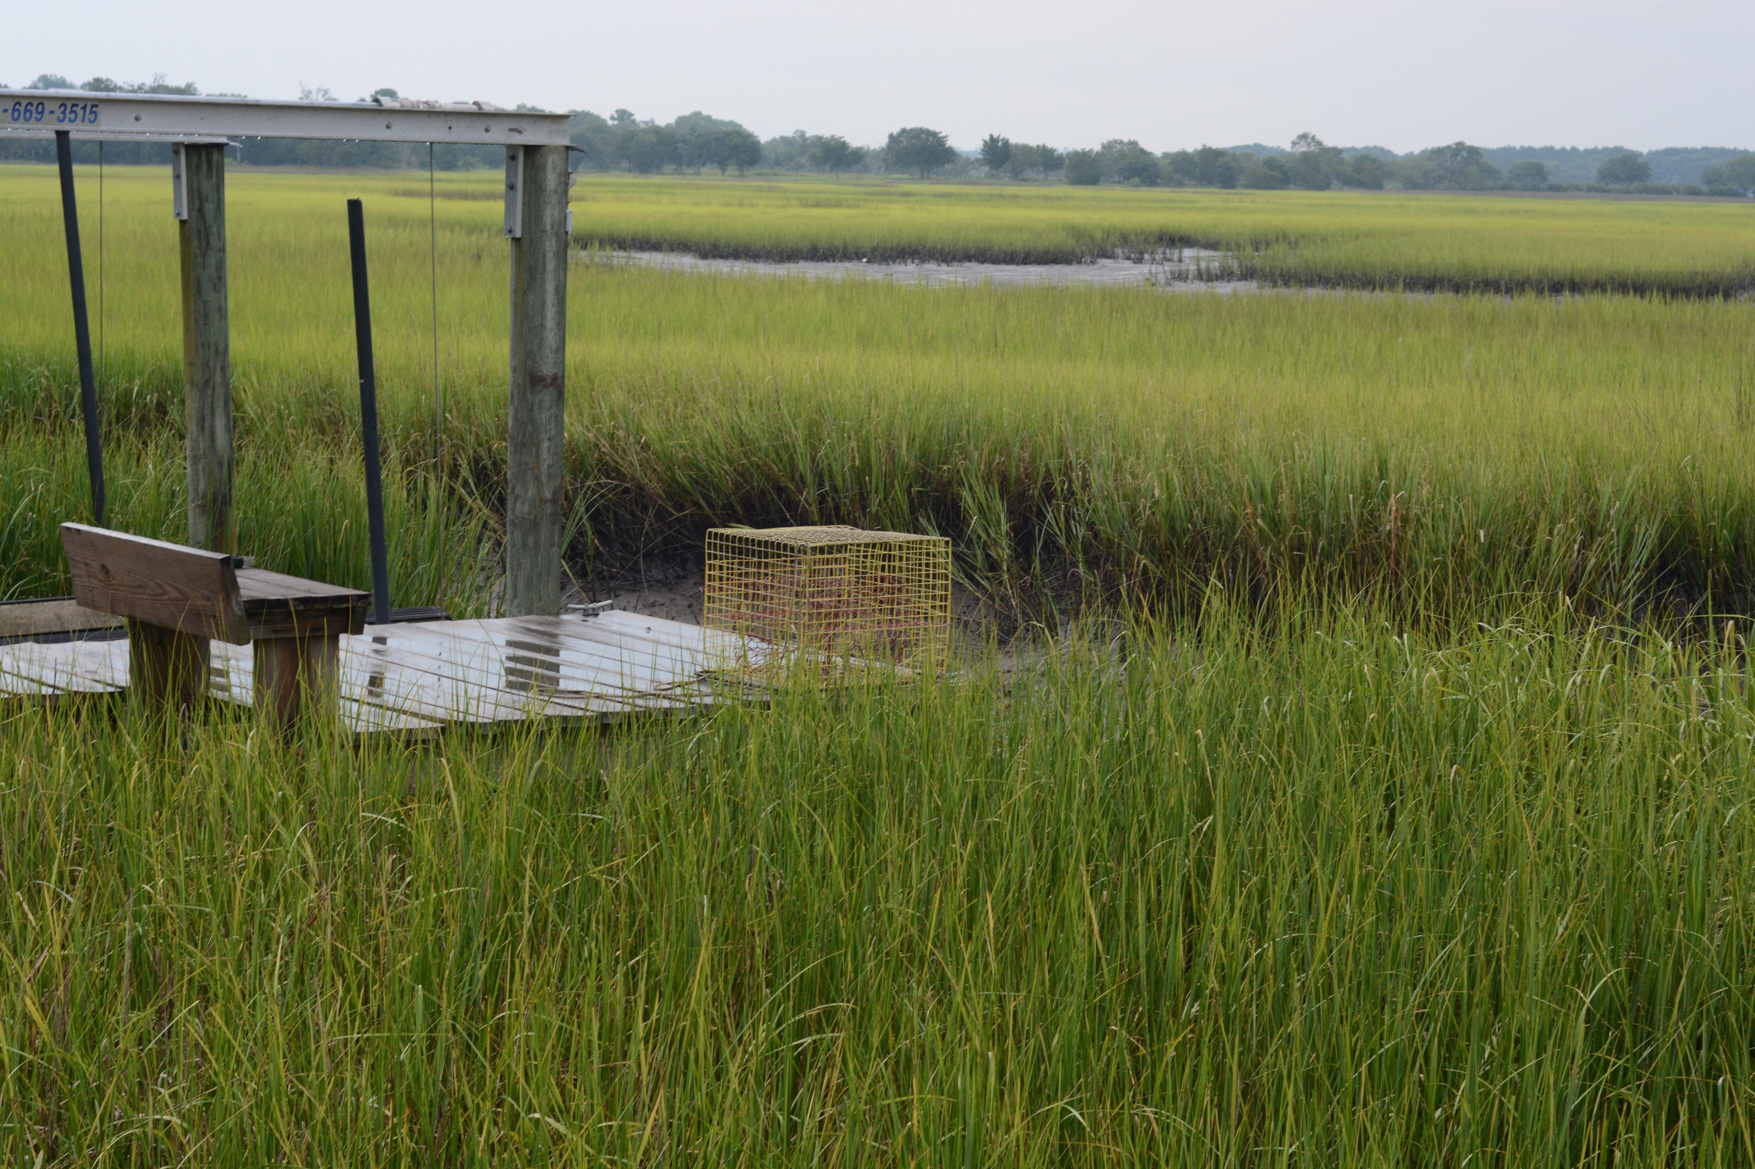
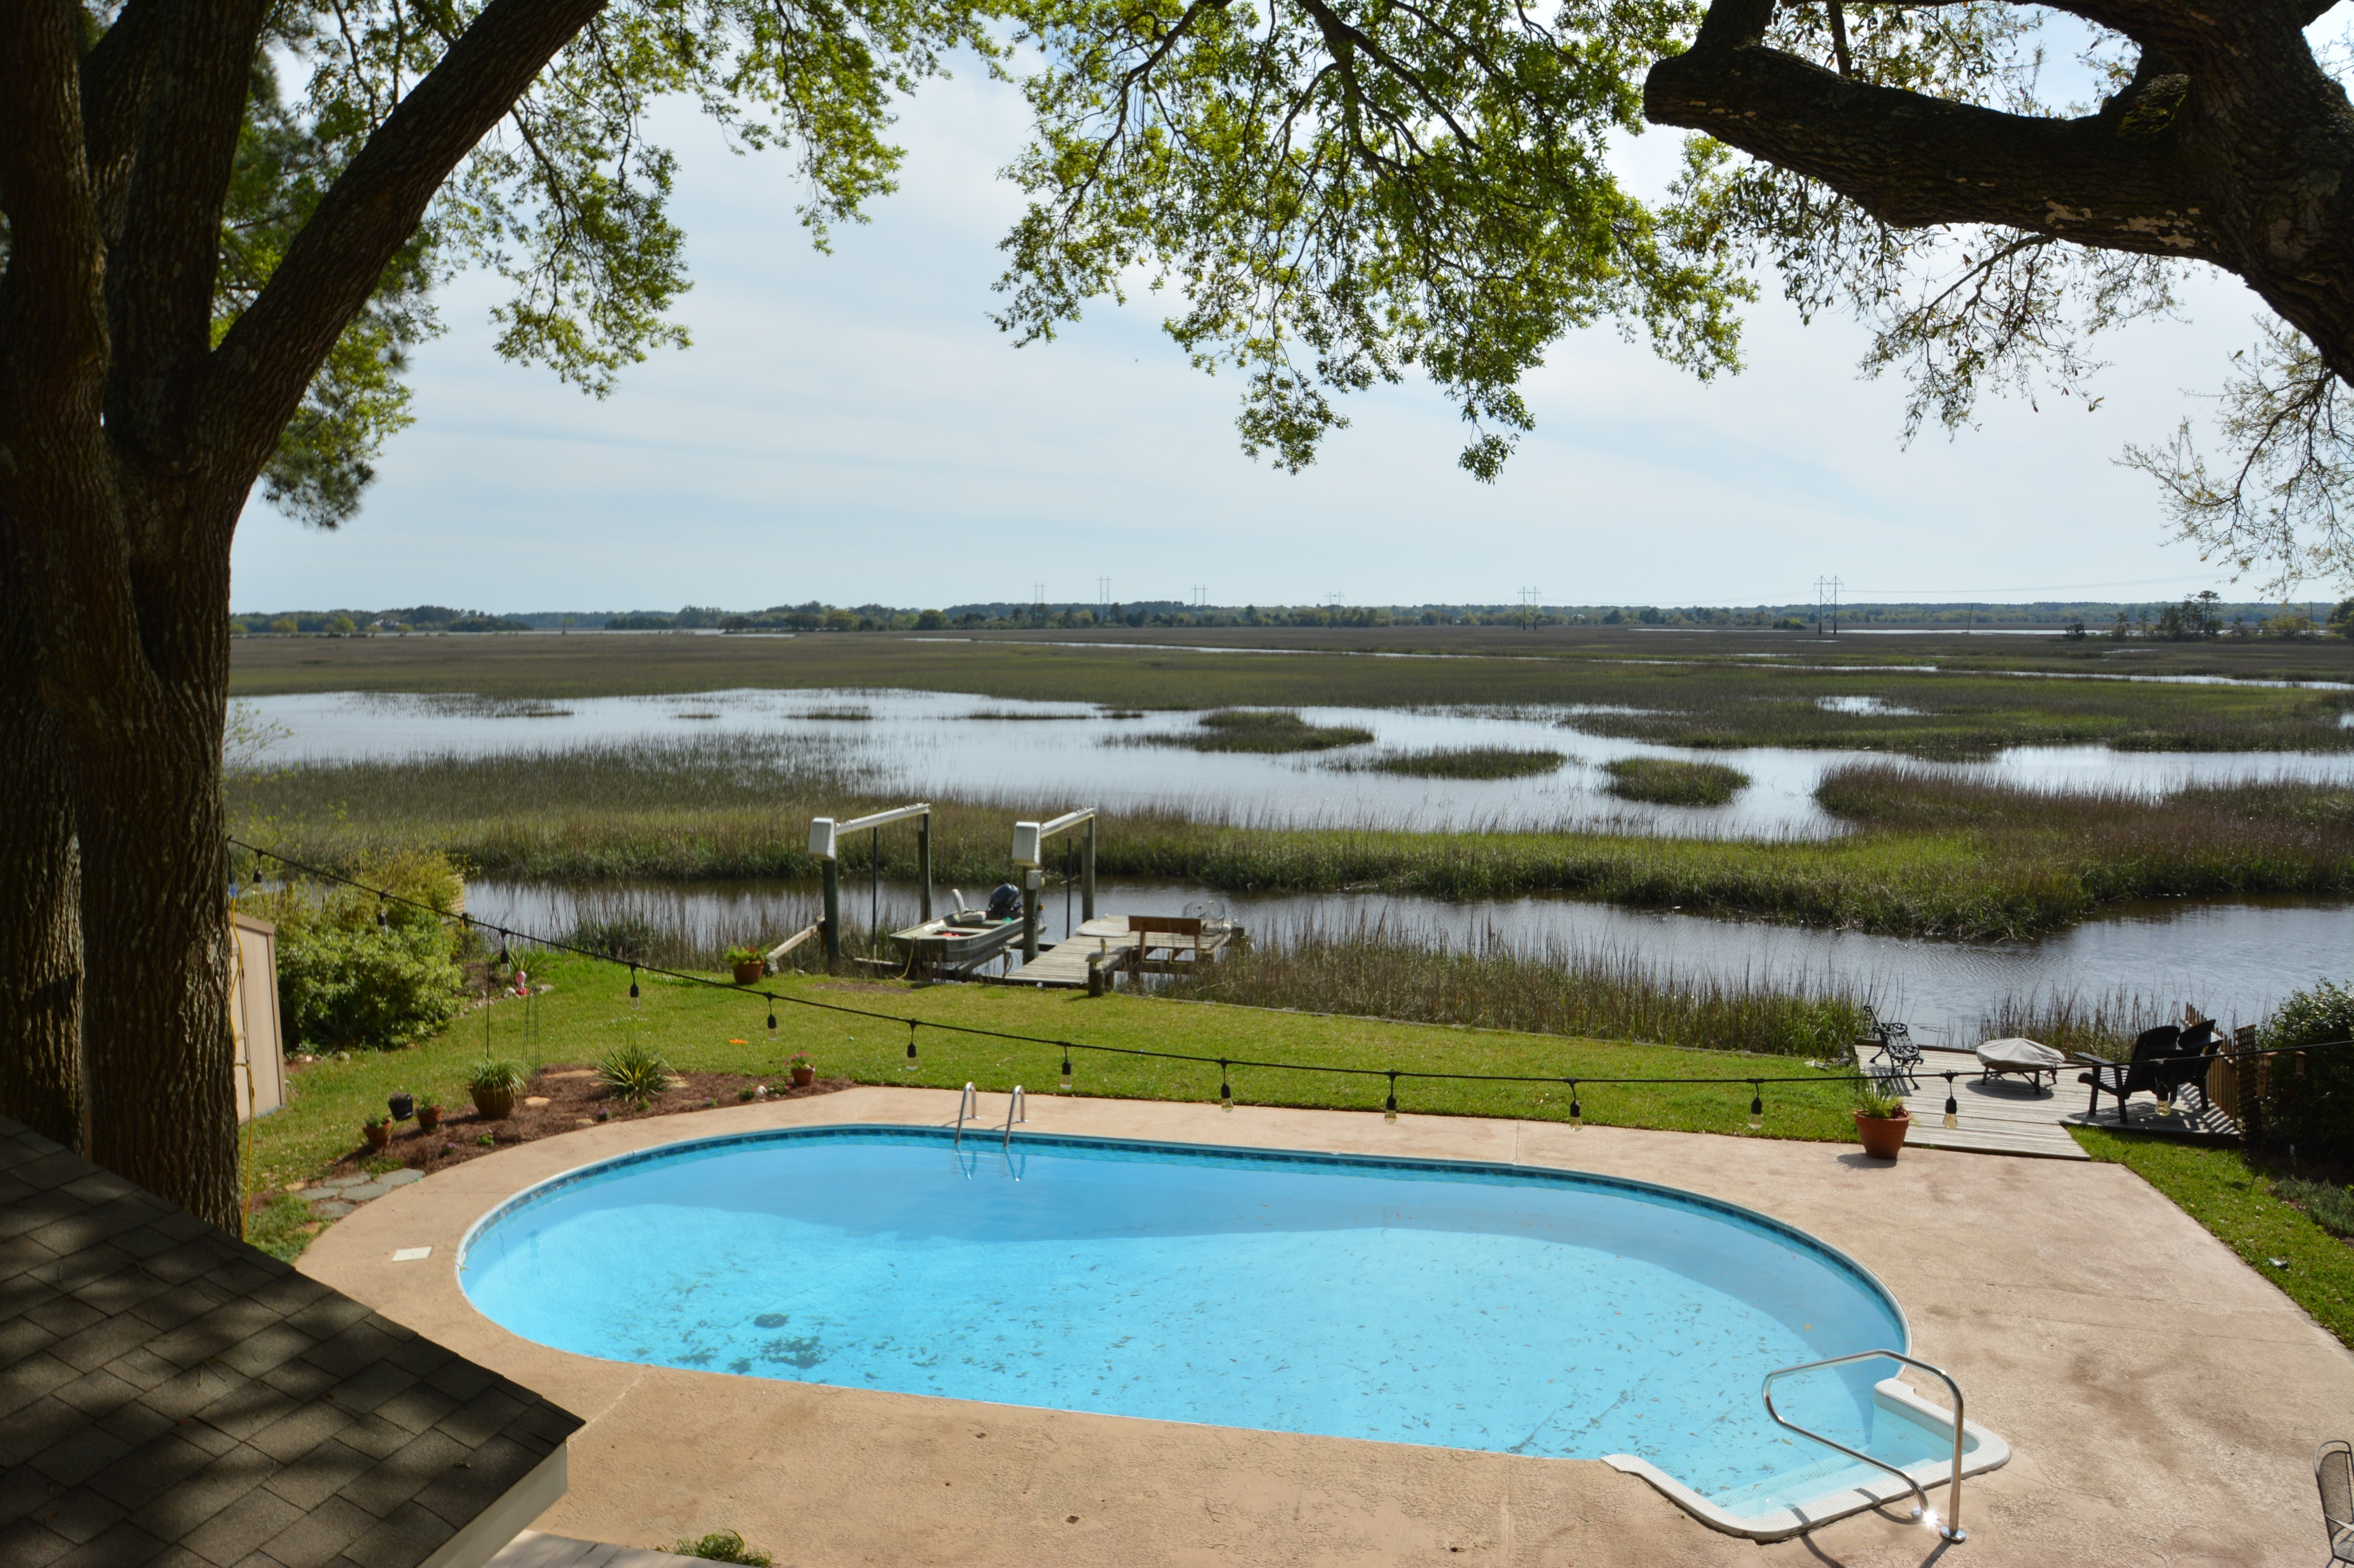
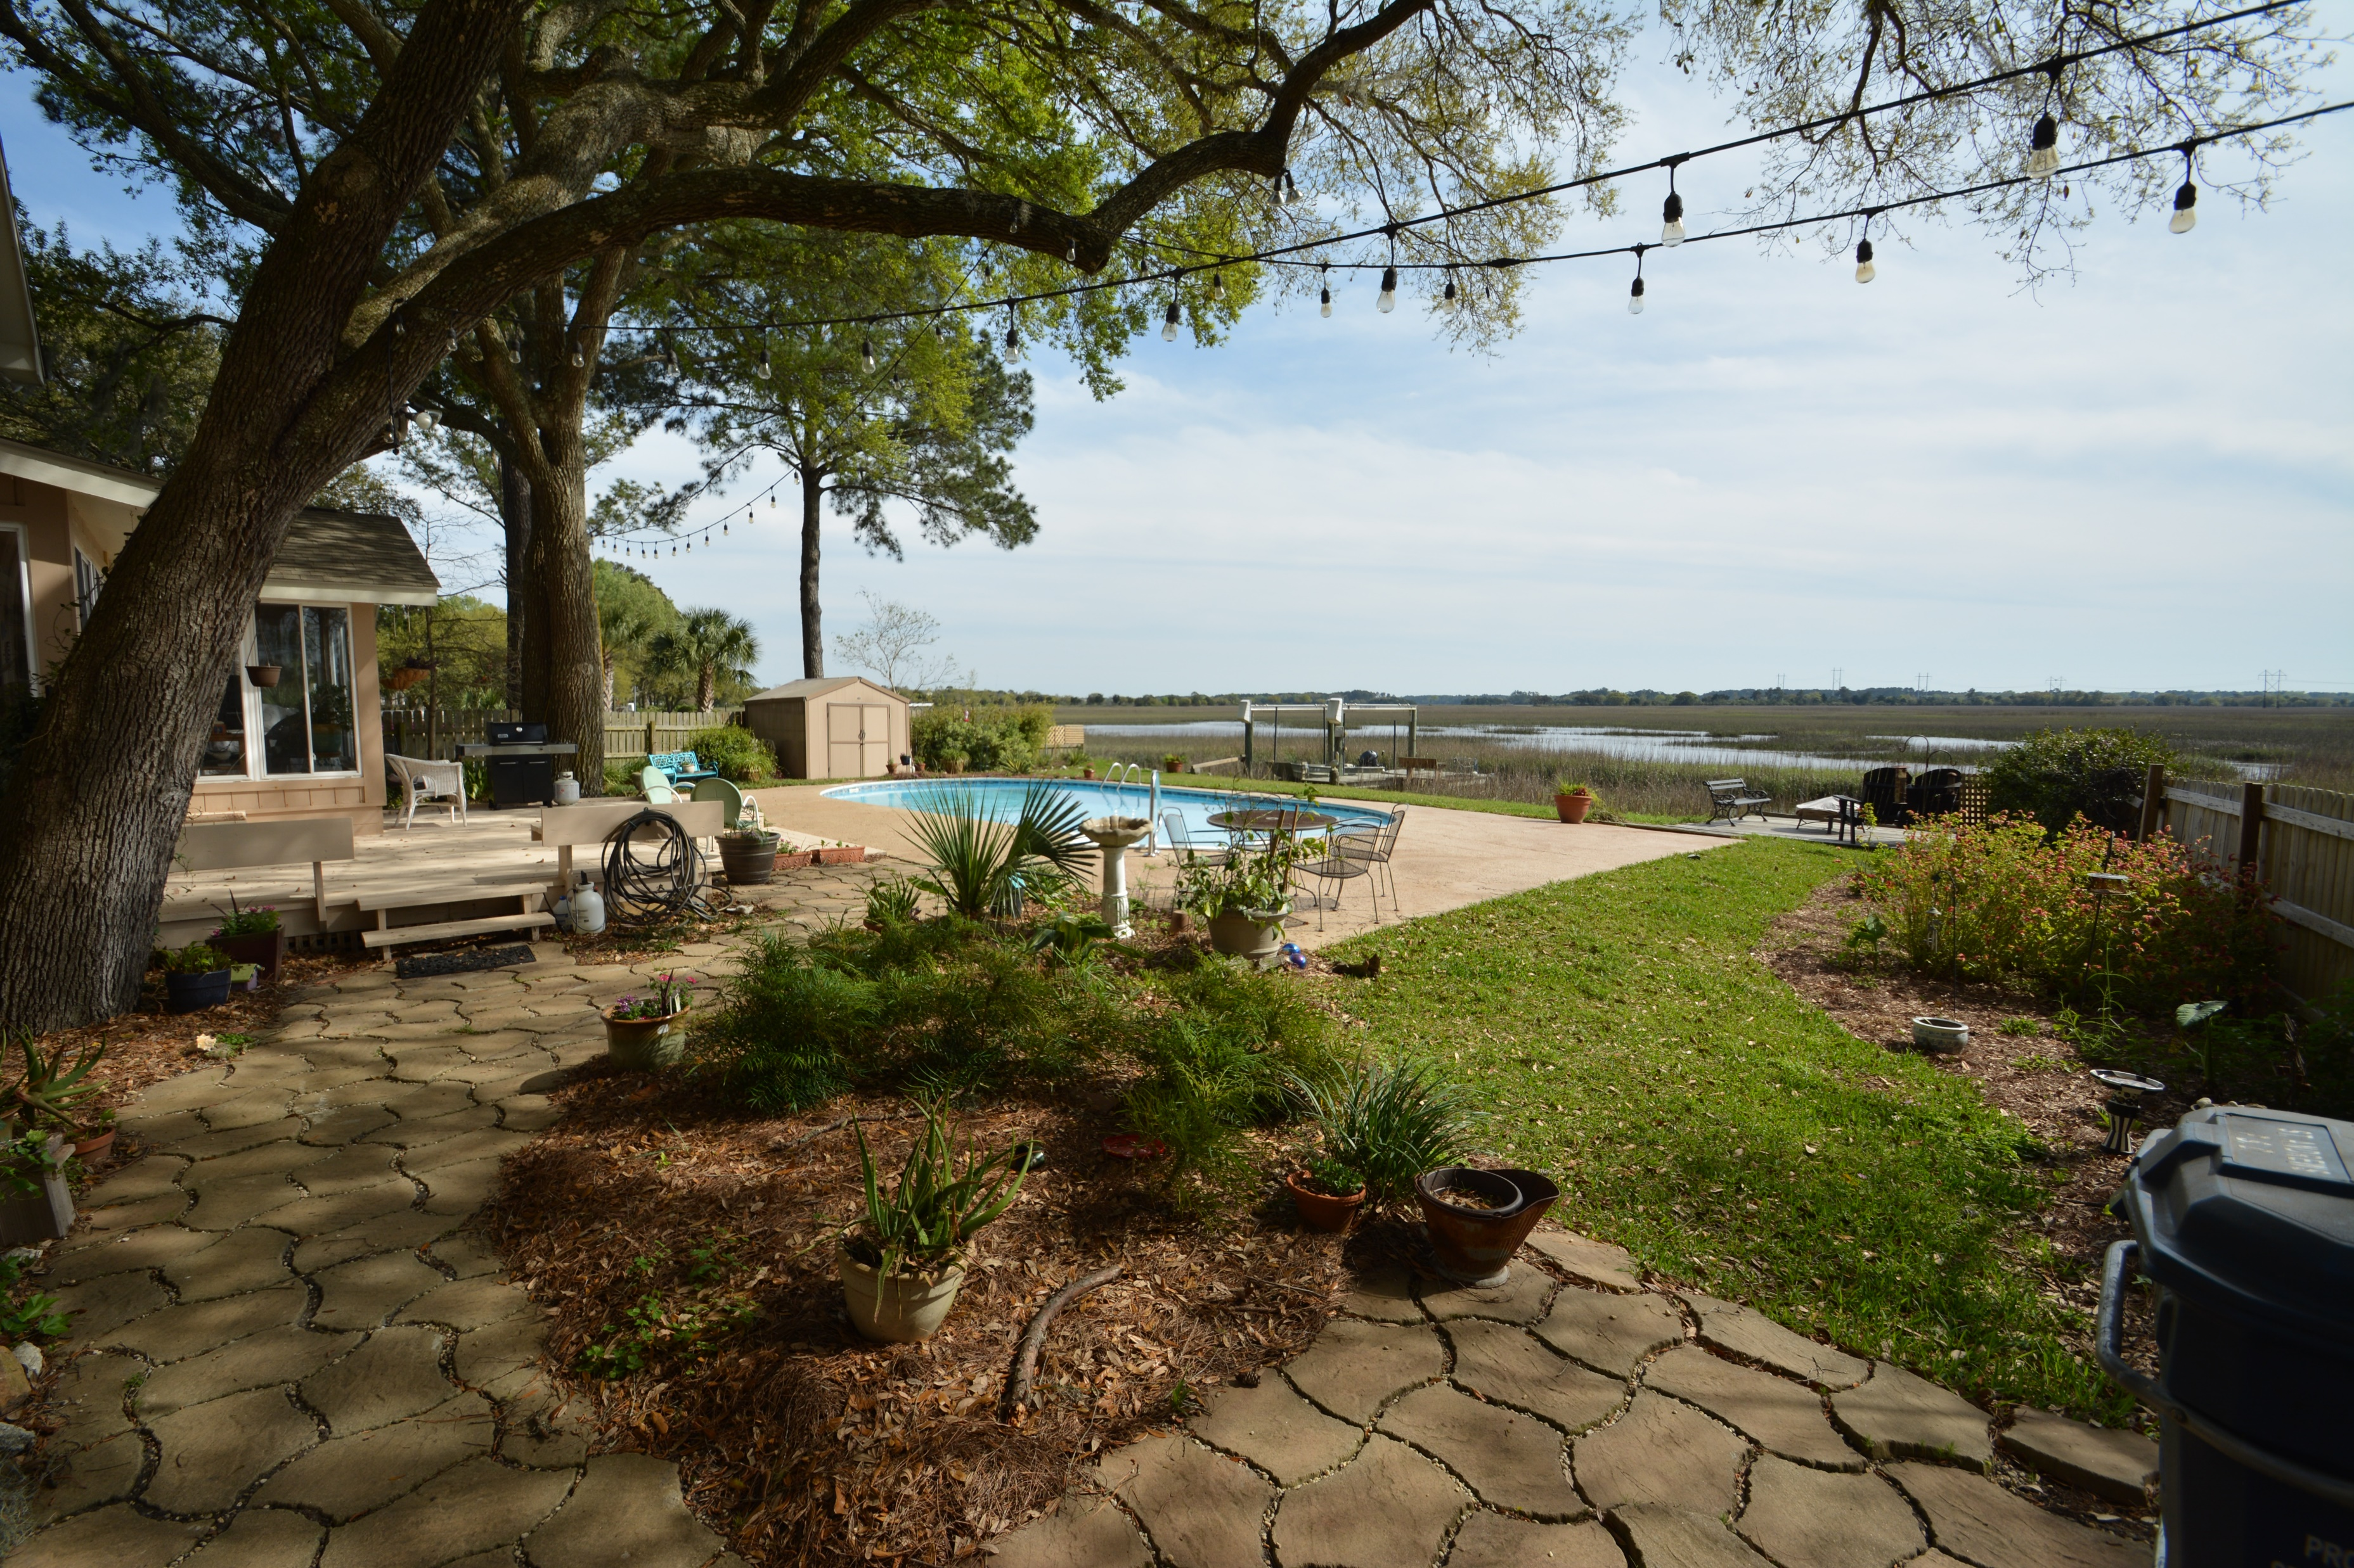
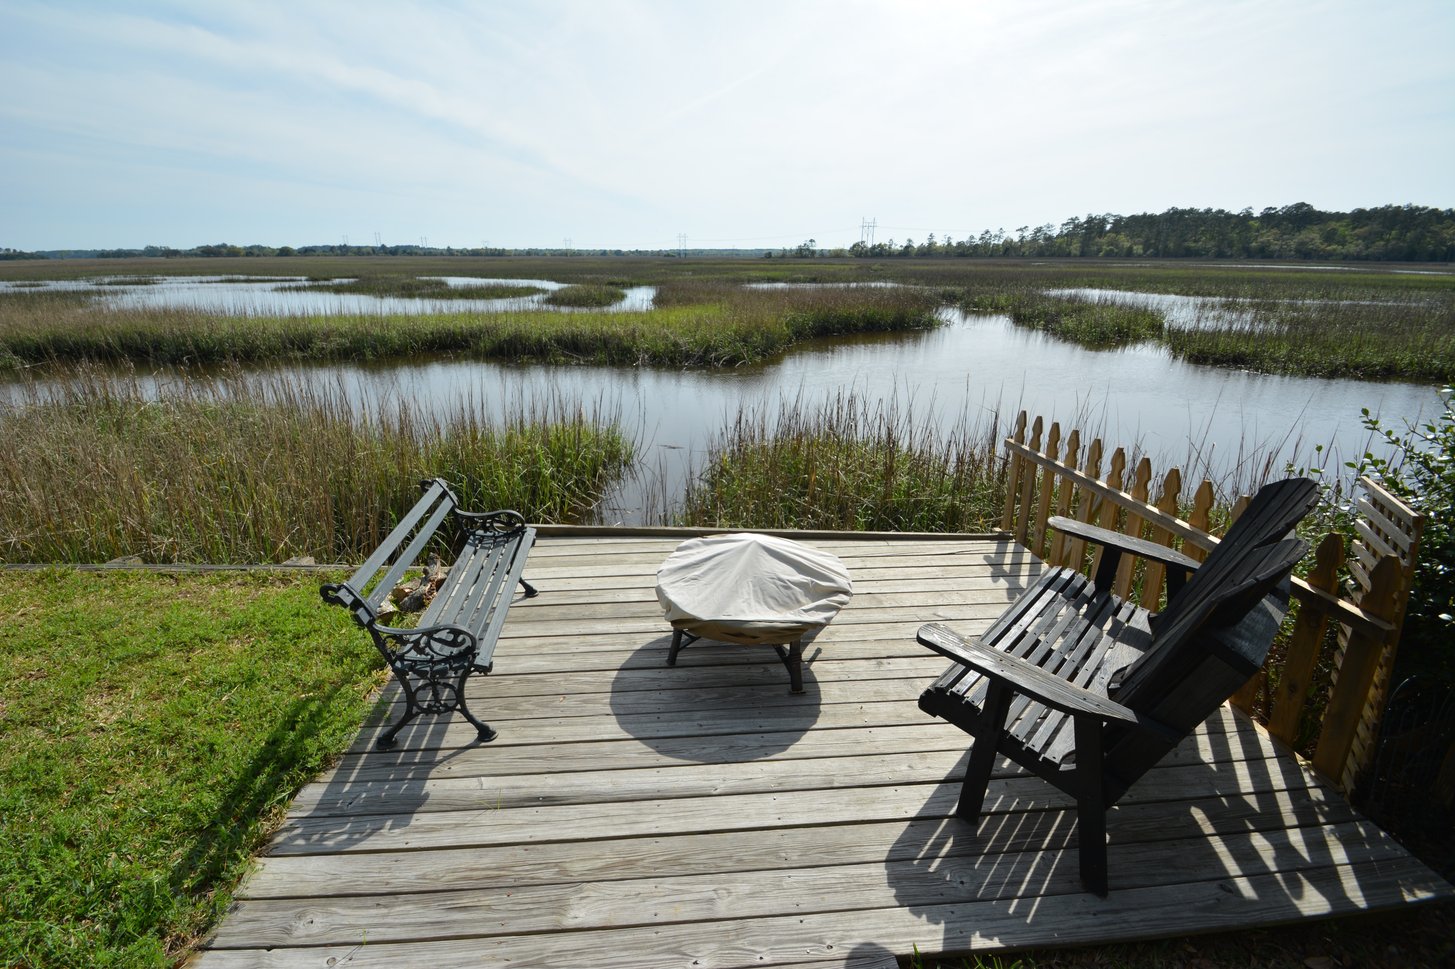
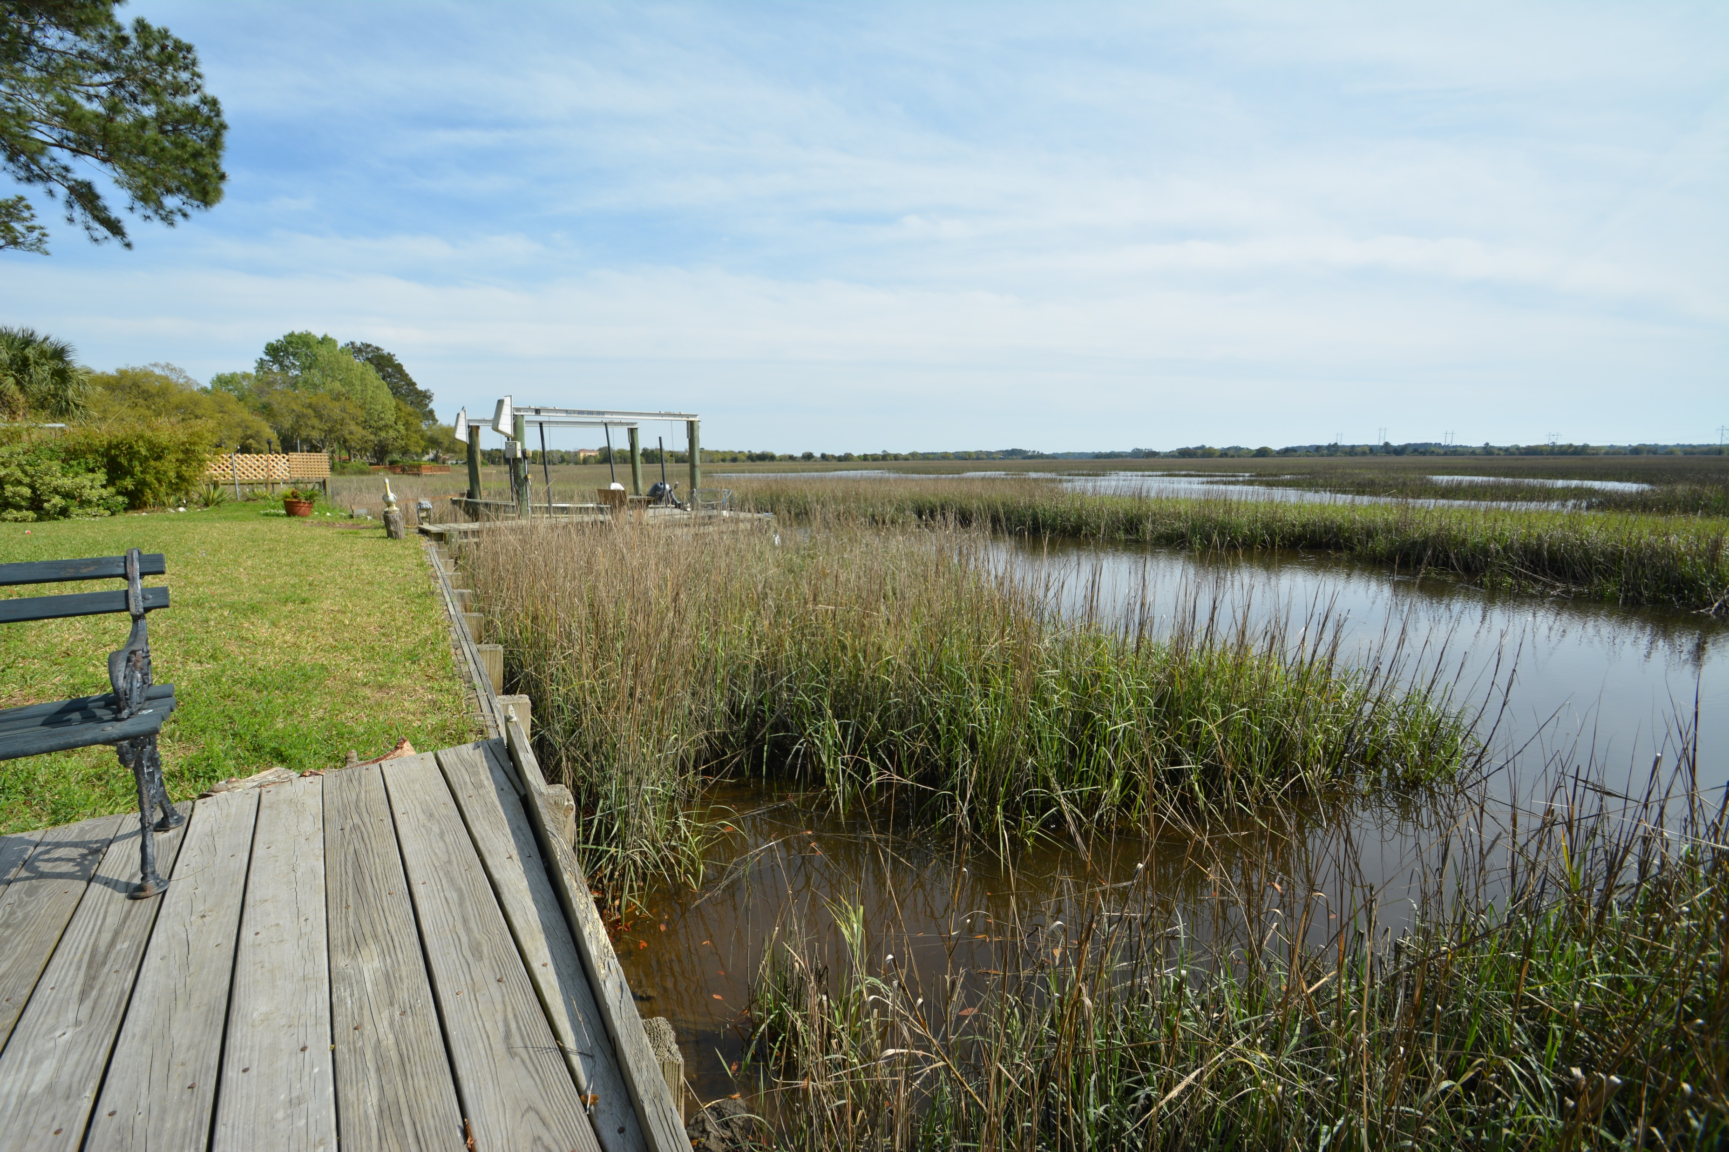
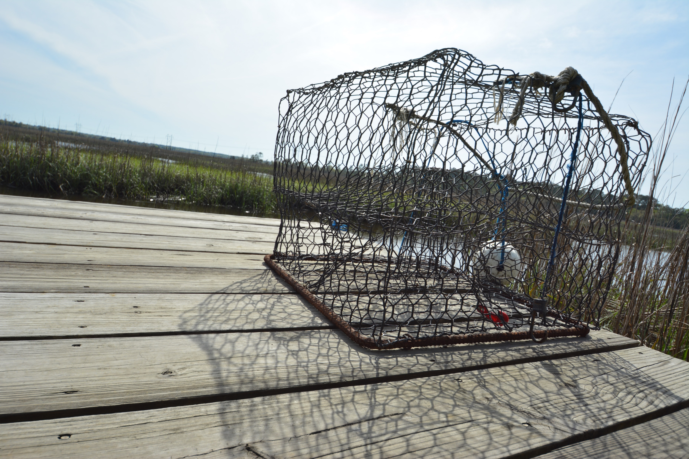
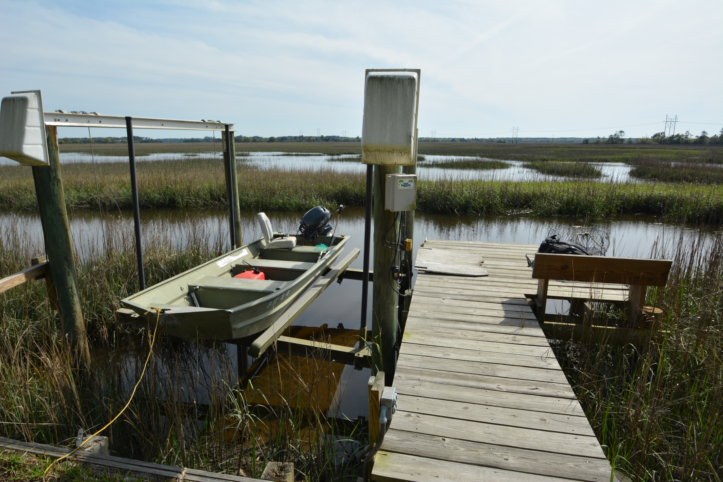
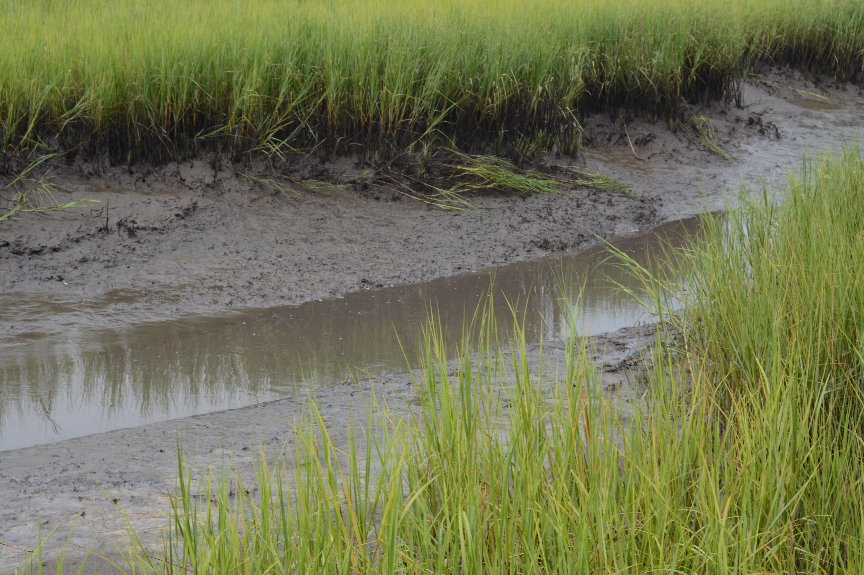
Charleston Waterfront Living at its Finest!
2513 Two Oaks Drive
Sylvan Shores ~ Charleston ~ MLS# 16008874
Great deck, patio and pool to relax all summer long. Boating, crabbing, fishing, watching wildlife all from your backyard! Enjoy dolphins and a variety of bird species including egrets, herons, pelicans, osprey, and eagles.
From the backyard enjoy panoramic views and sunsets! At mid – high tide you can navigate a short distance to the Stono River (Inter-coastal waterway). Dock with boat lift included. Sea wall borders the property.
Patti Nickerson
(843) 312-7478
pattinickerson@hotmail.com
4 Carriage Lane Ste 106
Charleston, SC 29407

