Slide 1
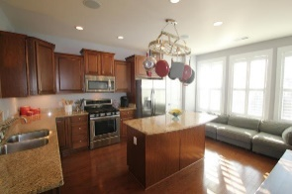
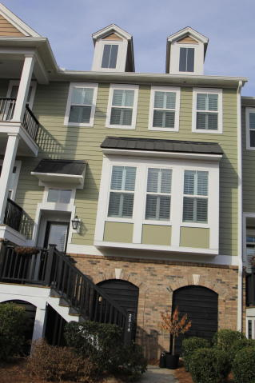
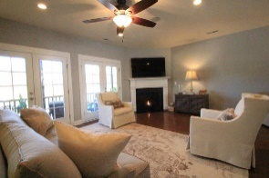
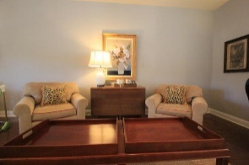
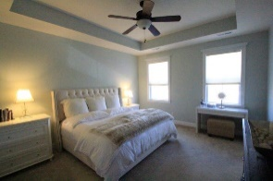
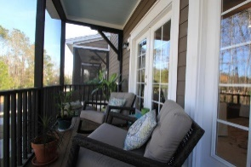
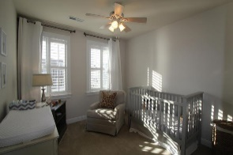
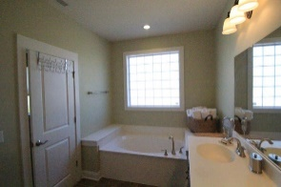


Motivated Seller says “SELL! SELL! SELL!”
2514 Rutherford Way Carolina Bay
Charleston, SC 29414
MLS# 17001263 ~ $299,999
Great home in Essex Farms, Carolina Bay. This home has all the extras you would want. Plantation Shutters throughout front of house. Entering the front door you walk into a nice foyer with stairs leading to 1st floor. Entrance door to Garage with lots of extra storage space is located at the end of Foyer. Upstairs you see an impressive kitchen with Granite Counters, Stainless Steel Gas Stove/Oven, Microwave, Refrigerator, Dishwasher and Wine Cooler. Next walk into your separate dinning area that leads into the Great room with a gas log fireplace. Upstairs you will find 3 bedrooms, a large Master with tray ceiling, dual vanities, garden tub, separate shower and large walk in closet. The 2 nice size bedrooms share a full bathroom. Don't delay, house is priced right in a very desirable neighborhood.
Andrea Giorno
ayvonnegio@gmail.com | 704-575-2463 | www.bnre.info
Brand Name Real Estate | 4 Carriage Lane, Suite 106 | Charleston, SC 29407

