Slide 1
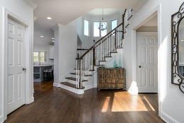
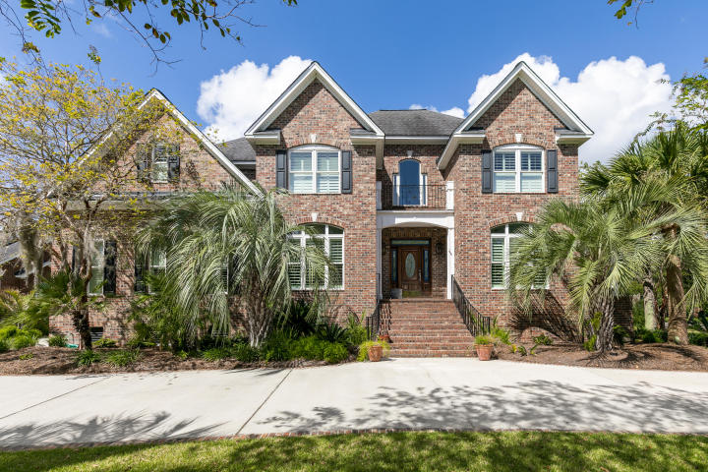
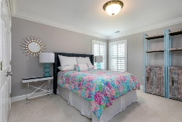
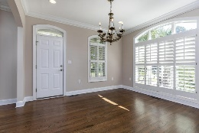
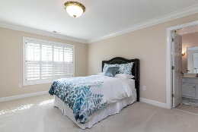
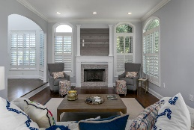
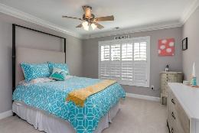
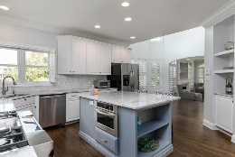
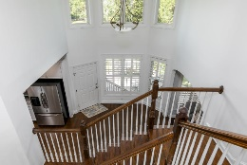
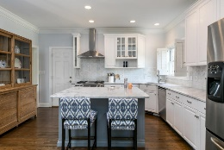
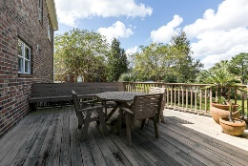
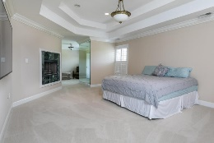
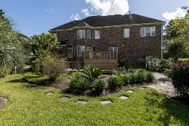
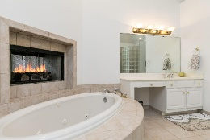
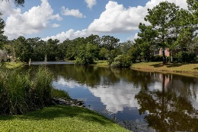

Brokers Open House ~ Thursday Nov 2 ~ 11:30a-2p
Drawing for $50 Gift Card ~ Lunch Provided By Jim and Nicks BBQ
2516 Mahan Court
Brickyard Plantation ~ Mount Pleasant ~ MLS# 17027025 ~ $790,000
4 Bedrooms
2 Fireplaces (One In Master Bedroom)
Elevator
Gas Cooking With Commercial Grade Oven
Heavy Landscaping
Pond View
Corner Lot
Approx. 3200 Sq Ft
Quartz Kitchen
3 Car Garage
Therese Jenkins
(843) 568-9748
therese@beautifulhomesllc.com
Beautiful Homes Realty
130 River Landing Dr #7322
Charleston, SC 29492
www.beautifulhomesllc.com

