Slide 1

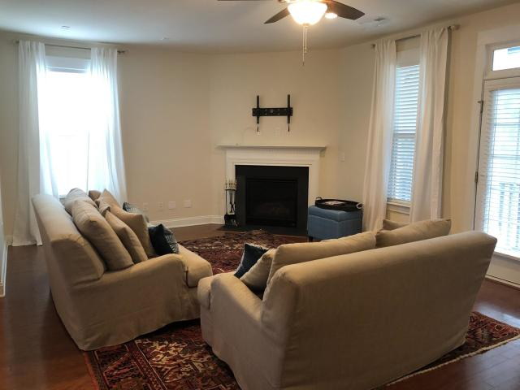
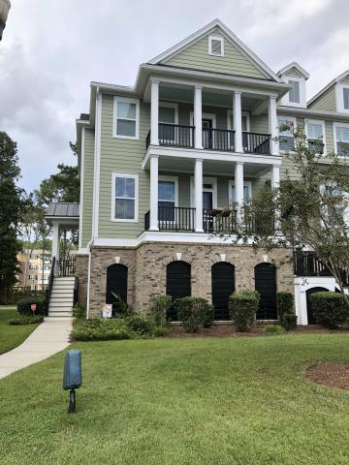
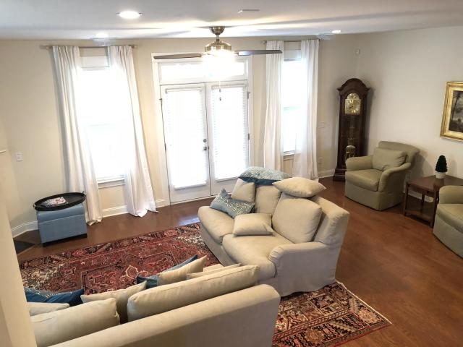
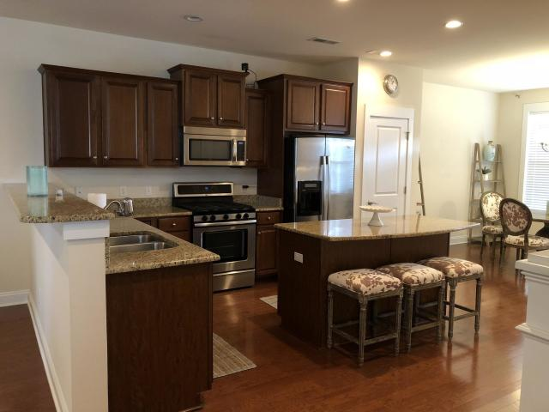
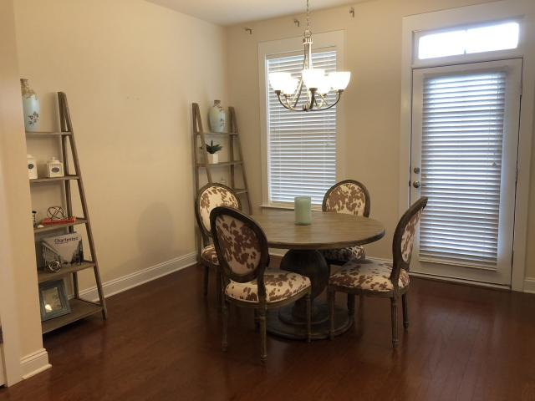
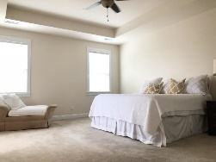
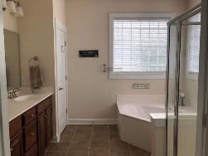
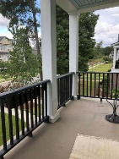
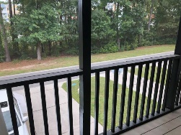
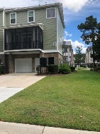
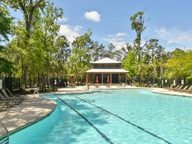
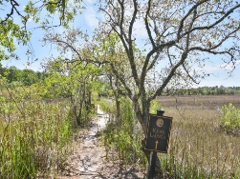

Open House & Luncheon
Tuesday Oct 30th ~ 11:30a-1:30p
Pam Bass
Realtor
M 843-259-4926 | O 843-277-6677
pam@pambassproperties.com
www.pambassproperties.com
2516 Rutherford Way | Carolina Bay | Charleston | MLS# 18025426 | $322,500
PRICE REDUCED on this Beautiful 3 BR 2.5 BA end unit townhome in the desirable Essex at Carolina Bay Neighborhood. This upscale townhome has an open floor plan with gleaming hardwood floors, a huge 25'x15' family room with gas fireplace and French doors that lead to the screened in porch. The well appointed kitchen features stainless steel appliances, granite countertops, gas range, a large center island and a pantry. Also on the 2nd floor is an office/library. All 3 bedrooms are located on the 3rd floor. The Master bedroom has trey ceilings, a luxurious master bath with a garden tub, dual vanities and a separate shower. There is another porch upstairs that is perfect for relaxing in the evenings. This unit has a new HVAC unit and the exterior has recently been painted.
There is also a large 2 car garage with tons of storage and a double driveway, not to mention it is on one of the larger lots in the development. There is already an elevator shaft so it would be easy to have an elevator installed. The neighborhood offers a zero entry pool, walking trails, playground and kayak launch. This townhome is conveniently located minutes away from downtown Charleston, hospitals, restaurants, shopping and only a short drive to local beaches! At this price it won't last long! Move-in-ready condition!
Coldwell Banker Residential Brokerage | 4969 Centre Pointe Dr. Ste 203 | Charleston, SC 29418

