Slide 1
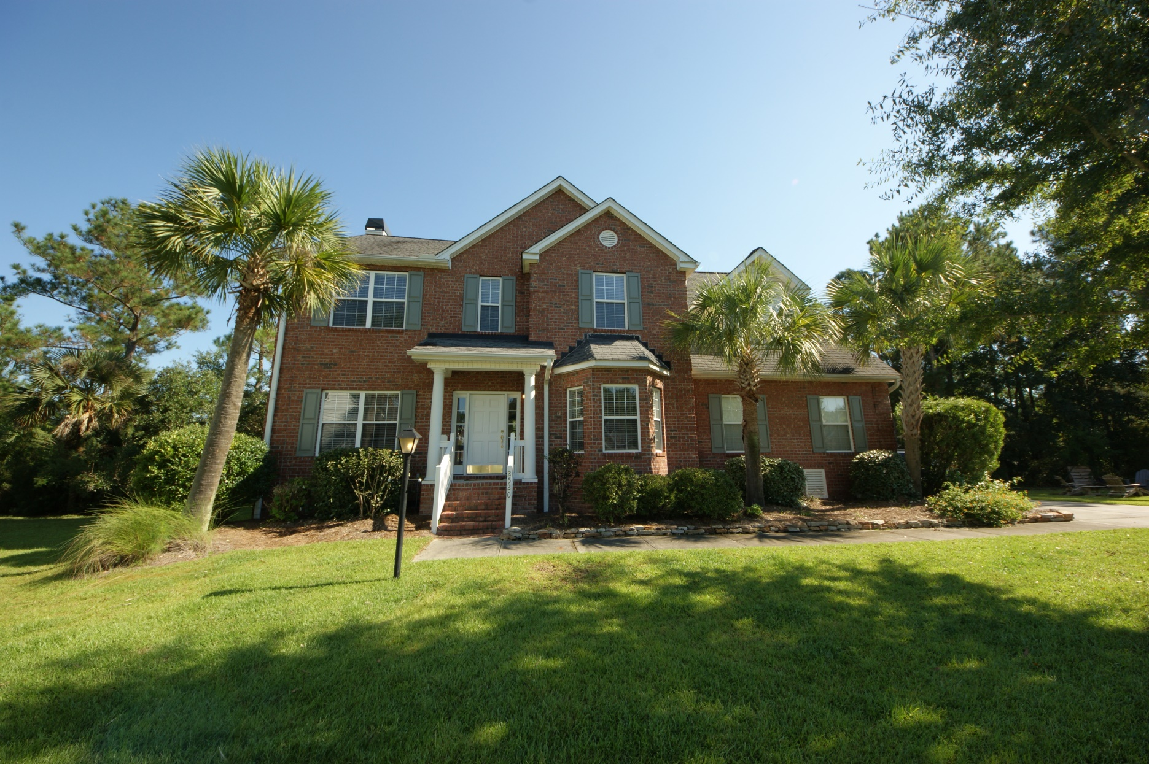
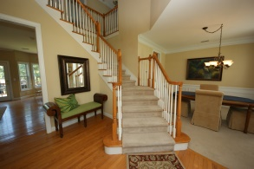
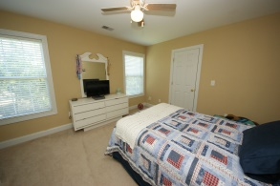
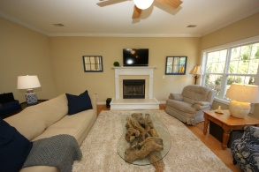
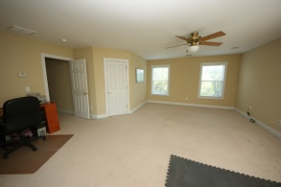
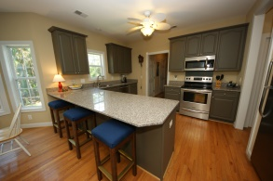
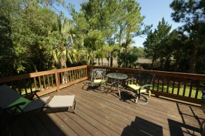
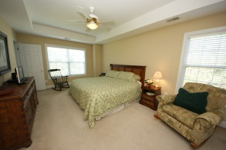
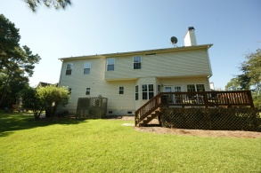
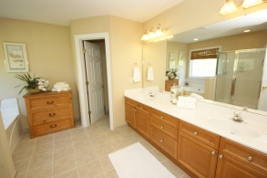
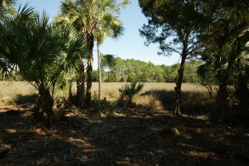
Open House
Saturday 1-3p
2520 Deer Walk Way
Dunes West
Mt Pleasant
MLS# 1426120
$514,400
This open concept 4 bedroom home sits on a .61 acre lot located on a cul-de-sac within the security of the gated community of Dunes West. This home features a beautiful marsh view and open concept living. The kitchen has been updated just this year. Custom finished cabinets, granite countertops and stainless steel appliances are all featured. In addition to the four bedrooms there is a spacious finished bonus room over the garage. The master suite features two closets a beautiful tray ceiling and on suite bath. The bath includes a double vanities , separate tub , shower and private water closet. Wont last long at this price!
David Carroll
843-564-3308 | tristr33@aol.com
Brand Name Real Estate | 207 East Bay Street Ste 311 | Charleston, SC 29401

