Slide 1
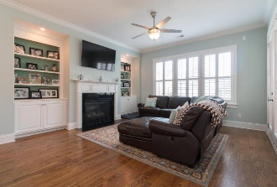
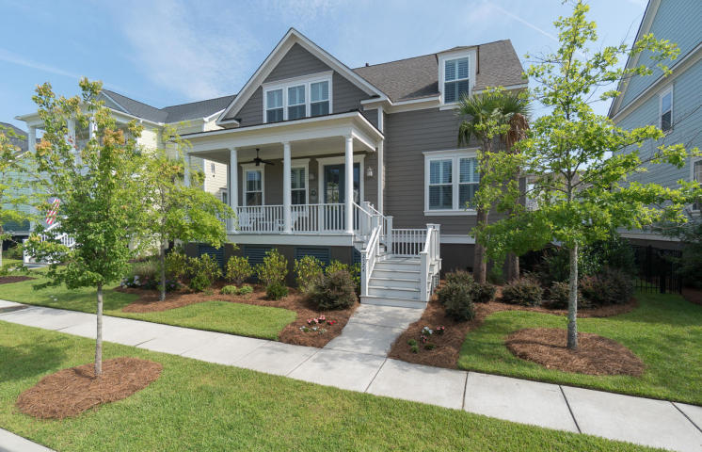
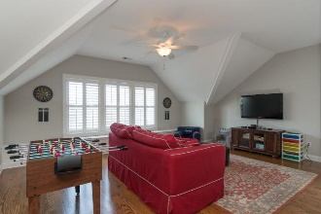
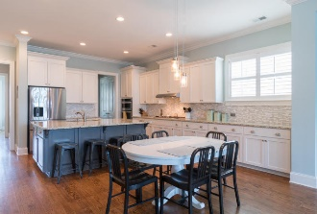
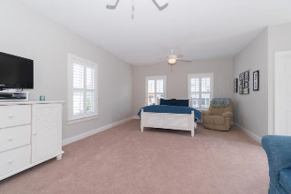
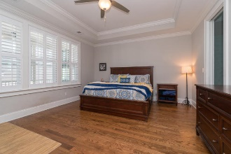
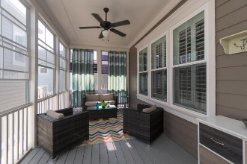
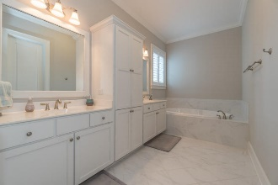
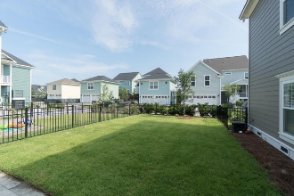

2524 Gatewood Street
Smythe Park ~ Charleston, SC 29492
MLS# 16016204 ~ $835,000
Get Out Of The Heat & Into A "Cool" Daniel Island House
OPEN HOUSE SUNDAY 1-4 PM
Built in 2014
5 BR 3.5 BA
3574 SF
Homeowners have added Plantation Shutters, Custom Lighting, Built-ins in Bedrooms, Made Screened Porch All Season with Panels, No Maintenance Aluminum Fence, New Sod in Back Yard and Freshly Painted Interior.
Great location on Daniel Island. Bring your clients.
Hard to find with GPS because newer portion of Daniel Island. Daniel Island Drive Past School and Smythe Park, to Wando Landing to Louisville to Gatewood.
Donna Landry
Mobile - (225) 921-2111
donna.landry@cbcarolinas.com
Betsy Sarsfield
Mobile - (843) 608-1048
betsysarsfield23@gmail.com
Coldwell Banker Residential Brokerage | 35 Broad St | Charleston, SC 29401 | www.thebestincharleston.com

