Slide 1
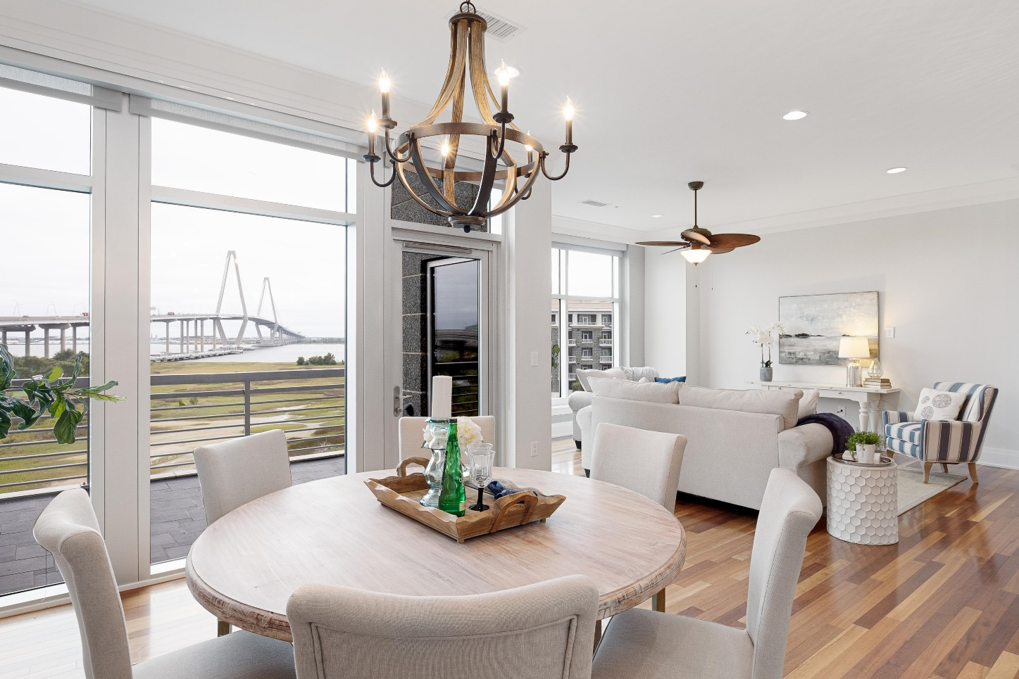
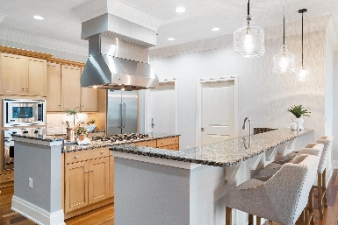
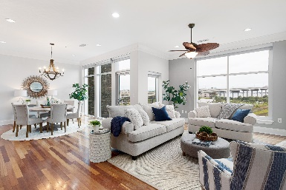
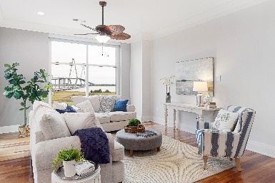
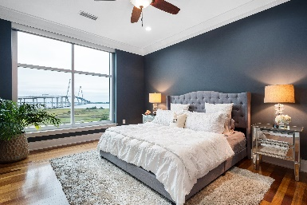


252 Cooper River Drive Tides Condominiums · Mount Pleasant, SC 29464 MLS# 19028694 · $947,000
MAJOR PRICE IMPROVEMENT ~ $153,000 PRICE DROP!
Currently the lowest priced 2 bedroom unit at the Tides. Stunning views of the Cooper River from your Living Room. This 5th floor condominium offers a front row seat to the Ravenel Bridge, one of the tallest cable stayed bridges in North America! Accessed by elevator opening directly into the unit, enjoy privacy and security while living the carefree lifestyle of The Tides. This unit has dedicated garage parking below equipped with an outlet for electric charging, resort style amenities and a full-time staff meticulously maintaining the grounds. The large gourmet kitchen has a 6 burner gas cooktop and Viking appliances. This unit has a new HVAC system and water heater and custom blinds.
Bill Trull
(843) 343-2175
bill.trull@carolinaone.com
Carolina One Real Estate | 195 W Coleman Blvd | Mt Pleasant, SC 29464-3495

