Slide 1
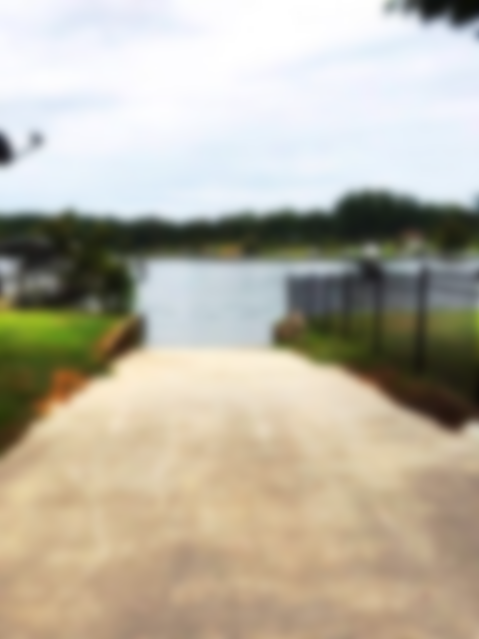
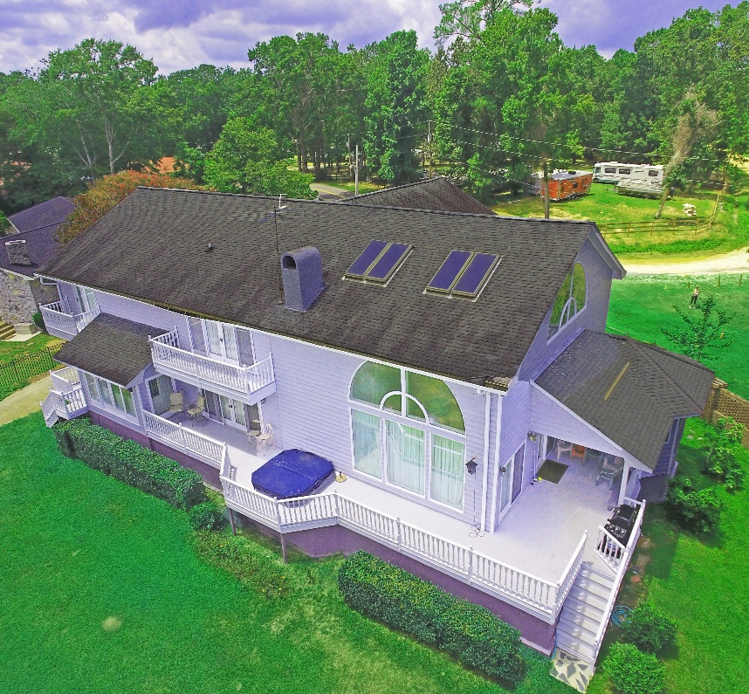
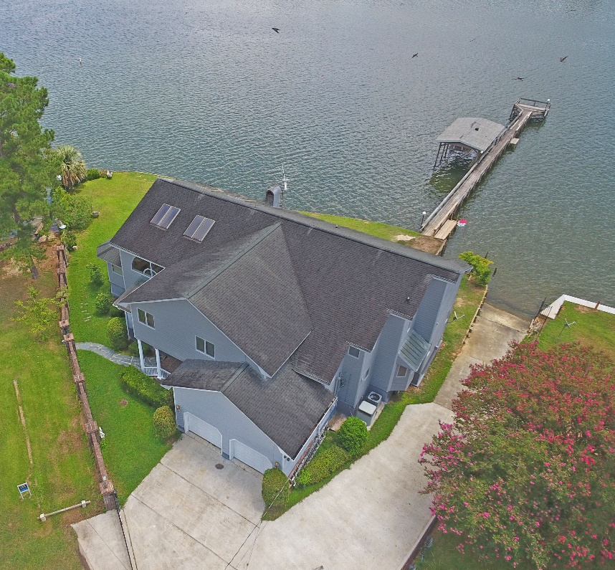
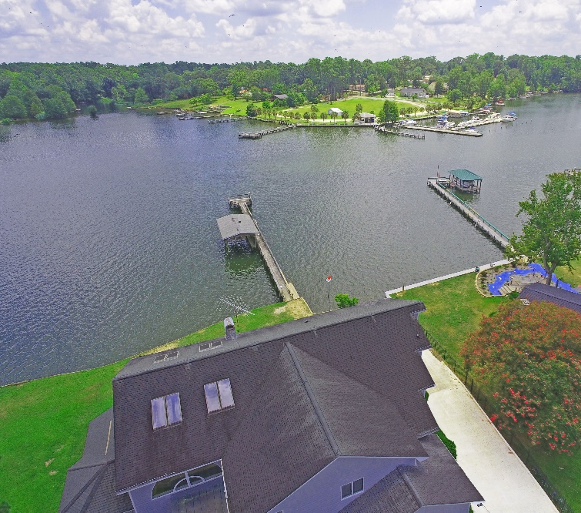
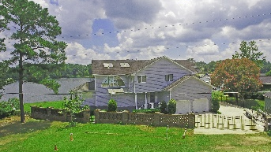
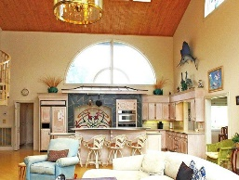
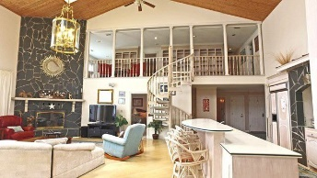
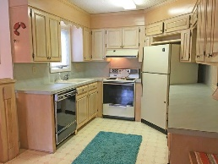
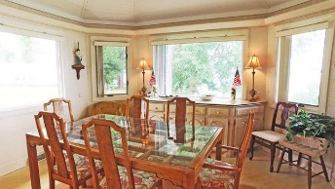
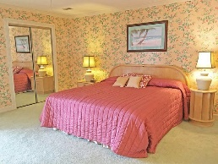
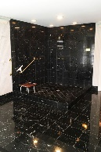
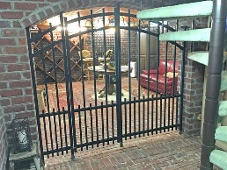
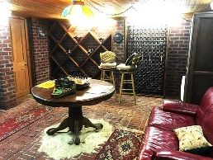
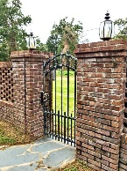
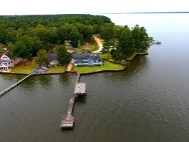

Make Lake Marion Yours!
252 Lake Marion Ln
Vance, SC 29163 ~ MLS# 17024598 ~ $597,000
Lake Marion panoramic views from 2 story glass windows in the main living area.
Home offers 6 bedrooms/3.5 bath. Can be closed off into a MIL suite with separate entry offering a 2 bedroom apartment. Enclosed basement for your workshop and dry storage. Enjoy a day on the lake with a bottle of wine from your own wine cellar. Has dock, ramp and boat lift in place. Words do not describe -Must SEE!
Lake Homes Realty, LLC
Elloree, SC 29047
www.SCLakeLife.com
Kristie Anderson
(803) 387-9459
kristie@sclakelife.com

