Slide 1
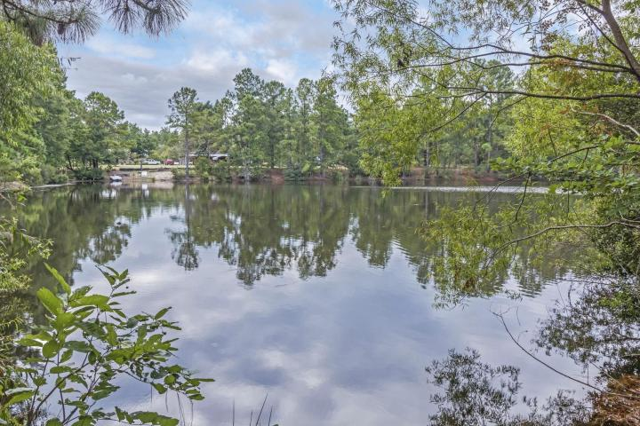
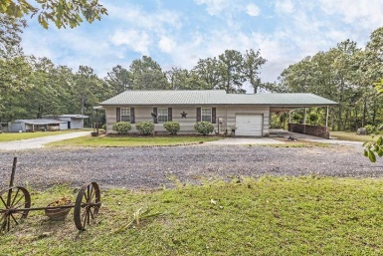
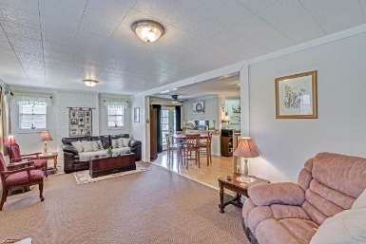
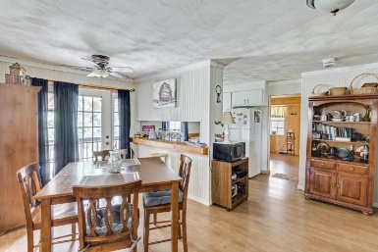
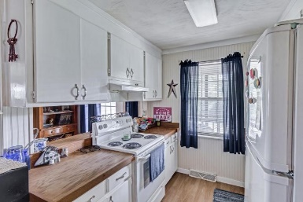
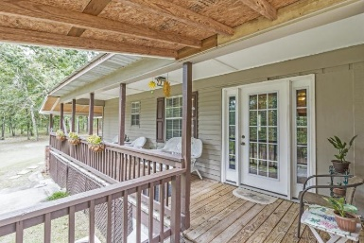
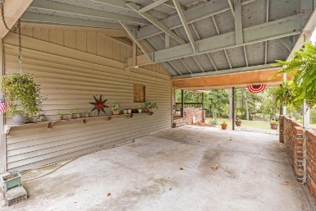
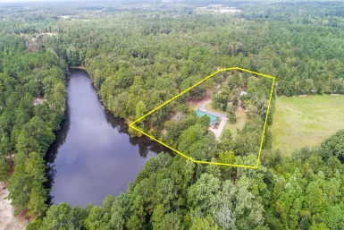
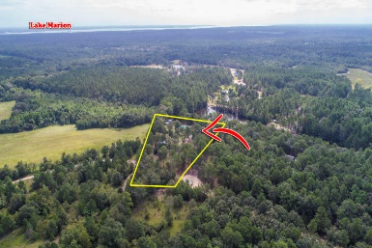


252 Tarpon Court Elloree, SC 29047 MLS# 17024307 | $167,500
Adorable 3 Bedroom Home on 4.2 Acres!
SELLER OFFERING $2500 TOWARDS CLOSING COST AND A ONE YEAR HOME WARRANTY!
This is the one! Adorable ranch style home offering 3 bedrooms, 2 full baths, over 1300 sq. ft., seclusion, and privacy! Peaceful tranquility at it's best! The home is centered on a gorgeous 4.2 acre tract and backs up to a large 11 acre community pond! You will love the cozy feeling this home has to offer! Whether you are purchasing your first home or looking to downsize, this home is the perfect choice! Whether it's relaxing in the cozy living room area after a long day at work or sitting on your back porch enjoying all the best mother nature has to offer, you are going to LOVE living here! This homes offers a large laundry room area, an adorable kitchen space, spacious bedrooms, large living room area, and more! There are two outbuildings on the property offering plenty of storage space. The first building measures 30 x 25 with cement floors, power, and a 15 ft. covered parking area. The second building measures 24 x 24 with power, cement floors, and a 2 car garage door.
Like to fish or kayak? You will enjoy activities such as this on the large 11 acre community pond! Want to go to the lake? You are located less than 5 minutes from Lake Marion, the largest fresh water lake in SC! With this home you get the best of both worlds all in one spot! Located less than 10 minutes from Santee and just over an hour drive to Charleston or Columbia! Hurry, this one will not last long, schedule your exclusive showing today!
Brandon Ray
(843) 499-1928
brandon.ray@carolinaone.com
www.therightrayhome.com
Carolina One Real Estate
900 N Main St
Summerville, SC 29483

