Slide 1
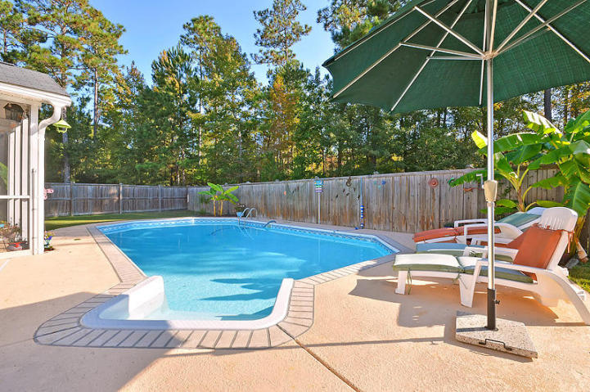
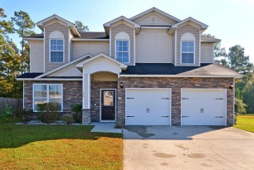
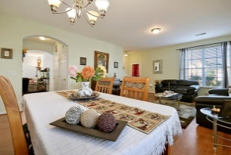
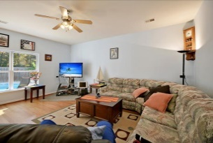
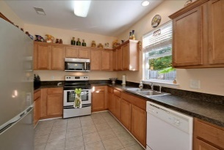
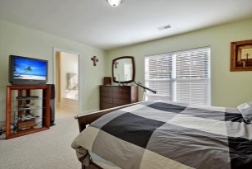
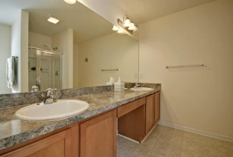
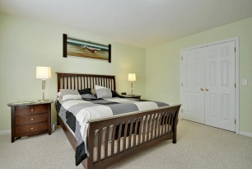
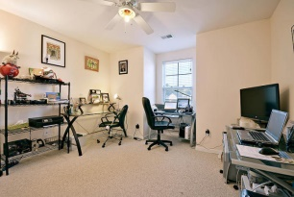
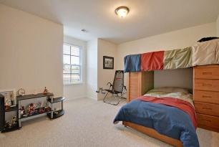
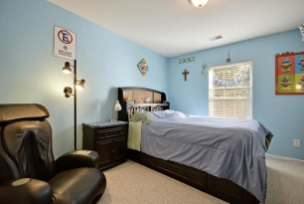
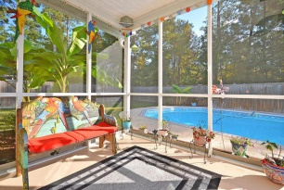
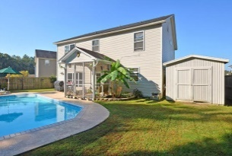


Backyard Paradise in Summerville!
252 Westbrooke Road
Felder Creek
Summerville, SC 29483
MLS# 14028091
$225,000
4 Bedrooms | 2½ Baths | 2,347 sf
Welcome home to this like new home ready for you to move in and make your own! A pool lover's paradise awaits you in the backyard. Privacy abound, step foot in 32.5'X16' SALT WATER pool which goes from 3-6 feet deep. Tons of privacy as this home backs to woods. Also in the backyard you'll find a 14X16 Storage shed and a patio. Stepping back in to the home you'll see a great screened in porch overlooking the pool. In the eat in kitchen you'll find tile flooring and stainless steel appliances. 9 Foot ceilings, hardwood floors, separate living and dining rooms as well as a large family room overlooking the pool completes the first floor. Upstairs you'll find a nice size master bedroom with large walk in closet, master bath with dual vanities as well as a garden tub and separate shower. There are three additional good size bedrooms upstairs as well as a full bath and laundry. Finishing off the second floor is a loft area, perfect for use as an office space or media area. This home is a must see! Great location, just minutes from I26 and a gorgeous pool to come home to every day! Perfect for entertaining!! Come take a look at this house today!!
Larry & Kathy Mazalatis
Larry Cell 843-693-0529
Kathy Cell 843-693-0159
Office 843-871-9133
AGENTOWNED PREMIERE GROUP | 1800 TROLLEY RD | SUMMERVILLE, SC 29485

