Slide 1
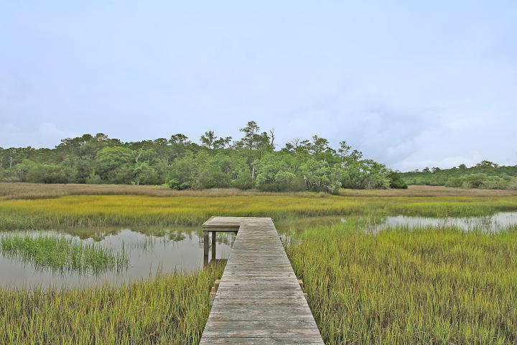
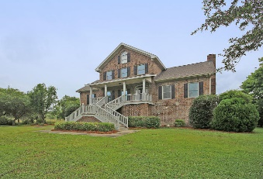
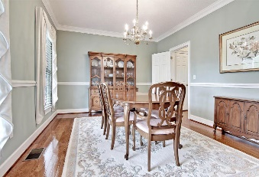
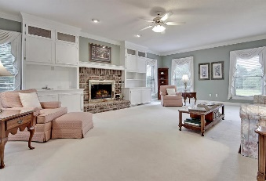
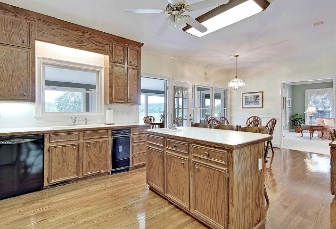
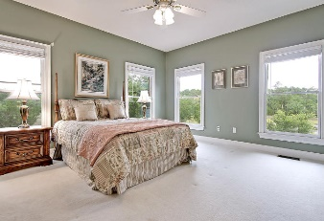
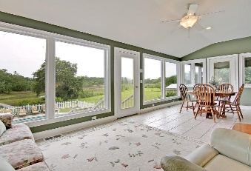
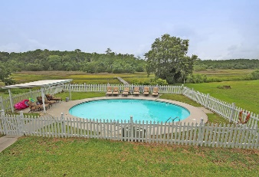
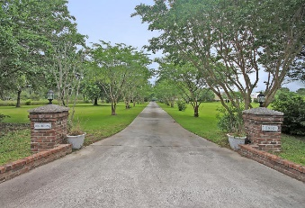


Come And See The Best Value On Johns Island!!!
2530 Royal Oak Drive
Royal Oaks
Johns Island
MLS# 16015479
Price Reduced to $585,000
A Distinctive fully detached 2 story elevated brick home situated in the quiet and exclusive Royal Oaks subdivision, surrounded by a private 2.45 acres of high ground on a tidal creek lot. This Exclusive home has 4 spacious bedrooms including the spacious first floor master bedroom suite that offers a large master bathroom with a relaxing tub, a separate walk-in shower and beautiful views of the marsh and tidal creek. There are several large rooms with authentic wood flooring on the main floor including an elegant formal dining room with classic chair railing and crafted crown molding, the family sized eat-in kitchen with crafted oak wood cabinets, built-in desk and appliances. The Valuable Great room is appointed with built-in book cases and a classic fireplace. There is a stylish sunroom with ceramic flooring and million dollar views of the marsh and tidal creek located just off the country kitchen. Enjoy the screened-in porch for outside relaxing or stroll down to the awesome in-ground pool that is surrounded by pool decking and a covered patio area. This Magnificent home offers a large garage capable of housing 5 cars. The home is priced for a quick sale. A pre-listing home inspection and a pre-listing appraisal is available upon request. Opportunity Knocks! Age, sqft, acreage, HOA fees, schools and taxes are approx. Buyers to verify.
Mason Thurber
(843) 709-5109
mason@theeverettgroup.net
RE/MAX Pro Realty, 9209 University Blvd, Charleston, SC 29406

