Slide 1
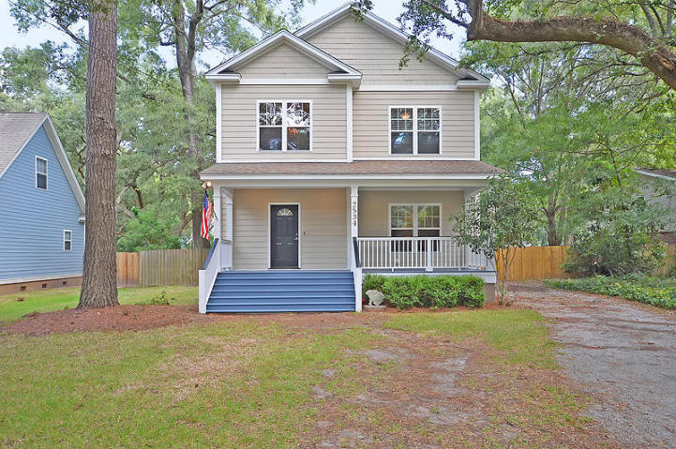
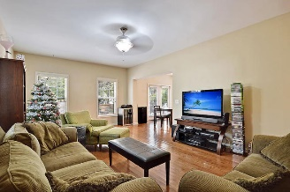
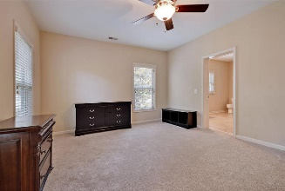
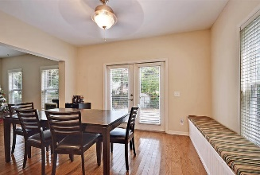
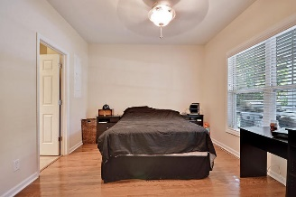
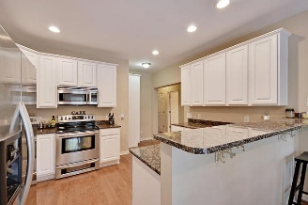
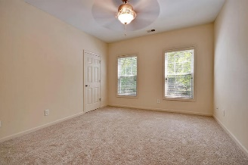
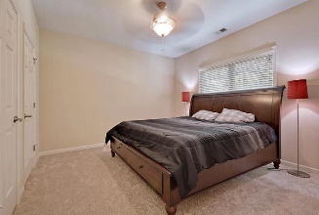
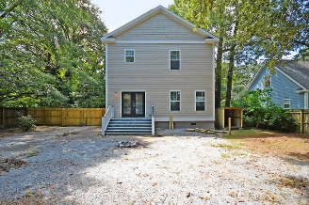
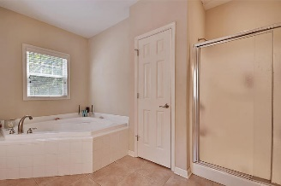
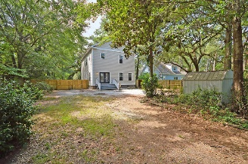
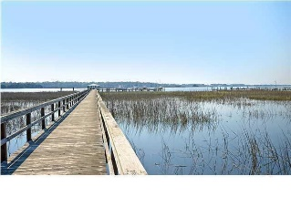

2534 Etiwan Avenue Longbranch | Charleston, SC 29414 MLS# 16022451 | $270,000
Loaded with Updates
Beautiful 4 Bedroom, 3 ½ Bath Home
Majestic Live Oak trees surround the front landscape which can be viewed while relaxing with a glass of iced tea on your front porch. Wonderful open floor plan with downstairs bedroom with full bath for guest or office. Gourmet eat-in kitchen with granite countertops, stainless steel appliances and gorgeous cabinets open to large family room. The huge master bedroom has an over-sized walk-in closet and extremely spacious spa-like master bathroom with dual sinks, soaking tub, and separate shower. Two additional large bedrooms are upstairs that share a bath. Fenced in backyard. Plenty of parking! NO HOA! Features: privacy, gorgeous trees, gourmet kitchen, open floor plan, no carpet downstairs, new carpet up and large master with spa-like bath-call today!
Stan Huff
843-670-2835 stan.huff@agentowned.com
Jill Marcacci
843-297-5590 jill@agentowned.com
www.agentownedrealty.com
AgentOwned Realty Co. Preferred Group, Inc. | 824 Johnnie Dodds Blvd | Mt Pleasant, SC 29464

