Slide 1
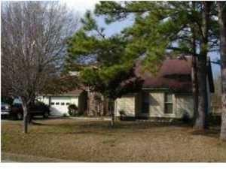

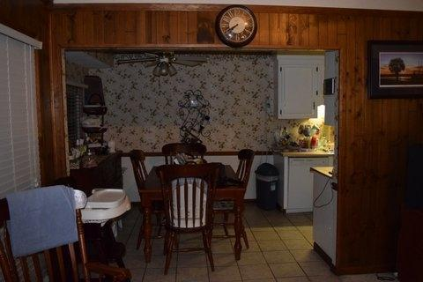
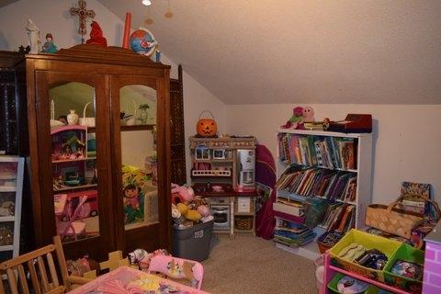
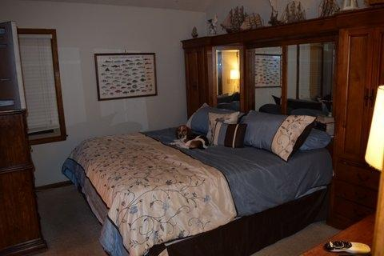
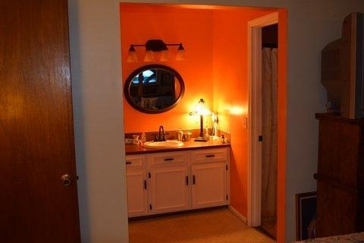
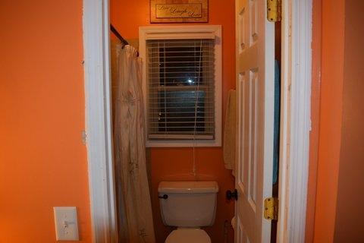
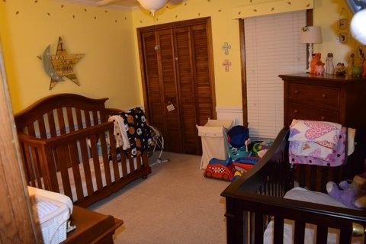
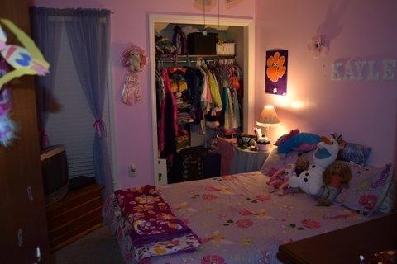
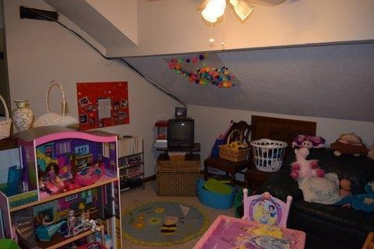
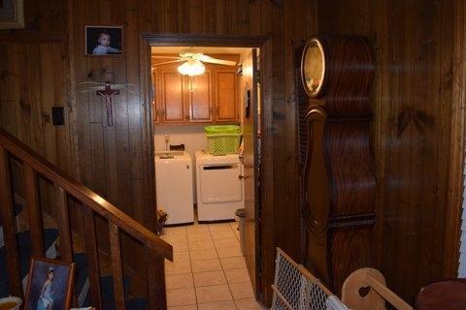
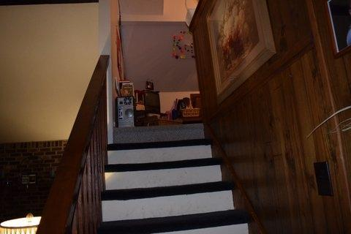



This is the one…
2534 Liverpool Drive
Melrose
Charleston, SC 29414
MLS# 14032053
$207,000
1,536 SF
3 Bedrooms :: 2 Baths
HIGHLIGHTED FEATURES:
CUSTOM cabinets with NO SLAM drawers (kitchen)
Can lighting
Hardi Plank exterior
TANKLESS water heater
Outside gas hookups for your gas grill (say goodbye to switching out tanks)
HUGE hidden STORAGE area
Powder room
Large back yard
Walk to the Neighborhood park in less than 3 minutes
Zoned for Stiles Point Elem.
Easy access to the new Harris Teeter grocery store. Drive to downtown with NO STOPLIGHTS!!!!
Great Value for NEW Construction in Stiles Point. Be sure to check the comps!
This is a wonderful home in a very desirable West Ashley neighborhood. The family room is large with a brick fireplace and hearth, floor length windows, a cathedral ceiling with exposed beams, ceiling fan all in a rich wood finish. Overlooking the family room you will find a cozy FROG / Artist's Loft with a great view of the area down below. This area could also be used as an office or a reading room. A full size laundry room is off of the family room. There is a one car garage and workshop area. Next you will find a nicely decorated eat-in kitchen. Here we have a pantry, ceiling fan, an Italian Ceramic tile floor. The Master Bedroom is a very nice 13' 6'' x 11'4'' room with a walk-in closet, a cathedral ceiling and a ceiling fan. The Master Bath has a step in shower. Both additional bedrooms are decent sized perfect for guests, kids or office space.
Lizzie H Ray
(843) 452-9298
lizzieray1122@gmail.com
Eric Draper
(843) 442-7118
eric.draper@gmail.com
www.charlestonrealestategroup.com
Charleston Real Estate Partners. LLC | 792 Folly Rd. C1 | Charleston, SC 29412

