Slide 1
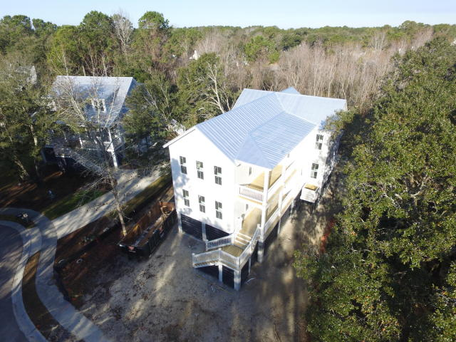
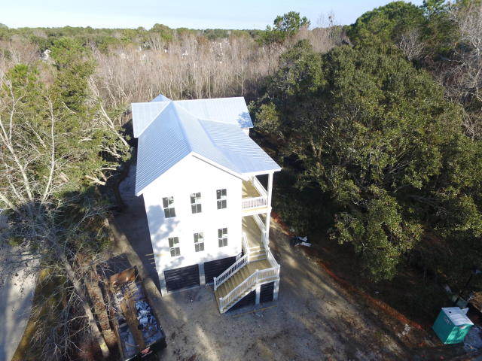

2536 Charter Oaks Dr
Charleston National · Mount Pleasant, SC 29466
MLS# 17029200 · $714,900
New Construction in Mt Pleasant!
Ready in Early April! Elevated New Construction on a WOODED CUL DE SAC LOT in a well established neighborhood. The first floor features a large Gourmet Kitchen, a 20' x 20' Family Room, a separate Large Dinning Room, a Mud Room, an Office and a Quest Suite. The second floor features a large 20' x 18' master bedroom with two walk in closets and a grand bathroom. In addition to the Master the second floor also features two additional bedrooms, a 2nd full bathroom and a spacious laundry room. Outside you will find Double Stacked Side Porches and a large Screened In Back Porch.
Christopher Ryan Smith
(843) 478-8908
ryan@4scapital.com
4S Realty, LLC
110 Sangaree Parkway
Summerville, SC 29486

