Slide 1
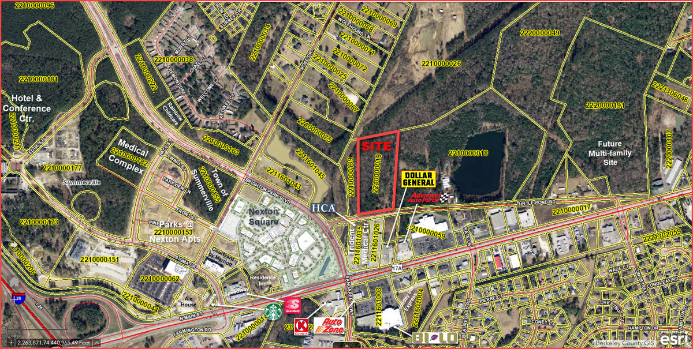
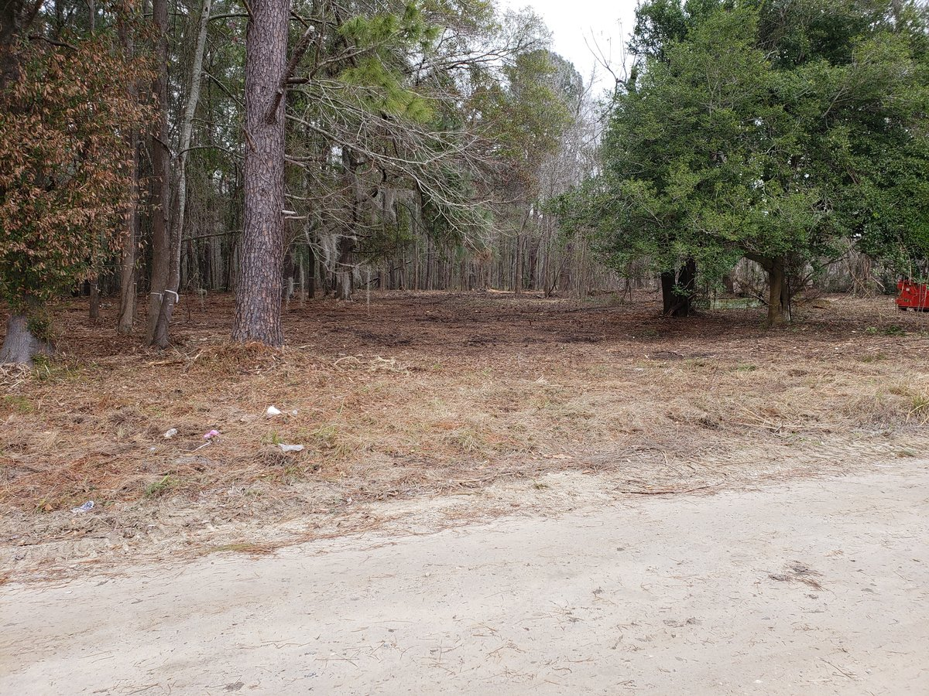
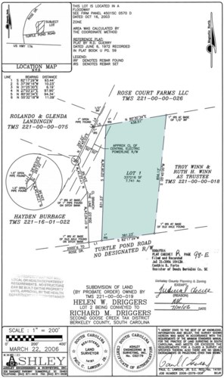
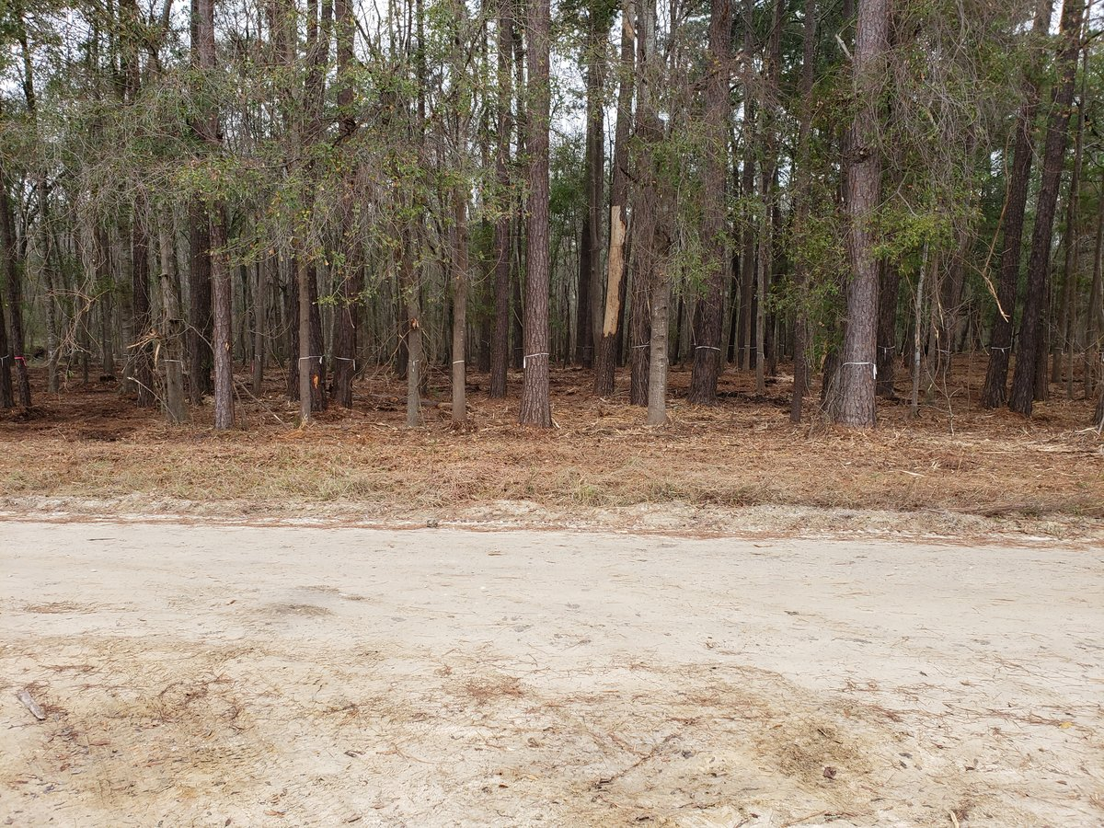
Land near Nexton
253 Turtle Pond Rd
Summerville, SC 29483 | MLS# 30368797 | $645,000
Property directly adjacent to the Nexton Development. Property sits on Turtle Pond Road just off of Brighton Park Boulevard and runs parallel to US-17A/N. Main Street in Summerville, SC. Newly constructed Nexton Square development only a stone's throw away from this property. This site is very accessible and visible from the entrance into Nexton & US-17A, but is not in the Nexton development's regime. Get the benefits without the cost of Nexton. Approximately 381 LF fronting Turtle Pond Road. All wetlands to be dedicated to Berkeley County after final use and project layout determined. General Commercial zoning will go into effect upon wetland subdivision and dedication/transfer to the County.
Charles Salmonsen
M (843) 224-0300 | O (843) 388-6613 | charles@salmonsen.com
Salmonsen Realty | 864 Lowcountry Blvd Ste B | Mt Pleasant, SC 29464

