Slide 1

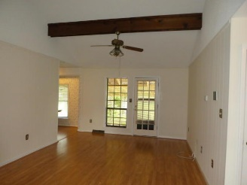
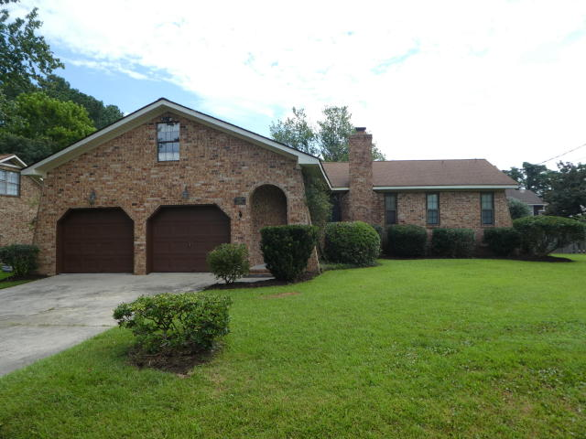
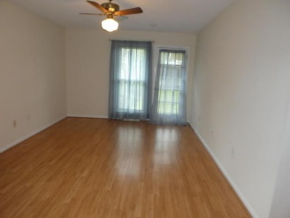
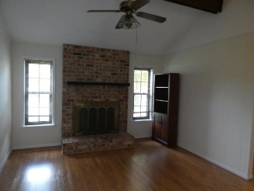
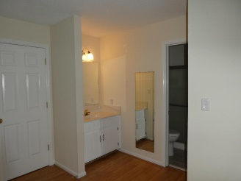
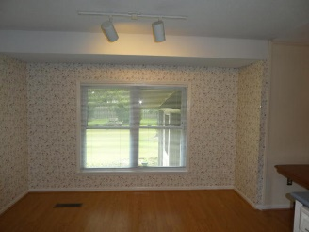
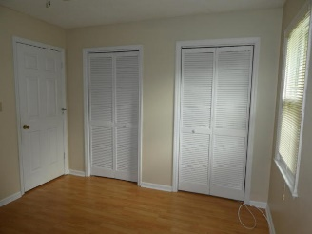
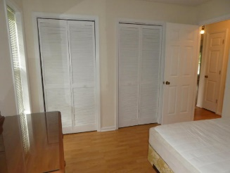
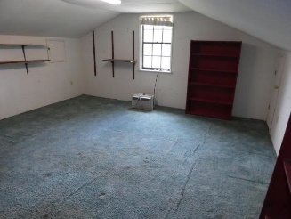
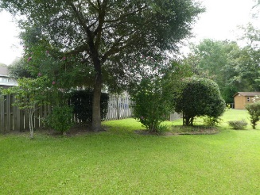
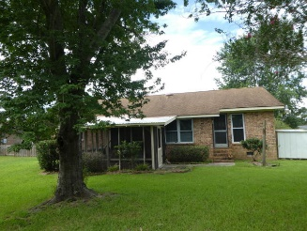
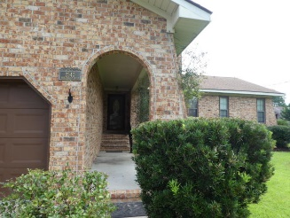

Just Reduced $5,000! PLUS
$3,000 Design Incentive To Buyer At Closing
Catherine Marshall Realtor
(843) 991-1898
cmarshallcatherine@gmail.com
www.cathymarshallcharleston.com
2540 Birkenhead Drive | Shaftesbury | Charleston | MLS# 17023433 | $262,500
Charming traditional brick Ranch home in a great location in West Ashley. This is a 3 BR, 2 Bath, 1.5 story home and has been maintained in a way that shows pride of ownership. The beautiful large yard is nicely landscaped and the back has a privacy wood fence. The main living area has laminate wood floors throughout the foyer, Family Room, all the bedrooms, laundry room and kitchen. The floor in 2nd Bathroom is tile. This home has an anti-allergen dehumidifier. The original charming Southern kitchen includes a dishwasher, refrigerator, electric range. Enjoy meals with a lovely view out the back from the eat in kitchen area. The screen porch adds a nice touch for extra outdoor entertaining and enjoyment. Beamed ceilings and a woodburning fireplace will add to many relaxing evenings in the cozy family room. The master bedroom is very spacious and has a walk in closet. The two additional bedrooms are a good size. The gutters in front are new. This home has been freshly painted. The close location to Highway 17, I- 526 and major shopping is within close proximity to downtown Charleston.
Coldwell Banker Residential Brokerage | 1127 Queensborough Blvd. 103 | Mt Pleasant, SC 29464

