Slide 1
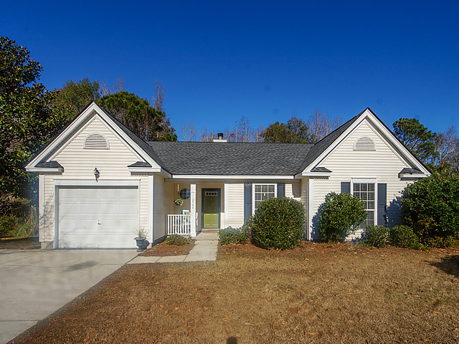
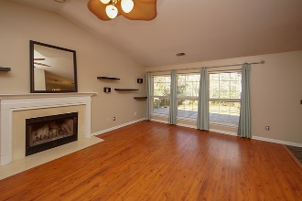
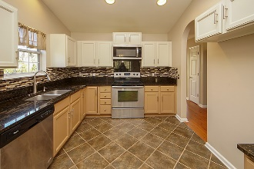
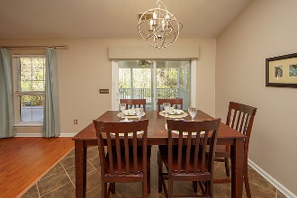
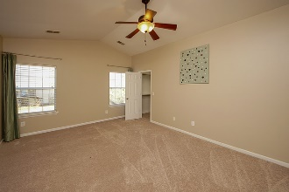
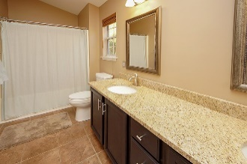
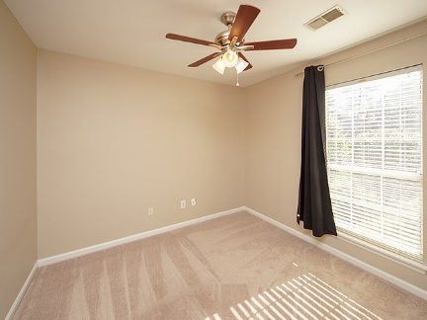
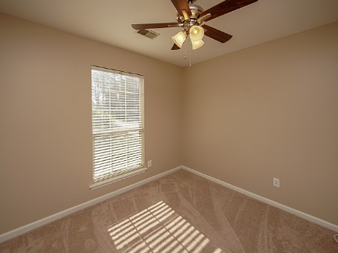
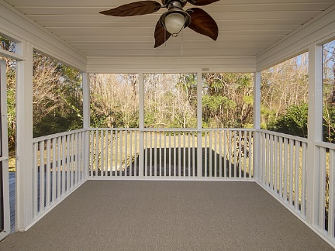
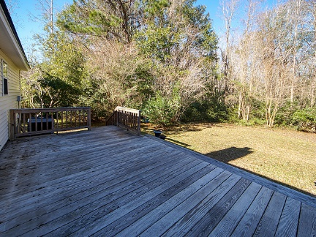



2544 Palmetto Hall Blvd
Dunes West
Mount Pleasant, SC 29466
MLS# 19001268
Just Listed in Mt Pleasant
Ranch, 3 bdrm, 2 ba. for $325,000!
Charming one-story home that is move in ready! Architectural Shingle roof and HVAC were both replaced in 2016, brand new carpeting in bedrooms, neutral paint, upgraded lighting and ceiling fans throughout. The kitchen has granite counter tops, stainless appliances, tile flooring and tiled backsplash. Both baths have been upgraded with tile flooring, granite counters and framed mirrors. Light and airy great room with wood flooring and a wood burning fireplace. Vaulted ceilings in great room, kitchen, master bedroom and master bath. Enjoying relaxing on the large screened porch and deck while overlooking the private backyard that backs up to the woods. Dunes West offers Club Memberships for swimming, tennis, golf, fitness center, club house and a boat ramp. This beautiful home is conveniently located to the beach, Towne Center shopping center, outstanding schools, and downtown Charleston. A wonderful opportunity to own a home in Mt. Pleasant for such a reasonable price!
Steps to the Beach!
Jennifer Nipper, Realtor®
(843) 478-1800 | jen@AgentOwned.com
www.AgentOwned.com
The AgentOwned Realty Co | 824 Johnnie Dodds Blvd | Mt. Pleasant, SC 29464
Real Estate • Mortgage • Insurance

