Slide 1
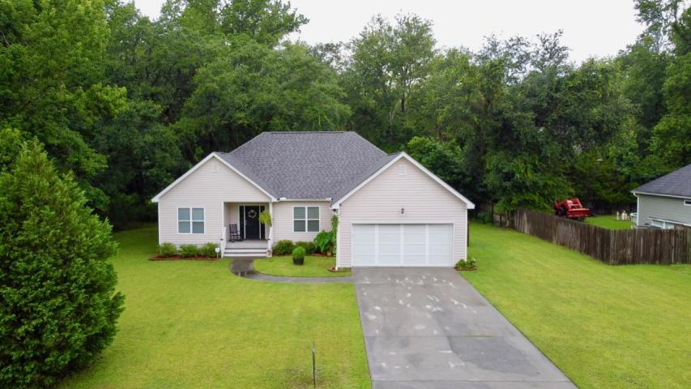
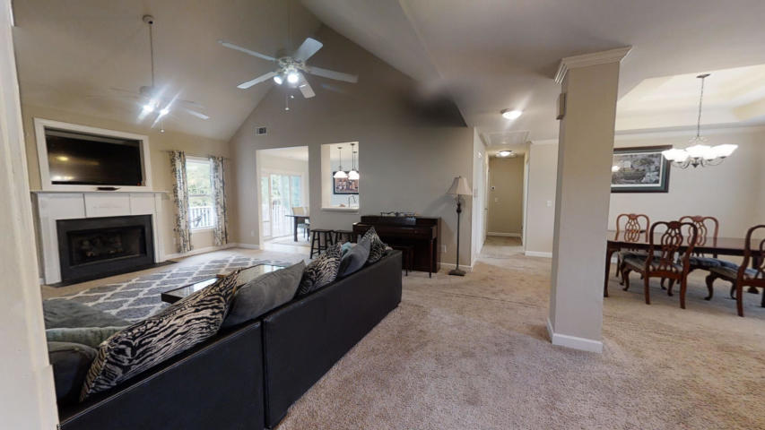
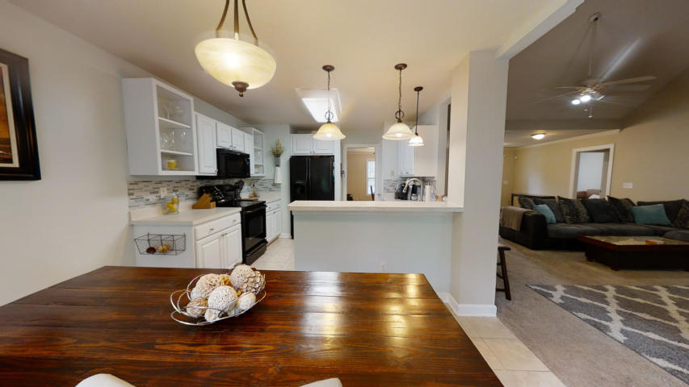
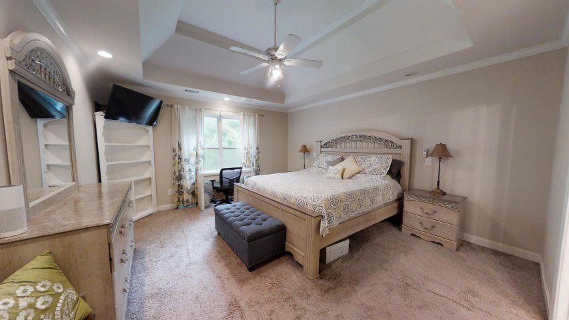


254 Main Road Westland ~ Johns Island, SC 29455 MLS# 20018010 ~ $292,000
No HOA & Not Directly on Main Rd!
Welcome Home! This home is very welcoming with an open floor plan. Easily entertain with friends and family on your almost half acre corner lot! The deck out back is waiting for you to grill out or enjoy some peace and quiet. This 3 bedroom 2 full bath home has everything you need. Master suite has tray ceilings and will easily accommodate a king size bed. Master bathroom is spacious with a double vanity, garden tub/shower combo and a walk in closet. The master is on one end of the house and the other two bedrooms and full bath are on the other end. Family room has cathedral ceilings with a beautiful fire place. There is also a dining room with tray ceilings. The kitchen is nicely adjoined to the dining and family room for easy entertaining. The laundry room is the perfect size and it gives you access to the 2 car garage. The Roof and HVAC was replaced in 2019! Schedule a showing today to appreciate the character of this home in person.
Virtual Tour: https://my.matterport.com/show/?m=t3NEy6Ltw4g&mls=1
Kelly Rozier
(843) 209-3129
kellywrozier@gmail.com
Brand Name Real Estate
4 Carriage Lane Suite 106
Charleston, SC 29407

