Slide 1
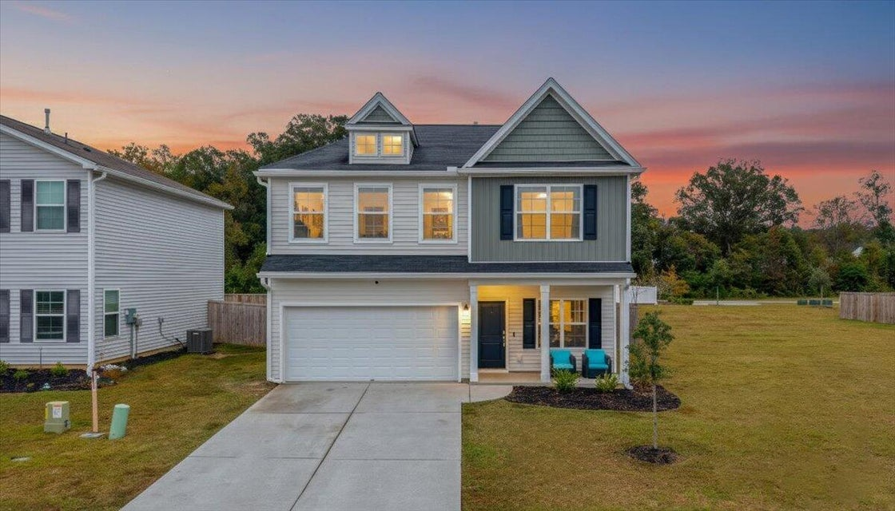



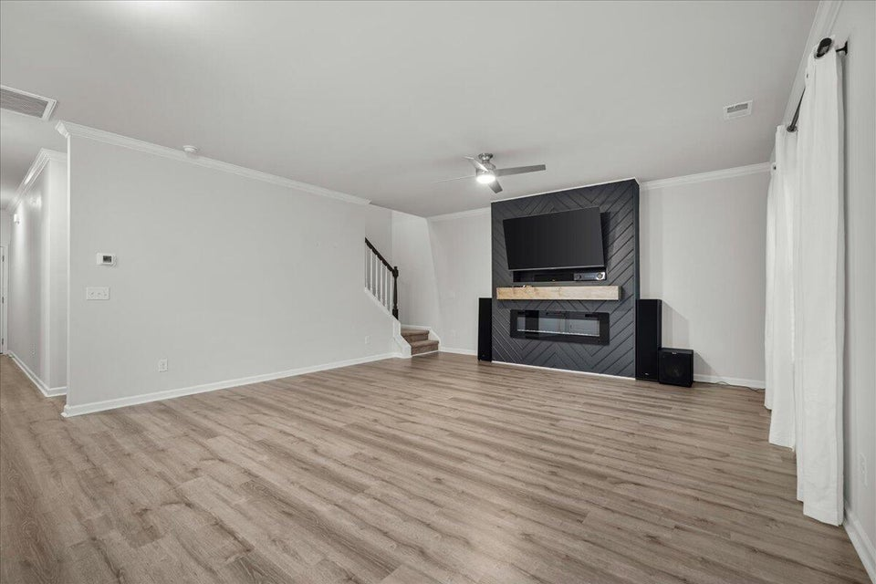
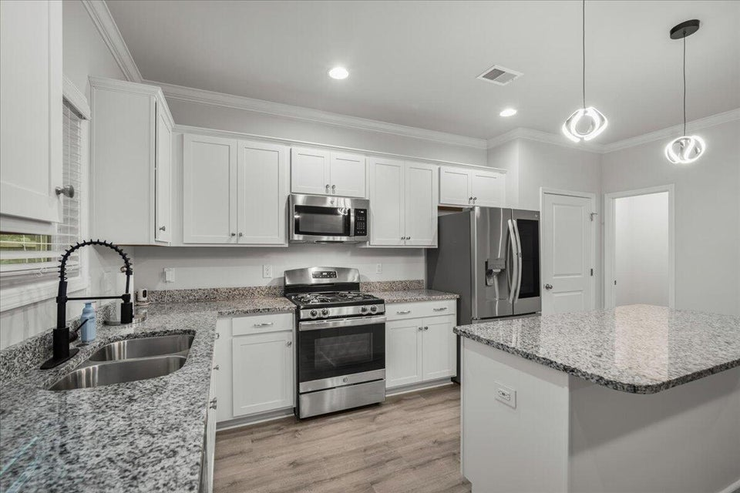
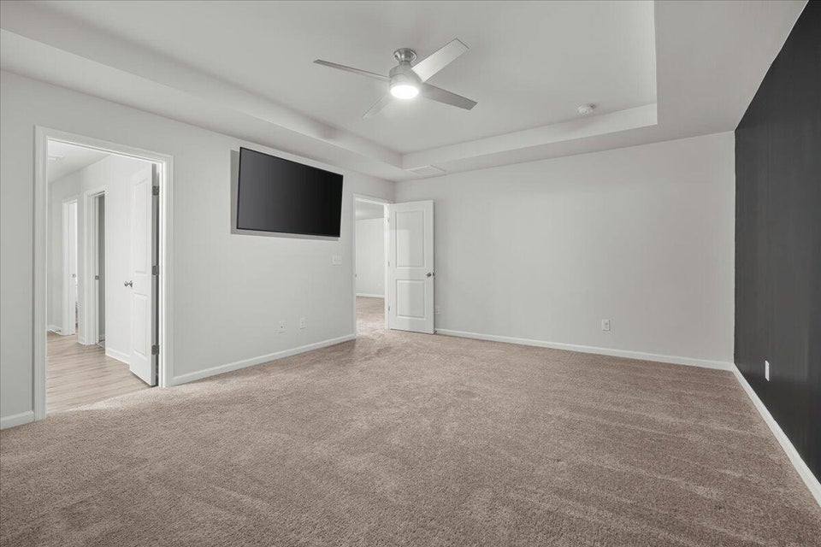
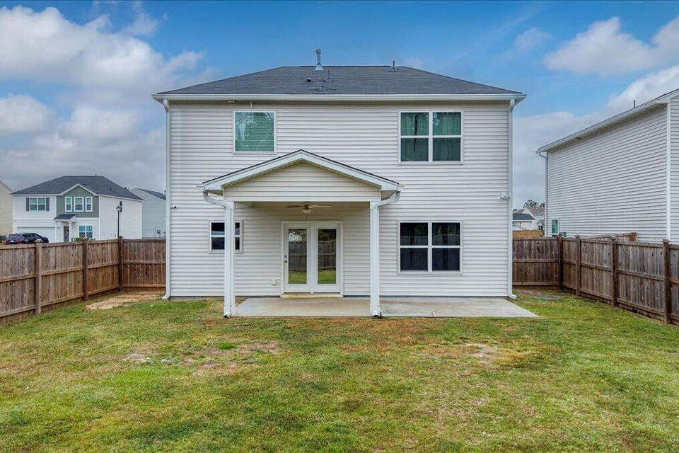


home inspection in hand
254 Torslanda Lane
Petterson Meadows | Summerville, SC 29483 | MLS# 25029158 | $399,900
Welcome home to the popular Meriwether plan in Petterson Meadows, where modern comfort and timeless Lowcountry charm meet. This beautifully maintained 3-bedroom, 2.5-bath home offers 2,237 square feet of living space and was built in 2022, blending fresh design with everyday functionality. Enjoy inviting outdoor spaces with a welcoming front porch, a covered back porch with a 10x12 patio extension, and a fully fenced backyard — ideal for relaxing, entertaining, or weekend cookouts. Inside, the open-concept layout flows seamlessly between the living room, dining area, and kitchen — perfect for gatherings and comfortable daily living. The formal dining room easily transitions into a home office or study, while the chef's kitchen impresses with granite countertops, a large island with pendant lighting, a gas range, an enormous walk-in pantry, and abundant cabinetry for storage. Upstairs, retreat to the spacious primary suite featuring a tray ceiling, spa-inspired bathroom with a garden tub and walk-in shower, and a large walk-in closet with direct access to the laundry room. Two additional bedrooms share a roomy second full bath, and the 16x12 loft provides flexible space for a media room, playroom, or fitness area. Outside, the extended patio, covered porch, and privacy fence make this home ideal for outdoor entertaining and grilling. Petterson Meadows offers community green spaces and a playground, all conveniently located near I-26, Cane Bay, Nexton, shopping, dining, and historic downtown Summerville a perfect balance of peaceful living and accessibility. Built in 2022, this 2,237 sq ft home delivers the perfect combination of modern design, low-maintenance convenience, and prime Summerville location. Don't miss your chance to make it yours!
VIDEO TOUR | VIRTUAL TOUR
Telecia Bilton 843-412-3586
tmbilton@rogcoastal.com
Realty ONE Group Coastal
1510 Trolley Rd
Summerville, SC 29485

