Slide 1
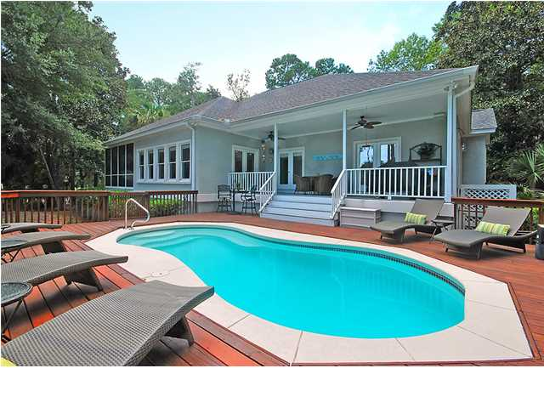
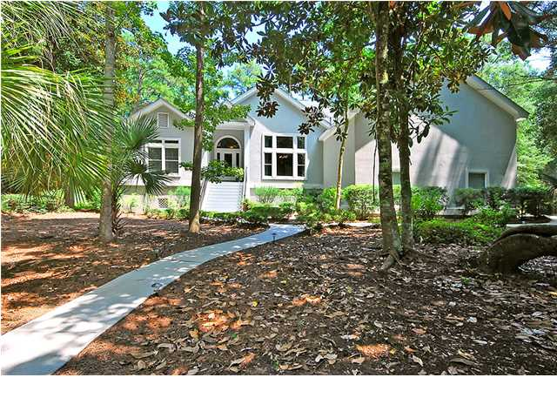
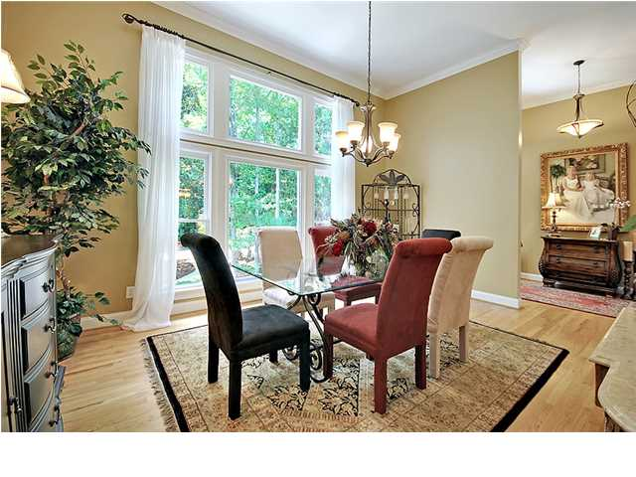
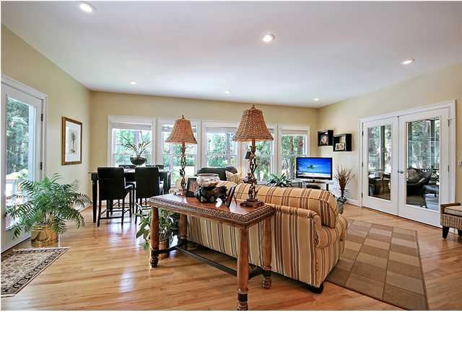
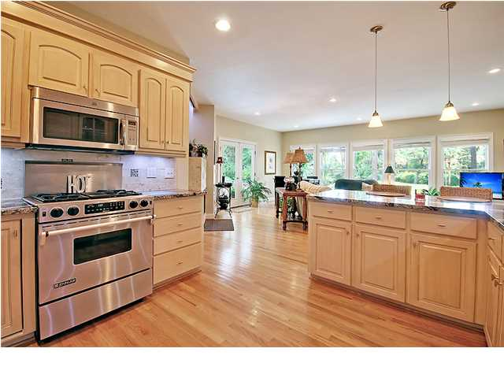
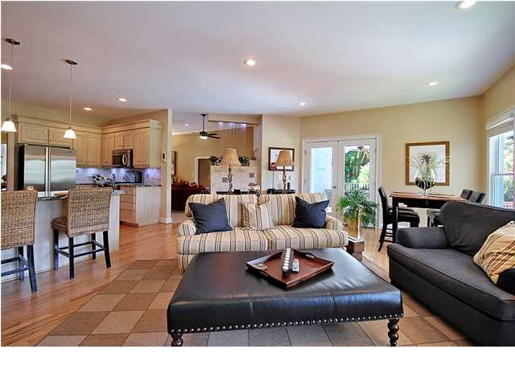
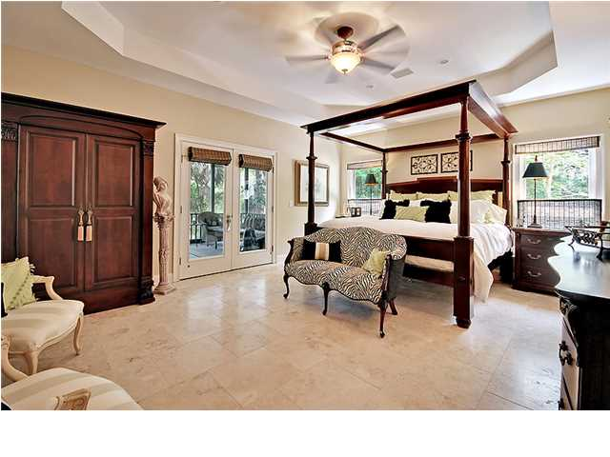
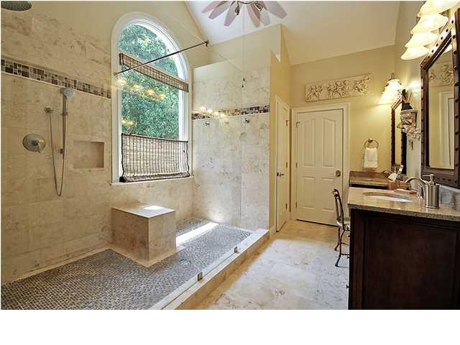
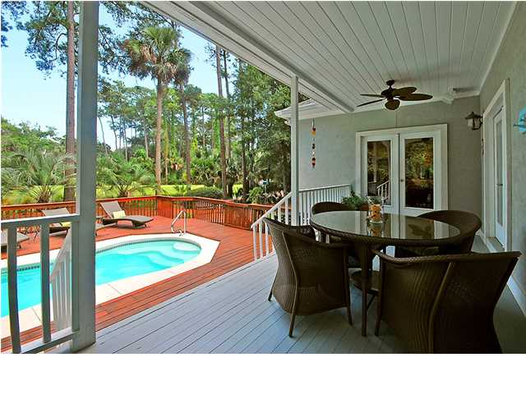
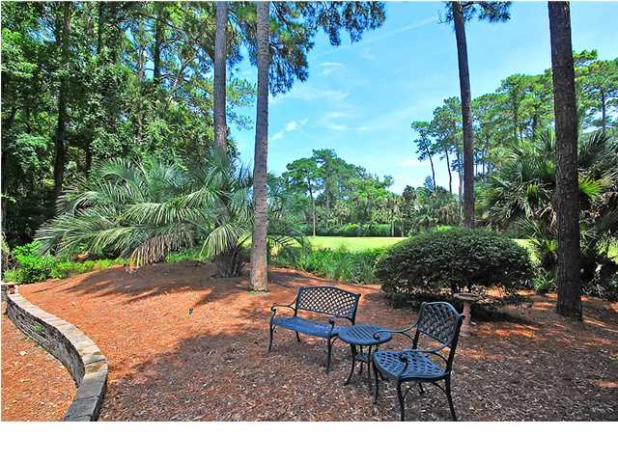

Price Reduced!
Welcome to your Dream Home on Seabrook Island
2550 The Haulover ~ MLS# 1421837 ~ $1,000,000
This fully furnished, meticulously renovated and maintained golf-course home has a private pool and is located within walking distance of the Seabrook Beach Club. This is the perfect situation for someone who wants to purchase a luxury beach home, move right in, and not lift a finger before you start enjoying your perfect beach get-away. Seabrook Island proudly presents this stunning four bedroom, four and a half bath home with a two car garage. Situated on a park-like .49 acre lot, you'll enjoy privacy from the towering trees and peaceful views of the golf course from the sparkling pool, deck and screened-in porch. Enter through the glass front door with side and palladian windows to reveal an open floor plan with 3,641 square feet of living area, high ceilings, recessed lighting and lots of natural sunlight. The formal dining room has hardwood floors and a floor to ceiling wall of windows making the room light and bright. The spacious living room boasts custom natural stone flooring, a wall of built-in bookcases and a stylish, two-sided gas fireplace that is shared with the family room. You and your guests will be left speechless by the stunning rain water feature situated above the fireplace. The family room is also loaded with windows and flows into the gourmet kitchen which features granite counters with a natural stone backsplash, a breakfast bar, stainless steel appliances and a gas burner stove. The owner's retreat is simply amazing with a tray ceiling, custom walk-in closet, natural stone flooring, access to the screened in porch and a master bath that is one to remember. You've heard plenty about walk-in showers but this seamless glass shower is beyond huge with incredible custom stone work and inlays, a palladian window and multiple shower heads! The bathroom also has a dual vanity with granite counters and a built-in sitting area. The oversized bedrooms both have en-suite full baths and so does the FROG which makes for a great play area, media room, exercise area, or a fourth bedroom. You'll have hours upon hours of fun and relaxation in the outdoor oasis whether you're floating in the pool, enjoying a drink on the covered deck or eating a meal on the screened-in porch. Upgrades in this home include a new retaining wall on the driveway, a newer two unit HVAC system, a four year old roof, UVA/UVB coated front-facing windows, an automatic hot water dispenser in the kitchen, upgraded door hardware, new interior and exterior lighting, new gas logs in the fireplace, and and new bath fixtures. As a part of the gated Seabrook Island community you'll have access to the golf course, marina, multiple tennis courts and racquet club, multiple swimming pools, club house, and equestrian center. If you're looking for a top of the line, move-in ready home in an extremely desirable neighborhood, be sure to come by today.
Call or email for details: (843) 654-7777 or Matt@MattOneillTeam.com

