Slide 1
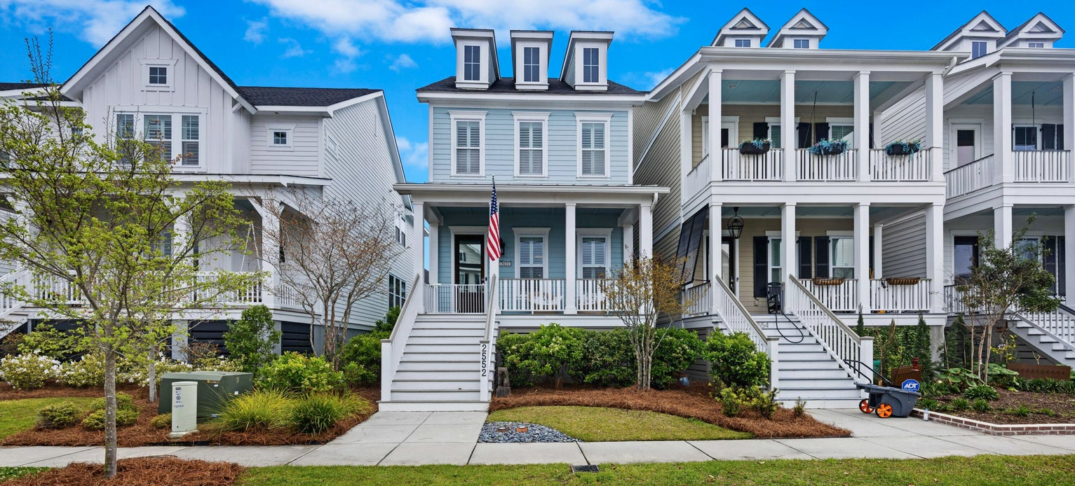
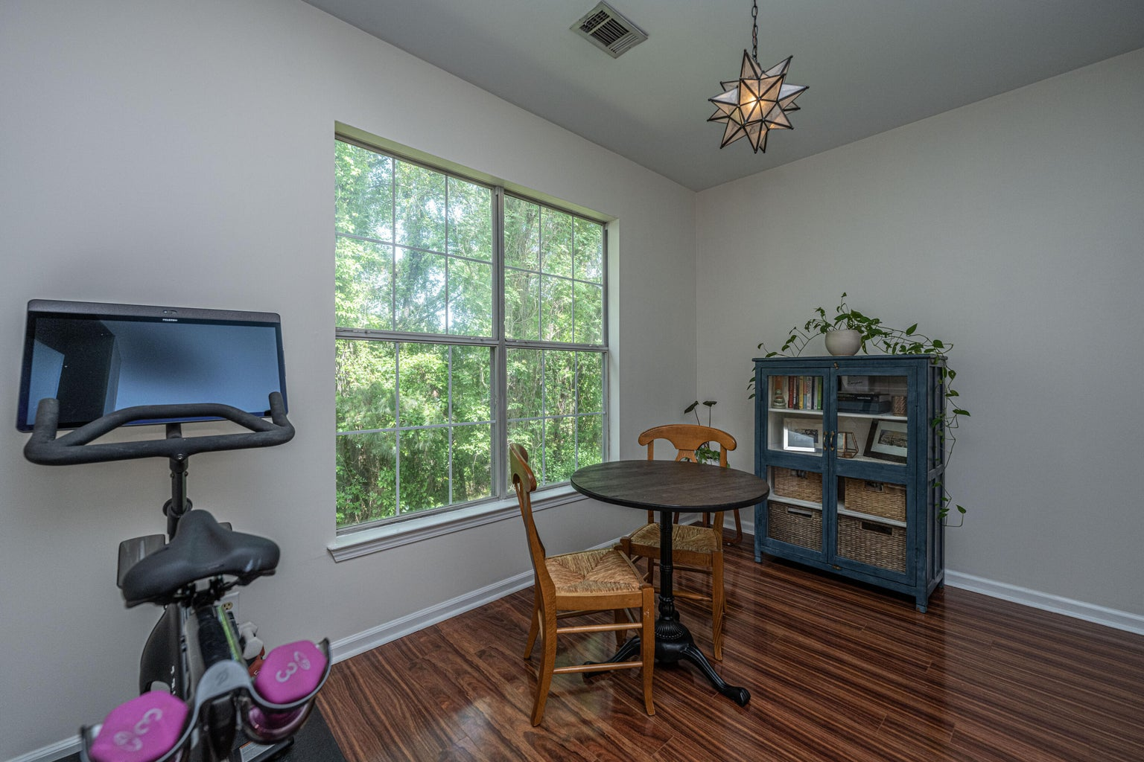
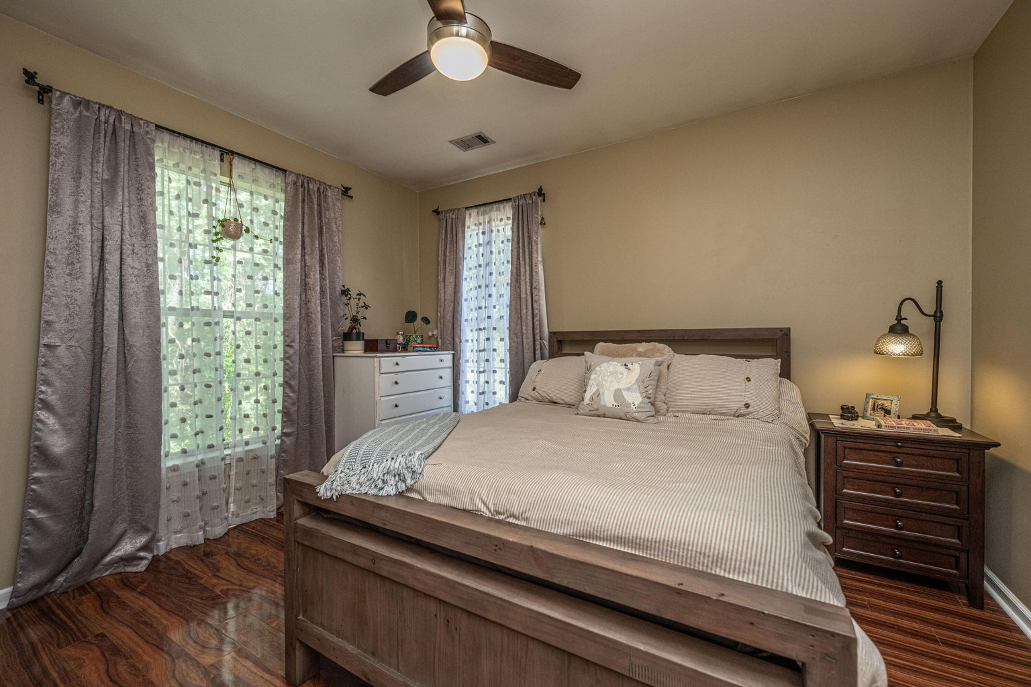
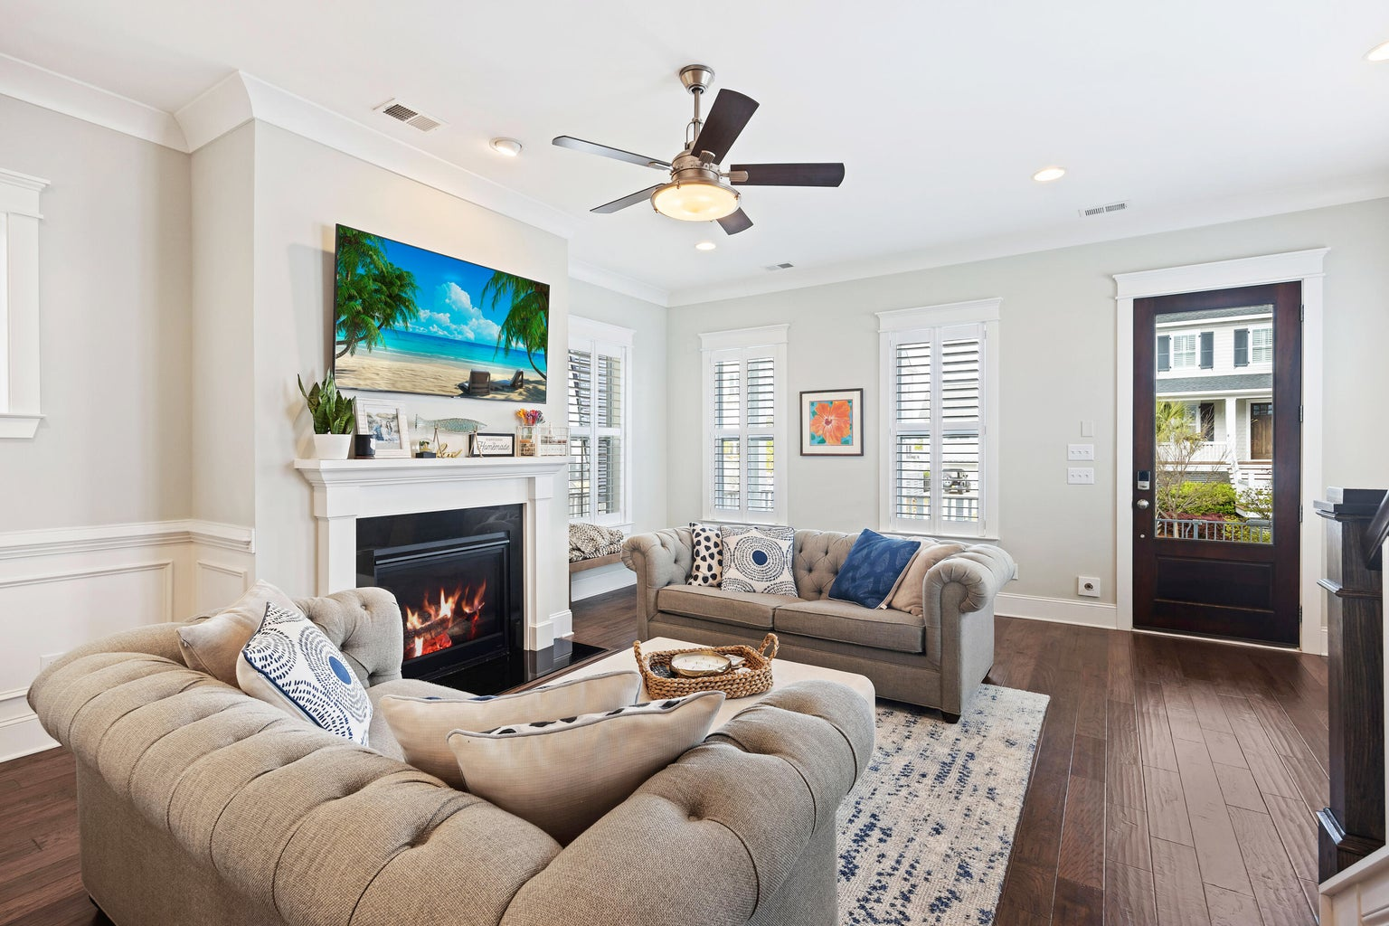
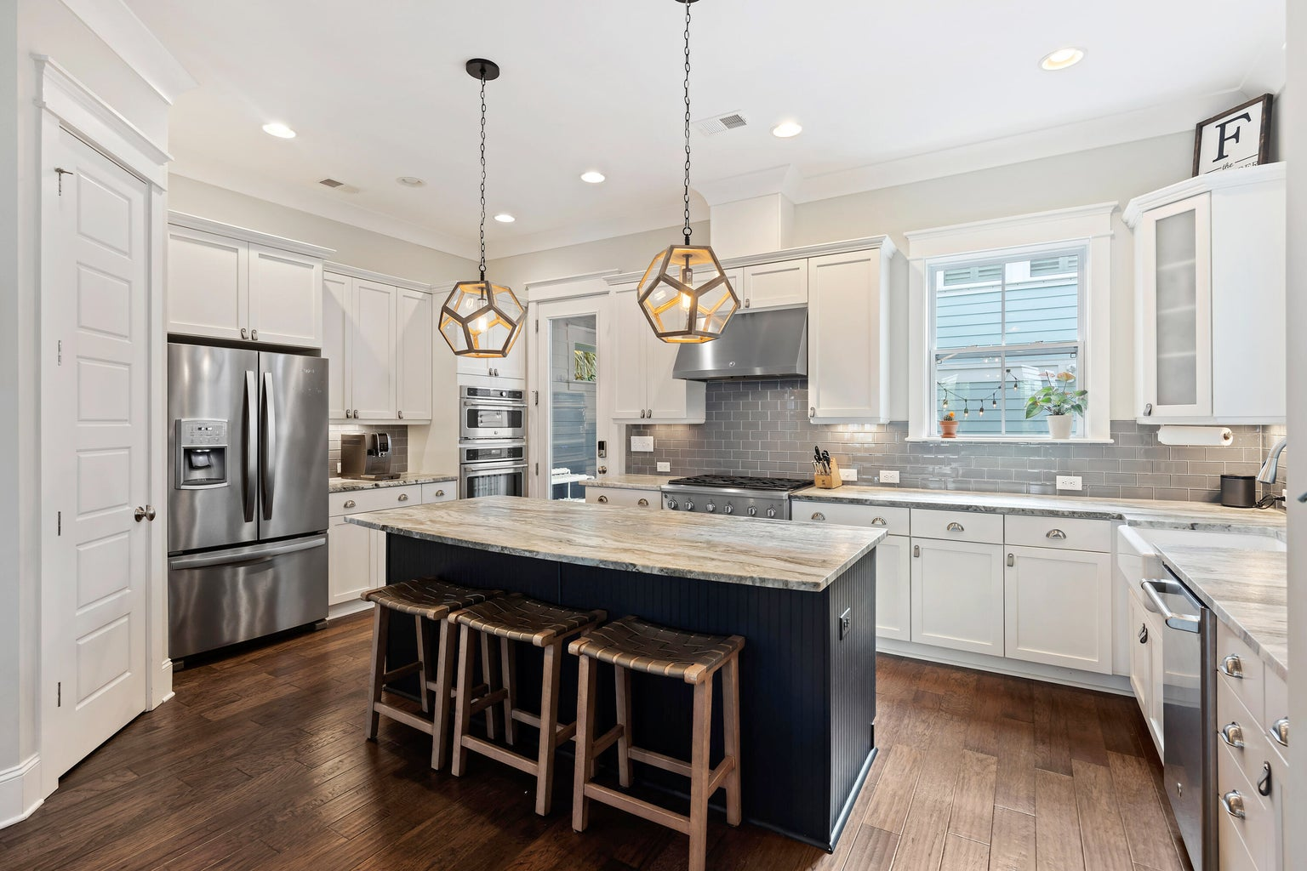
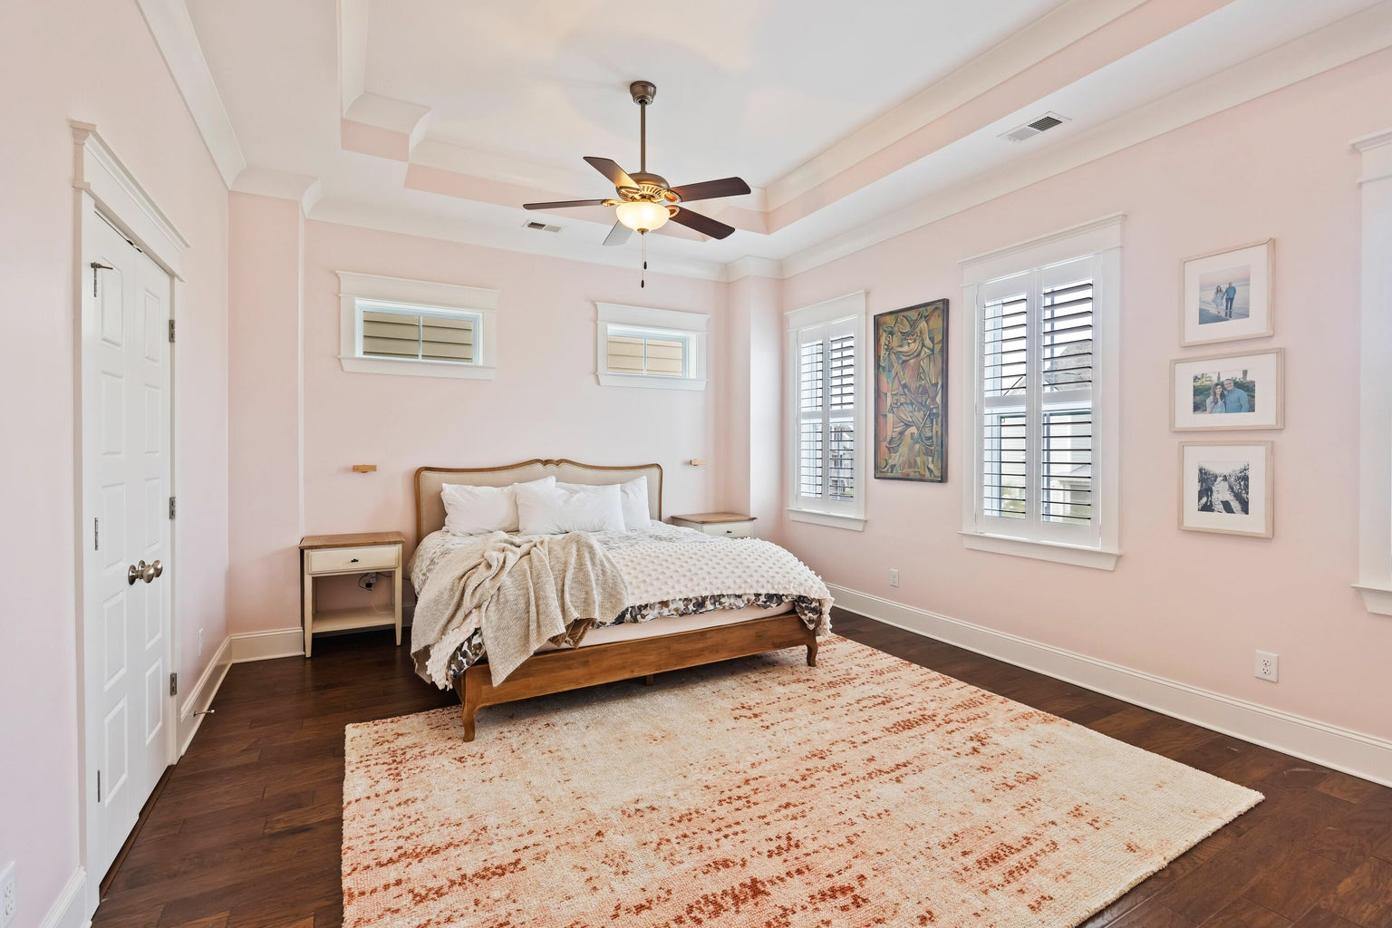
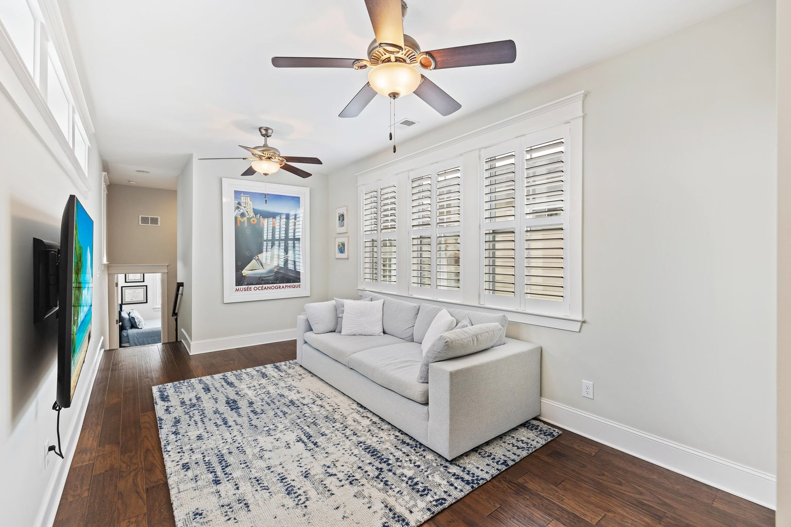
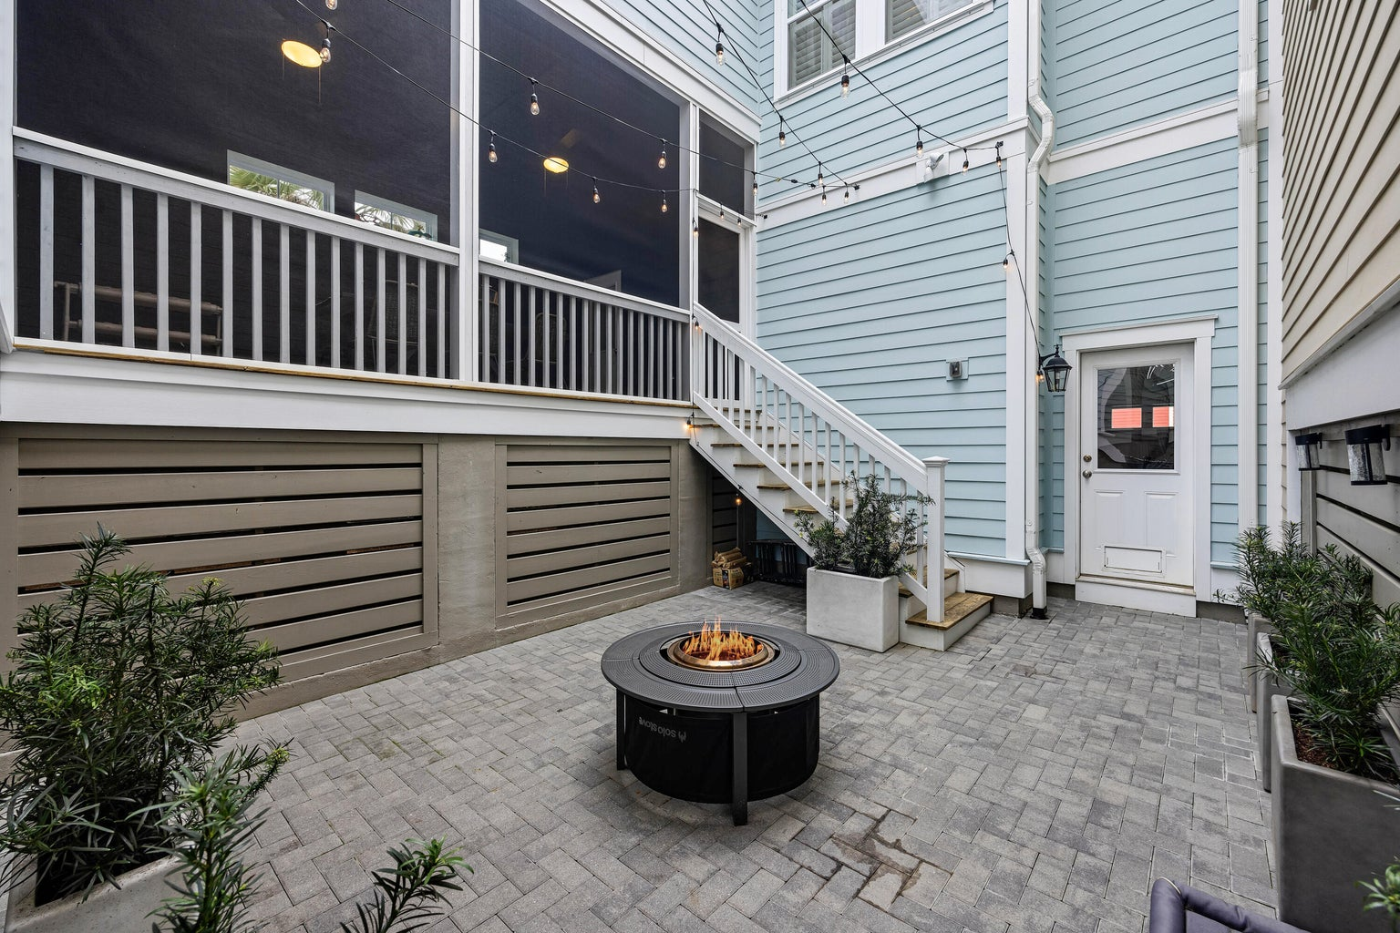





OPEN HOUSE SUNDAY 2-5
Custom 5br, 4.5ba 4700 Sqft Of Flex Space
10’ Smooth Ceiling
Heart Pine Flooring
Master Bedroom Suite On First Level
Second Master On Upper Level
Two Dens With Gas Fireplaces
Formal Dining Room
Gourmet Kitchen With Second Den/Warming Room And Breakfast Room
Walk-in Pantry
Large Bonus/Game Room Above Oversized Two Car Garage
Screen Porch & Outdoor Firepit
Large Pond Lot With Mature Trees And Irrigation System
3 Separate AC Units
Gas Hot Water Heater
New 35-year Roof
Private Gated Community With Community Pool, Clubhouse, Boat Launch And Dock
2552 Josiah Street
Daniel Island | Charleston, SC 29492 | MLS# 24008015 | $1,300,000
You must see this immaculate 3 bedroom, 2 1/2 bathroom home located in the highly desirable Daniel Island Community. This home is conveniently located a short walk or bike ride to Daniel Island School(K-8). Just around the corner is arguably the best of the three community pools. If you're looking for things to do, make sure you take advantage of Credit One Stadium and one of the many concerts and events they hold throughout the year. Don't miss out at the Di Waterfront Park with lots of fun activities, great dining and spectacular views. Make your way to the beach with a short drive to Isle of Palms & Sullivans Island or take a ferry from Daniel island waterfront to historic downtown Charleston for the day. This home is in the heart of all the Low Country has to offer.
Take a virtual tour
4
3
1,844
Telecia Bilton
843-412-3586
tmbilton@rogcoastal.com
Realty ONE Group Coastal
1510 Trolley Rd
Summerville, SC 29485

