Slide 1
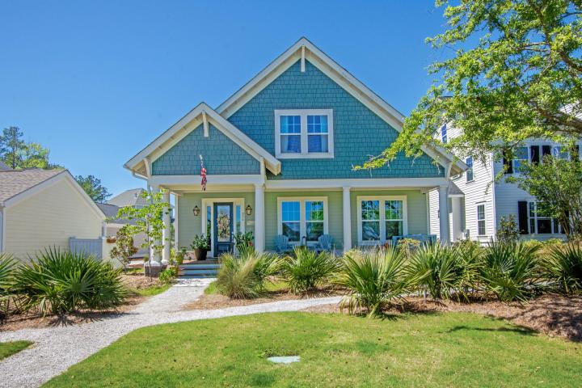
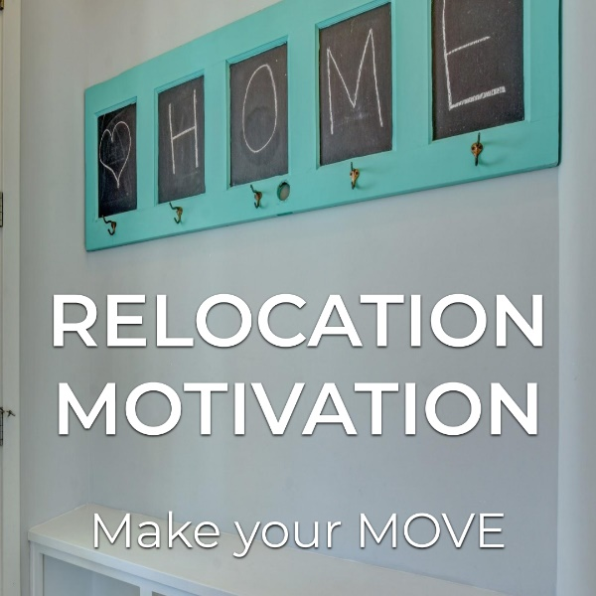
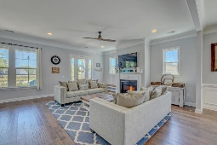
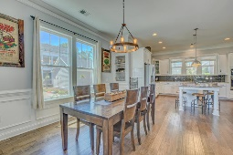
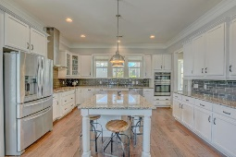
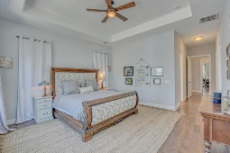
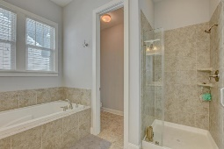
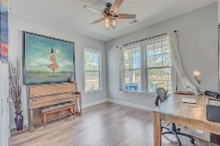
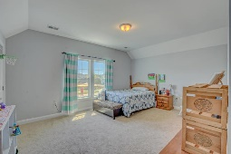
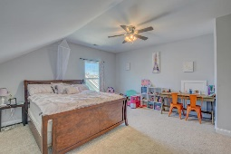
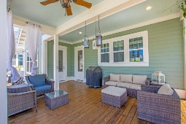
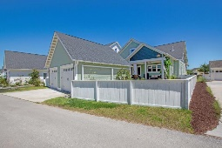
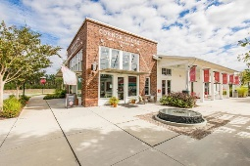
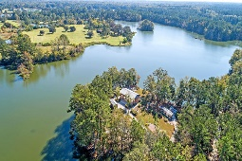


Relocation Motivation
In Summers Corner.
Bring All Offers!
256 Summers Drive
Summers Corner | Summerville
MLS# 19011171 | $490,000
Family relocating for work & must sell their home. There is no other home like 256 Summers Drive. Literally! The one & only build of this luxurious floor plan was also the first home closed in Summers Corner. Essentially custom built, this beauty boasts features making it a MUST SEE: 5 beds, 4 full baths, exquisite cross-gabled roof design, enormous gourmet kitchen, double crown molding, wainscoting, gleaming wood floors, tray ceiling plus his & hers closets in the master, 4-zone irrigation & MUCH MORE! Just as this home is one-of-a-kind, so is Summers Corner. You simply cannot find a neighborhood, no, a community, with this list of features: neighborhood cafe, multiple green spaces, gardens & parks, pool, DD2 schools & a freshwater lake...
That's right, Buffalo Lake is an exclusive amenity for residents. Stop by!
Summers Corner calls themselves a community built on a community. And it shows with a sense of belonging with great neighbors and great friends that share in many community activities - from workshops, dinner theaters & yoga at the lake to a seasonal, monthly Farmers Market and trivia night at the cafe.
If your family loves the great outdoors, then make Summers Corner your home with miles of trails, green spaces, garden and parks all within walking distance of every home & even there's even a dog park!
Jim Brantley
(843) 412-7647
brantleyjim@gmail.com
AGENTOWNED PREMIERE GROUP | 1800 TROLLEY RD | SUMMERVILLE, SC 29485

