Slide 1

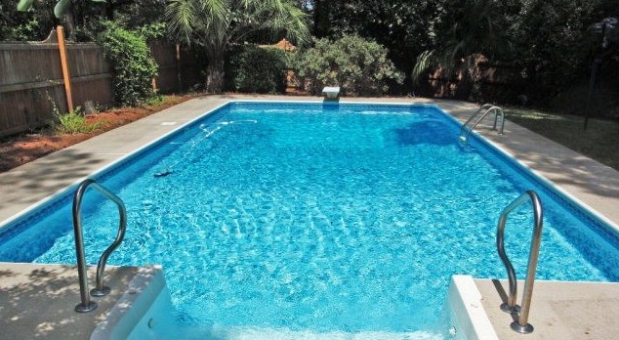

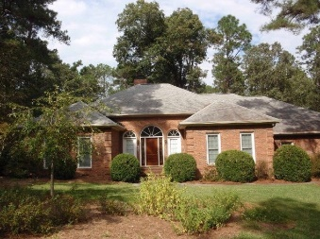
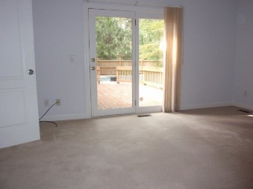
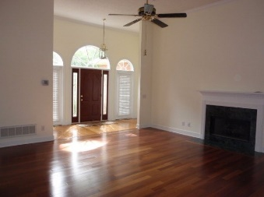
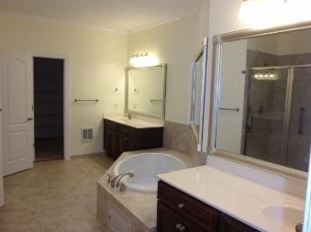
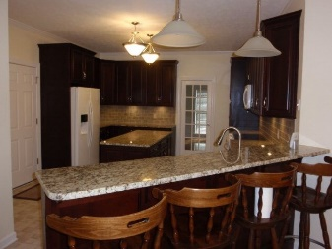
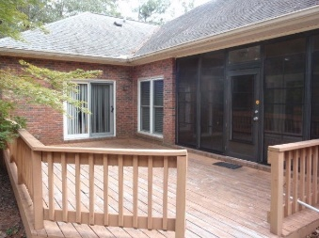
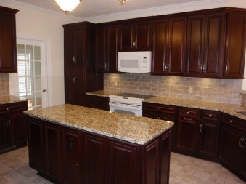
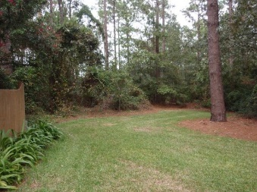


257 Chardonnay Ln The Vale ~ Aiken, SC 29803 MLS# 96066 ~ $298,000
Pristine 4 bedroom, 2.5 bathroom plus bonus room with beautiful in ground pool surrounded by privacy fencing. This home has been impeccably cared for with updates throughout including tankless water heater. Lovely updated kitchen makes entertaining a delight. Maximize your privacy with split plan offering 3 bedrooms and 1.5 baths off of private hallway and master suite with spacious master bathroom (on opposite side of the home). Master suite and 2nd bedroom open to outside deck area and screened porch. Two car attached garage has a 13 x 13 work area. This home truly has it all and is priced to sell quickly. Contact listing broker for full list of upgrades.
Valli Catchpole 803.617.8540 / valli1@me.com Property Consultants of the South, 1429 Lyon Dr SE, Aiken, SC 29801 / www.FineSouthernLiving.com

