Slide 1

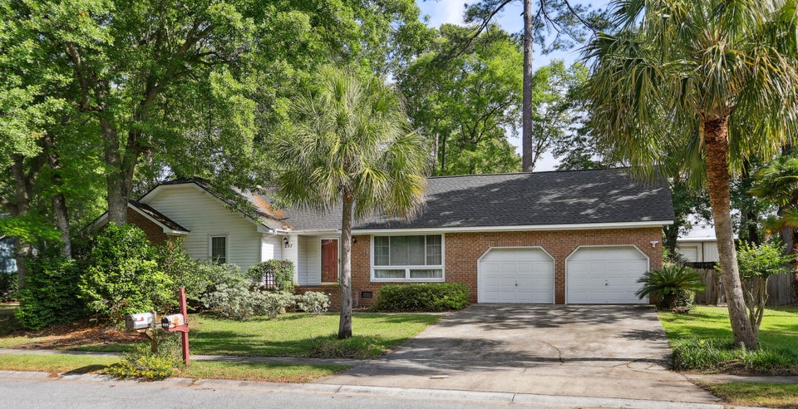
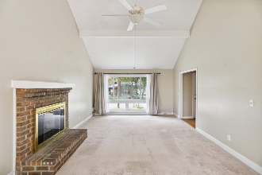
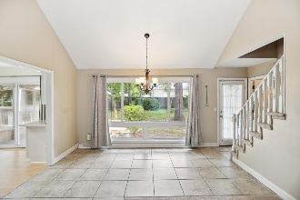
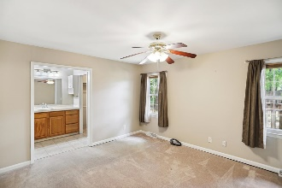
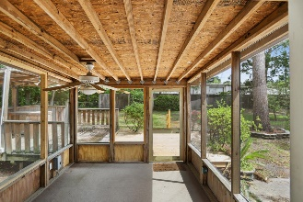
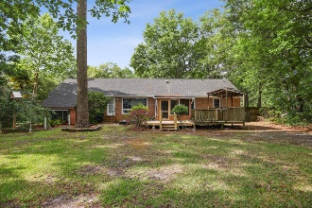

Back On The Market
Due To Buyer Financing
Falling Through
Pam Bass Realtor
843-259-4926
pam@pambassproperties.com
www.pamsellscharleston.com
257 Savannah Round | Irongate | Summerville | MLS# 24019965 | $348,900
This home is back on the market due to buyers financing falling through. New Roof, New HVAC and New Hot Water Heater. Seller offering $500 bonus to agents who bring an acceptable offer before 12/31/24
New Roof, HVAC and Granite Counter tops! Nestled in a mature, established neighborhood, this brick ranch home offers the perfect blend of convenience and comfort. Located just 5 minutes away from local shopping centers, hospitals, and restaurants, and only 10 minutes from Walmart, Lowe's, and Downtown Summerville, you'll have everything you need right at your fingertips. Situated on a large lot, the home boasts a fully fenced rear yard with majestic oak trees providing ample shade and privacy. The exterior features low-maintenance brick and vinyl trim. Step inside the entrance foyer which leads to a spacious great room with a stunning 14-foot high, beamed cathedral ceiling. Large "picture windows" on both ends flood the room with natural light, creating an inviting and open atmosphere. The great room features a brick fireplace with gas logs.
The eat in kitchen is spacious with lots of cabinets, brand new counter tops, new tiled backsplash and a new gas range. There is also a round skylight illuminating the space. The master bedroom is spacious and has a walk-in closet and a new countertop in the master bathroom. In addition to three bedrooms on the main floor, there is a fourth bedroom over the garage, currently used as an office. The Finished Room Over Garage (FROG) has a separate wall air conditioner.
Step outside to a screened porch and large wooden deck, perfect for enjoying the outdoors. In addition, there is a concrete patio and firepit which provide ample space for entertaining or relaxation. The Roof, HVAC and hot water heater are brand new.
If you're seeking a home in a mature neighborhood with a central location, abundant privacy and a community pool, don't miss the opportunity to view this special property.
VIRTUAL TOUR
EXP Realty LLC | 170 Meeting Street Ste 304 | Charleston, SC 29401

