Slide 1
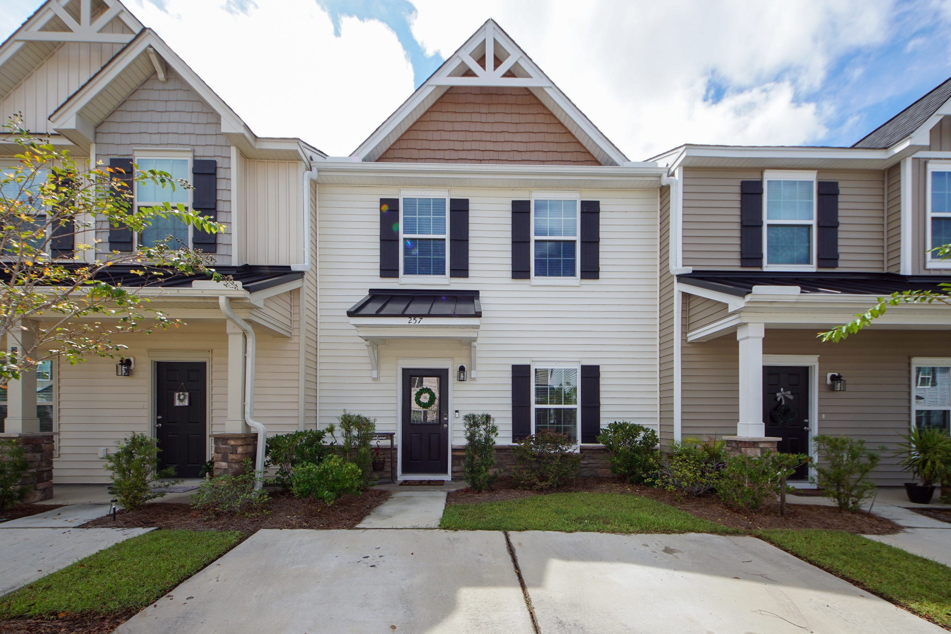
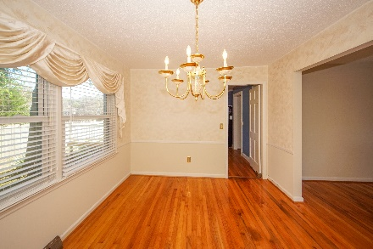
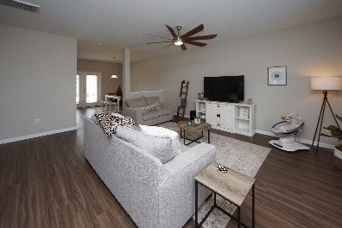
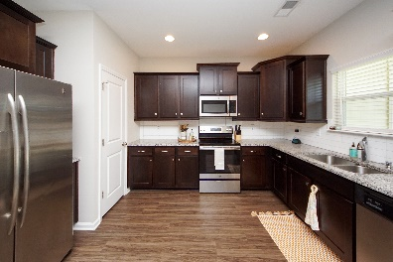
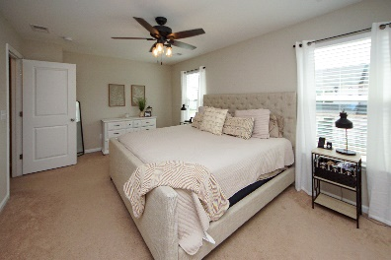
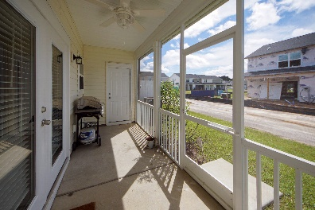
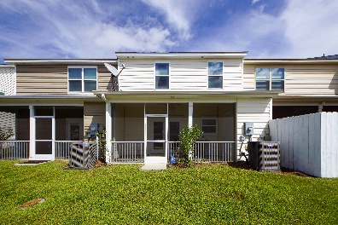


257 Swallowtail Lane
Landings at Montague :: Goose Creek
MLS# 21024871 :: $248,000
Otranto Beauty
$318,000
Open House Sunday 12:30-3:30
Don’t Miss It!
Why wait for new construction!
Own this move in ready town home with all the bells and whistles! Spacious kitchen with staggered cabinets, granite counter tops, upgraded lighting, upgraded luxury vinyl plank flooring throughout, smooth ceilings, recessed lighting and an inviting screened porch. Dual master bedrooms are located upstairs. Conveniently located off of highway 52, residents can enjoy nearby shopping and dining in the Goose Creek area. HOA includes: trash service, yard maintenance, yearly termite bond renewal, and pressure washing. There is a wait list for the new town homes in this subdivision, so don't miss your opportunity to own this one. Ring doorbell will convey with the sale. This is a must see and must own!
Come take a virtual tour: https://charlestonvirtualhomes.com/2210379
Connie White, Broker
843-532-3356
connie@chrepros.com · conniewhiterealestate.com
Charleston Homes · 597 Old Mt. Holly Road · Suite 301 · Goose Creek, SC 29445

