Slide 1
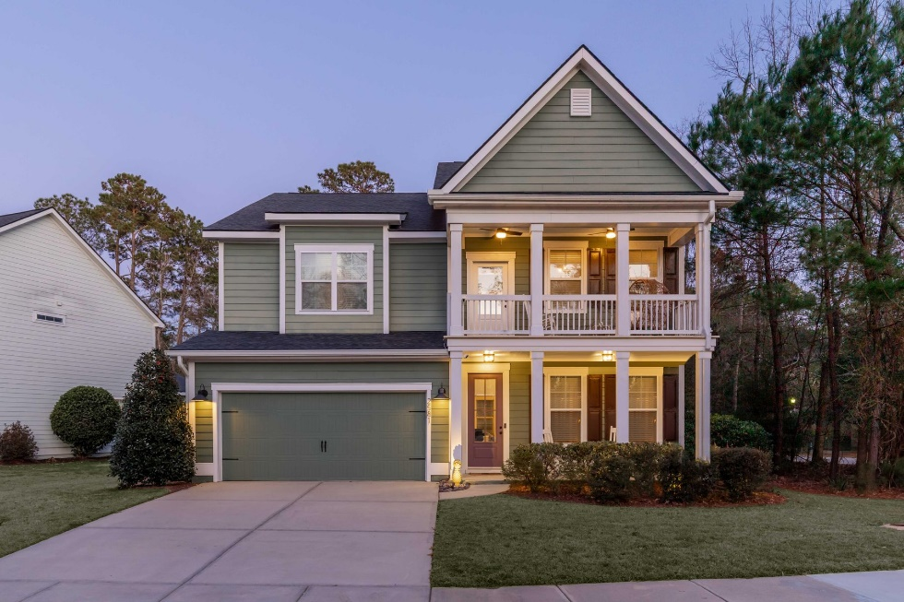
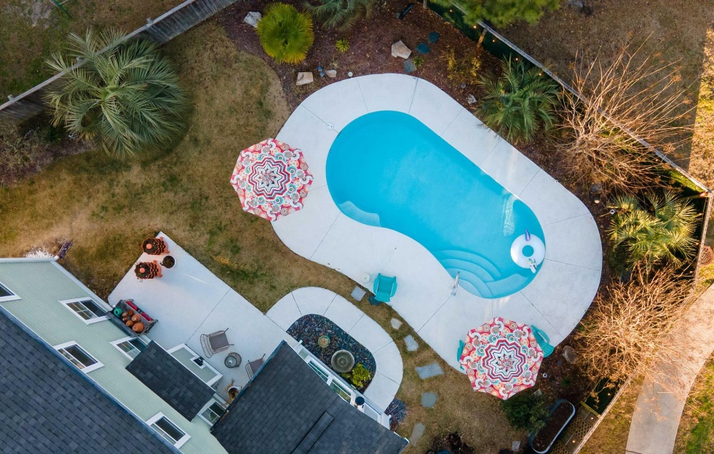








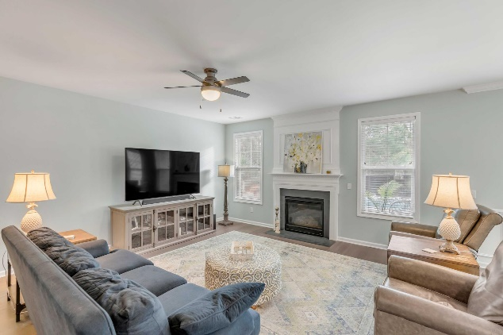
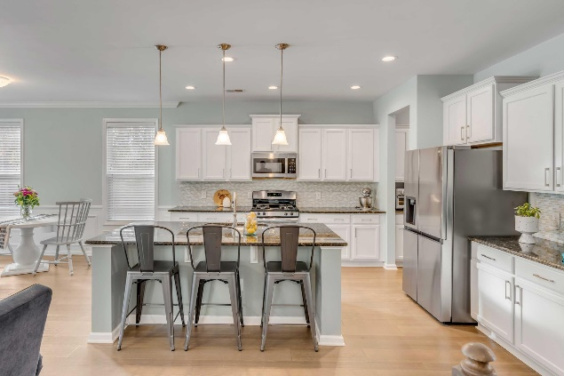
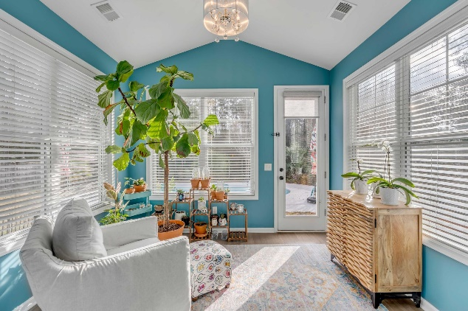

MLS# 24001936
Best Value in
North Mt. Pleasant!!!
2581 Larch Lane
Park West
Mount Pleasant, SC 29466
Open House
4 BED
3 BATH
3,260 SF
$975,000
Immaculately kept, light and bright home on a corner lot with a pool in Park West, just inside the neighborhood for easy in and out convenience. You'll be warmly welcomed by double front porches into the home to find the dining room on the right, and beyond that, the spacious open concept kitchen/dining/living area. The kitchen includes a new refrigerator and is connected to the formal dining room by a butler's pantry and large walk-in pantry with plenty of storage. The living area and breakfast room extend to a sunroom leading you to a private, professionally landscaped, backyard pool oasis where you will love entertaining friends and family. Once back inside, continue downstairs to find a guest room which could also be used as a home office, a newly renovated bath, and a custom built in dropzone by the garage entry.
Upstairs is a wide open flex space, currently used as a gym, that would be a fantastic playroom, media room, or whatever suits your needs. Additionally there are two spacious guest bedrooms and full bath, a laundry room, and a primary suite sanctuary, encapsulating the entire back of the home, boasting a flex space (sitting area, gym, office), an enormous closet, and a completely renovated spa bathroom with designer marble tile shower and surround, ceramic tile floors, beautiful quartz countertops, separate his and hers sinks, HEATED spa bathtub with jets, and bluetooth speaker system offering the ideal relaxation space where you can escape to clear your mind at the end of a long day.
Interior features include new carpet, new smoke detectors, co2 detector, new microwave, new lighting, gas fireplace and range.
Exterior features and improvements include cooltop decking pool surround, saltwater pool, rainbird irrigation system, new gutters and downspouts with leaf guards, a privacy fence, tension bar and outside pad entry, and additional ceiling storage in the garage. The side-yard to the left of the home has ample space for kids to play!
This home has a versatile, practical floor plan that works for a variety of buyer's needs, offers loads of storage, has been lightly lived in, loved, and well maintained. Convenient to 41 and the amenities center, the location within the neighborhood will save you time and gas money and who couldn't use more of that!
Stacy Smith
843-276-2998 | stacy@smithspencer.com
Smith Spencer Real Estate | 701 East Bay St Ste 513 | Charleston, SC 29403
Matt Kimes
843-860-1669 | mattkimeshomes@gmail.com
www.mattkimeshomes.com

