Slide 1
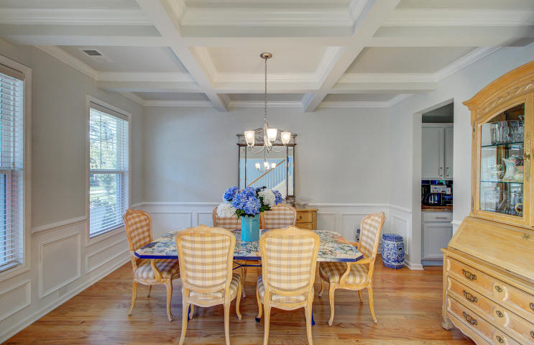
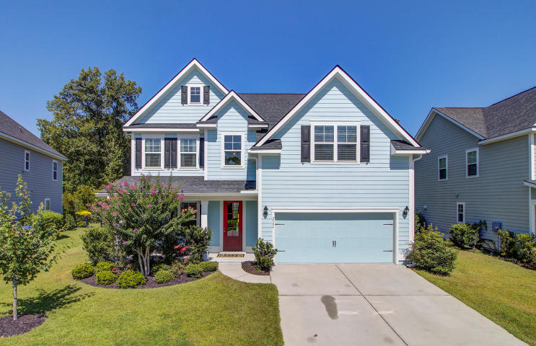
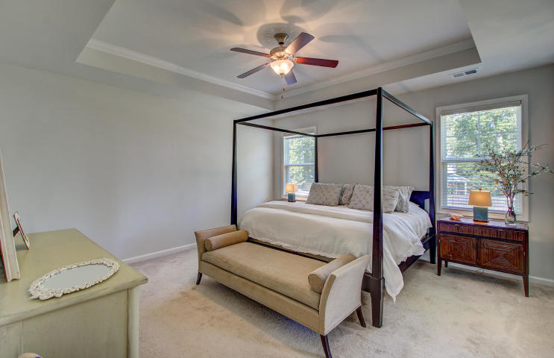
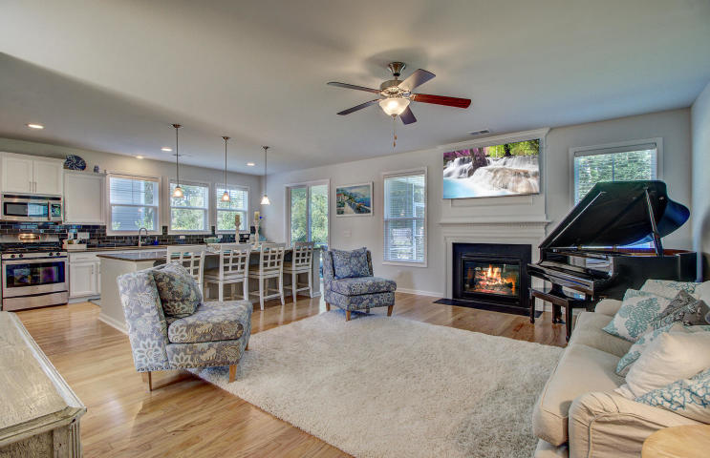
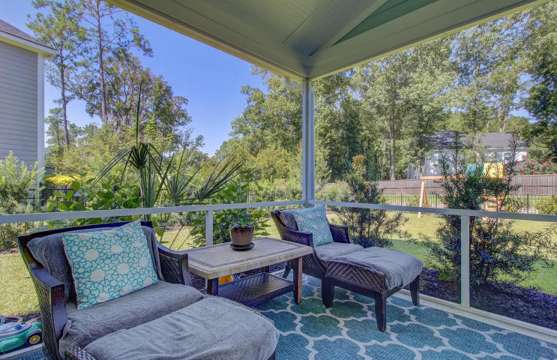
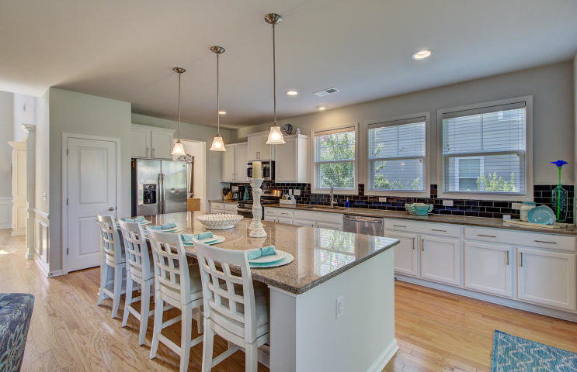
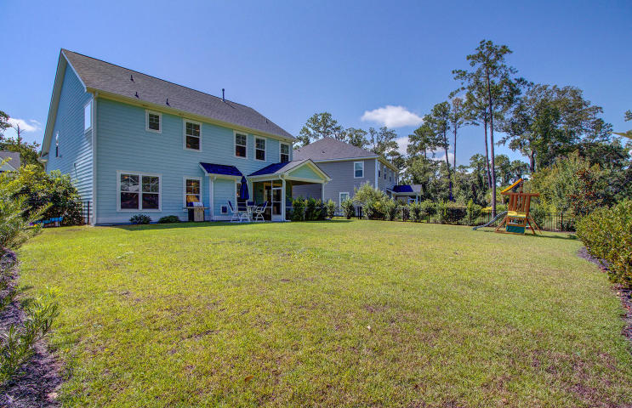


Just Listed in Mount Pleasant
2584 Larch Lane
Park West
Mount Pleasant, SC 29466
MLS# 20021639 | $540,000
The benefits of this beautiful home are endless! First it is a stunning home with tons of curb appeal. Upon entry your eyes are immediately drawn to the formal dining room with coffered ceilings! Hardwood floors throughout the main living spaces on the main level and tons of natural light are impressive features of this perfectly designed home. The kitchen is massive and opens to the large family room along the back side of the home. An oversized island with seating for four is an attention getter and enhances not only the appearance of the kitchen, but its functionality too! This design fosters a sense of togetherness whether spending time with family, friends, or both! Granite counters, stainless steel appliances and white cabinets all create a fresh look and this kitchen will be the envy of others! A special feature of this home is the mother in law suite on the main level. What a benefit for anyone who prefers not to climb stairs. The master suite and three additional bedrooms are all upstairs. The master suite with tray ceiling overlooks the incredibly large back yard. Its bathroom is the perfect layout with dual sinks, a large tile shower, garden tub, and huge walk in closet! Two additional guest bedrooms share a full bath in the hall and the laundry room is conveniently located upstairs as well. The fifth bedroom is an oversized FROG- large enough to be a full guest suite- with room for a sitting area in addition to a full guest bedroom set. Don't need a fifth bedroom? This would make an excellent additional family room/bonus room/playroom/home office or any combination. If you have been disappointed to see small yards at so many homes in the area you will be THRILLED to see the huge back yard (enclosed with an attractive metal fence) at 2584 Larch Lane! This is a rare find and affords a truly special place for children and pets to play. Enjoy the wonderful weather we are spoiled with in Charleston while sitting on the front porch or inside your screened porch overlooking the back yard. Students in Park West attend award winning schools. Park West amenities include a Junior Olympic sized pool, a second zero entry pool, playground, tennis courts, volleyball courts, and miles of walking and jogging trails throughout the master planned community. Close to shopping, fifteen minutes to the beach and a short ride to Historic Downtown Charleston, this is a prime location. The current owners enjoy easy access in and out of the neighborhood making this an incredibly convenient location within the popular Park West Community. This is one special home and it is ready for its new owners to enjoy!
Check out the virtual tour here: https://my.matterport.com/show/?m=oY8sTKwtLgN
Ellen O'Neil
Broker/Owner, ABR, e-PRO, CNE
Charleston Realtor of Distinction
(843) 300-8530
www.EllenONeilProperties.com

