Slide 1
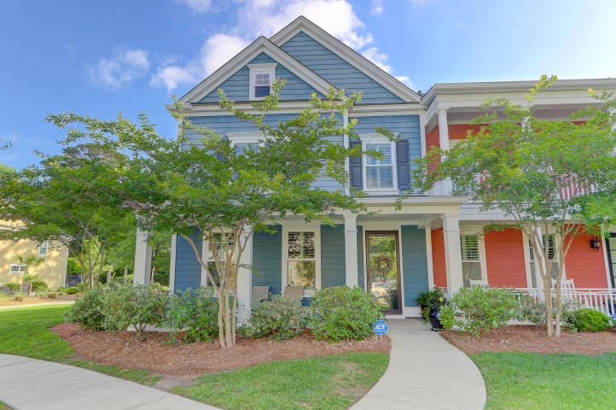
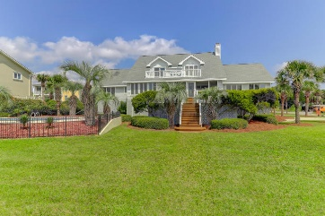
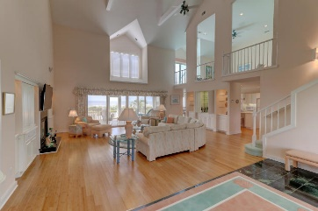
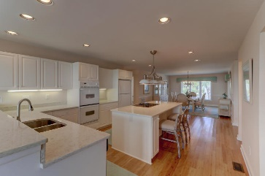
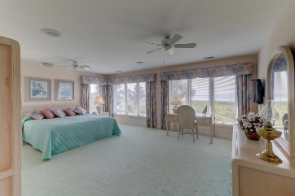
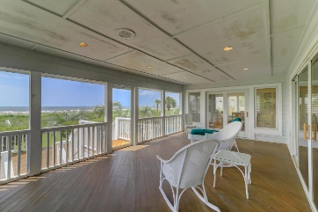
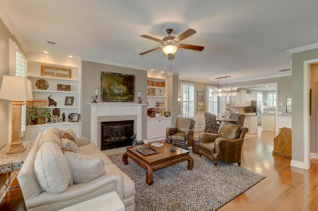
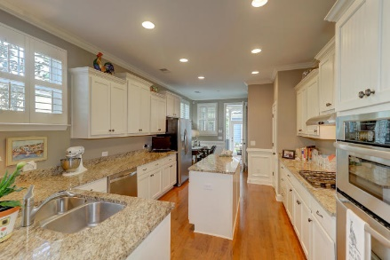
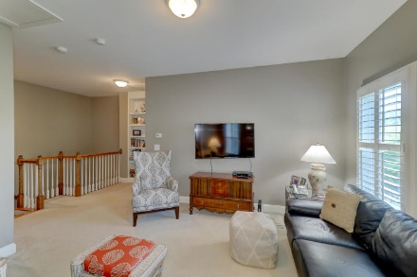
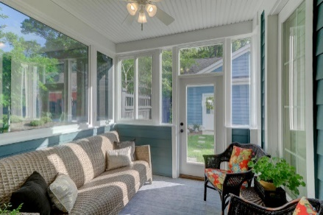


2584 Kings Gate Lane #1301 Dunes West | Mount Pleasant, SC 29466 | MLS# 19012352 | $410,000
New Price For This Exceptional
End Unit Townhome In The
Heritage At Dunes West!
New Price
Large Master bedroom on 1st Floor with luxurious master bath! Spacious great room with dining flex space open to kitchen, nice appliances, gas stove top, Kitchen island with stunning counter tops and generous pantry. Hardwood floors downstairs with gas fireplace. This home shows like a new home!! Great condition! 2 Car detached garage, Courtyard, Lovely sun room off the kitchen, great for an office or just a wonderful place to relax! This home includes lots of closet space and storage. The homeowners association maintains the landscaping, irrigation, flood insurance and insurance on the building. Spacious 2 bedrooms upstairs with 2 baths. Must see this immaculate home with many upgrades. Plantation shutters on some windows!
Darlene Smith Office - (843) 886-8110
Mobile - (843) 696-7824
darlenesmith@carolinaone.com
DarleneSmithTeam.com
Carolina One Real Estate
1503 Palm Blvd Ste
Isle of Palms, SC 29451

